Slide 1

The Chronic Hypertension and Pregnancy Treatment Trial
Society for Clinical Trials 2023: Trial of the Year Session
Alan T.N. Tita, MD, PhD
University of Alabama at Birmingham Heersink School of Medicine for the CHAP Consortium

Slide 2
Disclosures
None relevant

Slide 3
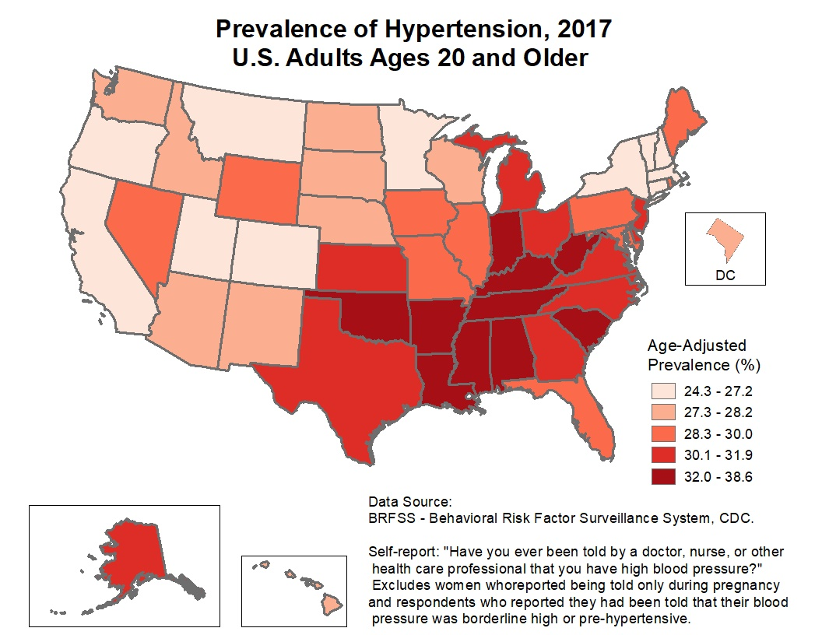

Slide 4
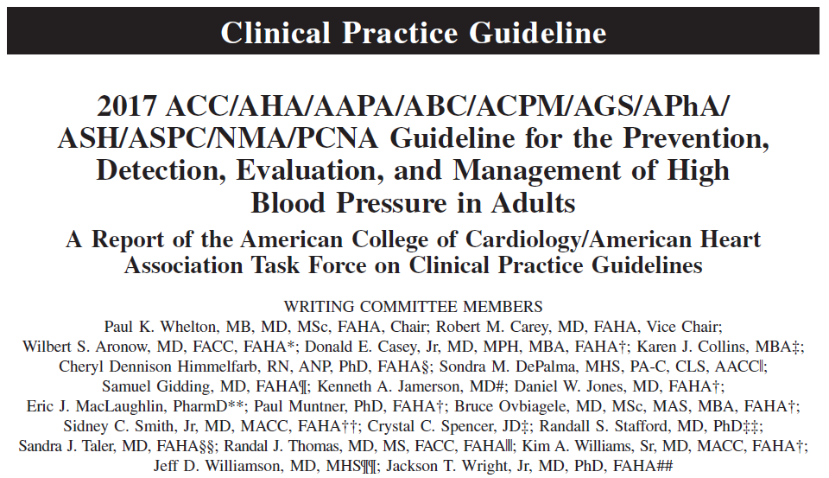
Whelton PK, et al. J Am Coll Cardiol. 2018;71(19):e127-e248.
Whelton PK, et al. Hypertension. 2018;71(6):e13-e115.

Slide 5
BP Classification (JNC 7 and ACC/AHA Guidelines)
SBP |  | DBP
<120 | and | <80
120–129 | and | <80
130–139 | or | 80–89
140–159 | or | 90-99
≥160 | or | ≥100
2003 JNC7/JNC8
Normal BP
Prehypertension
Stage 1 hypertension
Stage 2 hypertension
2017 ACC/AHA
Normal BP
Elevated BP
Stage 1 hypertension
Stage 2 hypertension
Stage 2 hypertension
Major area
of
difference
Blood Pressure should be based on an average of ≥2 careful readings on ≥2 occasions
Adults with SBP or DBP in two categories should be designated to the higher BP category
Whelton PK, et al. J Am Coll Cardiol. 2018;71(19):e127-e248.
Whelton PK, et al. Hypertension. 2018;71(6):e13-e115.

Slide 6
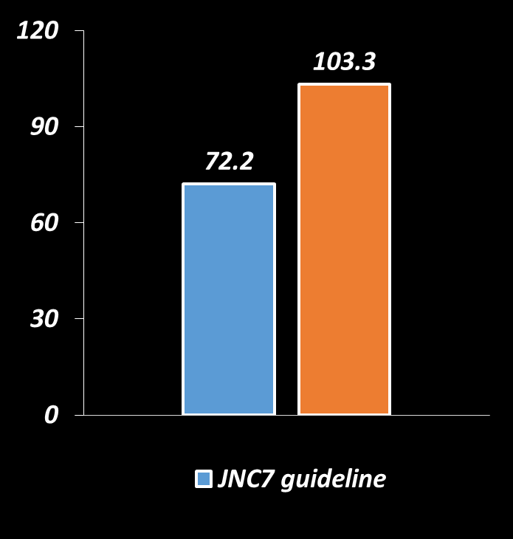
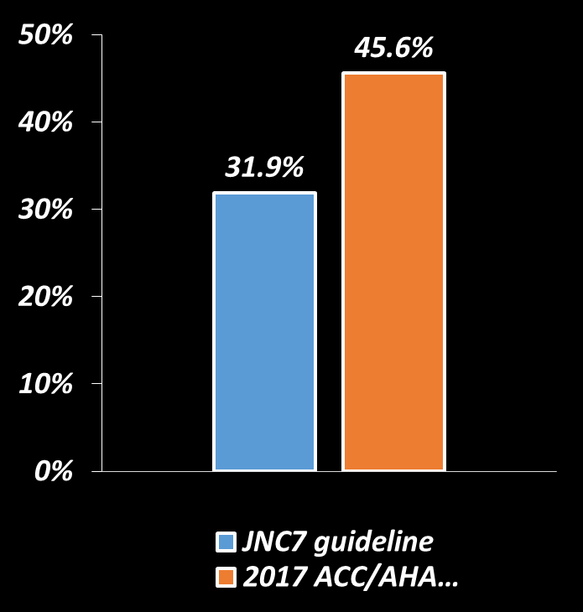
Prevalence of Hypertension – 2017 ACC/AHA and JN7 Guidelines
Prevalence of hypertension, %
Number with hypertension, millions
Whelton PK et al. Hypertension. 2017
Whelton PK et al. JACC. 2017
Muntner et. al. JACC. 2017
Muntner, et. al. Circulation 2017

Slide 7
BP THRESHOLDS AND RECOMMENDATIONS
FOR TREATMENT
BP thresholds and recommendations for treatment
Normal BP
(BP <120/80 mm Hg)
Elevated BP
(BP 120-129/<80 mm Hg)
Stage 1 Hypertension
(BP 130-139/80-89 mm Hg)
Stage 2 Hypertension
(BP >140/90 mm Hg)
Promote optimal lifestyle habits
(Class I)
Non-pharm-acologic therapy
(Class I)
Clinical CVD or estimated 10 y ASCVD risk ≥ 10%
No
Yes
Non-pharmacologic therapy
(Class I)
Non-pharmacologic therapy and BP lowering medication
(Class I)
Non-pharmacologic therapy and BP lowering medication
(Class I)
Whelton PK, et al. Hypertension. (2017). Originally published November 13, 2017. doi: https://doi.org/10.1161/HYP.0000000000000065
Whelton PK, et al. J Am Coll Cardiol. (2017). pii: S0735-1097(17)41519-1. doi: 10.1016/j.jacc.2017.11.006. [Epub ahead of print].

Slide 8
BP Thresholds for and Goals of Pharmacological Therapy in Patients With Hypertension According to Clinical Conditions
Clinical Condition(s) | BP Threshold, mm Hg | BP Goal, mm Hg
General
Clinical CVD or 10-year ASCVD risk ≥10% | ≥130/80 | <130/80
No clinical CVD and 10-year ASCVD risk <10% | ≥140/90 | <130/80
Older persons (≥65 years of age; noninstitutionalized, ambulatory, community-living adults) | ≥130 (SBP) | <130 (SBP)
Specific comorbidities
Diabetes mellitus | ≥130/80 | <130/80
Chronic kidney disease | ≥130/80 | <130/80
Chronic kidney disease after renal transplantation | ≥130/80 | <130/80
Heart failure | ≥130/80 | <130/80
Stable ischemic heart disease | ≥130/80 | <130/80
Secondary stroke prevention | ≥140/90 | <130/80
Secondary stroke prevention (lacunar) | ≥130/80 | <130/80
Peripheral arterial disease | ≥130/80 | <130/80
ASCVD indicates atherosclerotic cardiovascular disease; BP, blood pressure; CVD, cardiovascular disease; and SBP, systolic blood pressure.

Slide 9
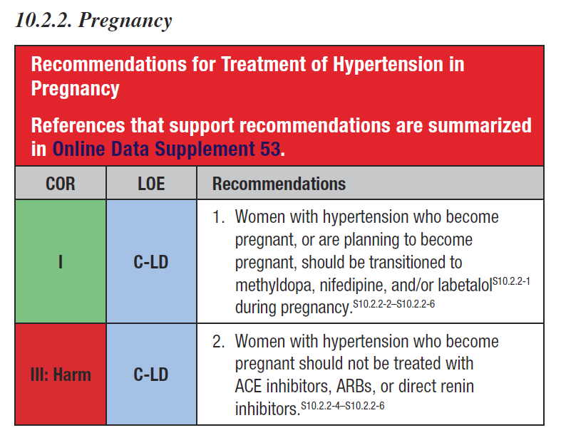
2017 ACC/AHA & Pregnancy

Slide 10
CHTN in Pregnancy
Classified as
Severe ≥160/110
Mild 140-159/90-109
    >70-80%
ACOG: Obset Gynecol 2019 Caritis: NEJM 1998 (Database)

Slide 11
CHTN in Pregnancy
2% prevalence
  Prevalence rising
    Demographic shifts (age, obesity)
Ananth: Hypertension 2019

Slide 12
CHTN in Pregnancy
Well-Established Complications
Outcome CHTN RR
Preeclampsia 25.3% X3-10
SGA 11.1% X2-3
Abruption 1.5% X2-3
Preterm birth 38.0% X3-4
  PTB<35 week 18.1% X4-5
Perinatal death 6.2% X3-5
Bateman: AJOG 2012; Caritis: NEJM 1998; Gordon: JRM 2007

Slide 13
CHTN in Pregnancy
Rare Complications
Outcome AOR
Maternal death x3-5
Pulmonary edema/CHF x6-12
Ventilation x5-8
Cerebrovascular accident x4-7
Acute renal failure x10-16
Stay >6 days x6-7
Bateman: AJOG 2012; Gordon: JRM 2007

Slide 14
CHTN - MANAGEMENT

Slide 15
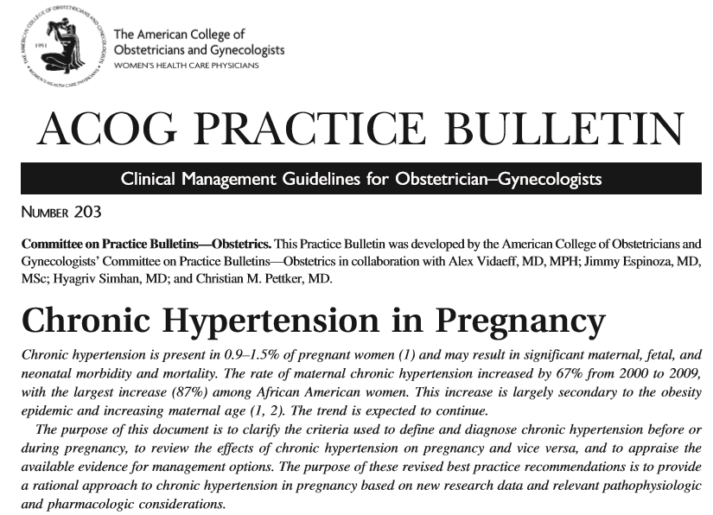
Treatment of CHTN in Pregnancy
ACOG: Obstet Gynecol 2019

Slide 16
Antihypertensive in Pregnancy
ACOG Recommendations:*
Treat severe CHTN: ≥160/110
1st line options
  labetalol, nifedipine
*Moderate quality evidence / strong rec.
ACOG: Obstet Gynecol 2019

Slide 17
Antihypertensive in Pregnancy
ACOG Recommendations:*
Mild CHTN: <160/110
    Withhold therapy
      Risks and benefits of discontinuing medication unclear
      Reasonable to discontinue or continue
* Low quality evidence
ACOG: Obstet Gynecol 2019

Slide 18
Antihypertensive Therapy
RCTs in Pregnancy
  Few
  Underpowered
  Design limitations

Slide 19
Abalos: Cochrane review 2018
Anti-hypertensives or placebo/none
Mild to moderate HTN <170/110mmHg
    Chronic or pregnancy-associated
58 trials (N=5909)

Slide 20
Abalos: Cochrane review 2018
Selected Outcomes
Severe HTN
Perinatal death
Miscarriage
Eclampsia
Severe Preeclampsia
Abruption
SGA
Neonatal RDS
0.5
0.7
0.4
0.3
0.5
1.4
1.0
0.3

Slide 21
Abalos: Cochrane review 2018
Design flaws
Underpowered (<100 women/trial)
Publication bias
    Selective reporting of outcomes
Heterogeneous groups

Slide 22
Magee: BMJ 1999
Systematic review
    Anti-hypertensive vs. none
  Mild CHTN only
  7 trials
  N=623

Slide 23
Magee: BMJ, 1999
Selected Outcomes
Severe Hypertension
Perinatal mortality
Preeclampsia
Abruption
SGA
0.3
0.4
0.7
0.4
1.3

Slide 24
Antihypertensive Therapy
Safety Concerns
↑Small gestational age (SGA)
  B blockers: OR 2.5 (1.02-5.9)
  Reduced MAP: Increasing SGA
Magee: Eur J ObGyn 2000
Von Dadelszen: Lancet 2000

Slide 25
Antihypertensives in Pregnancy
Persistent calls for large RCTs:
NHLBI Pregnancy Working Group 2000
AHRQ Evidence Report 2000
ACOG (Technical Bulletin) 2001
NHLBI JNC 7th Report 2003
SOGC (Practice guidelines) 2008
American Society of HTN (ASH) 2009
RCOG (Nice guidelines) 2010
ACOG (PB/Task Force) 2012/2013/2018

Slide 26

Antihypertensives in Pregnancy?

Slide 27
Summary
Treatment and BP control
    Effective for general population
    Uncertain benefits and safety in pregnancy
→ Conflicting recommendations

Slide 28
NHLBI Cooperative Agreement
Chronic Hypertension and Pregnancy (CHAP) Project
Antihypertensive Therapy for Mild CHTN during Pregnancy:
A Pragmatic RCT
CHAP Project Consortium

Slide 29
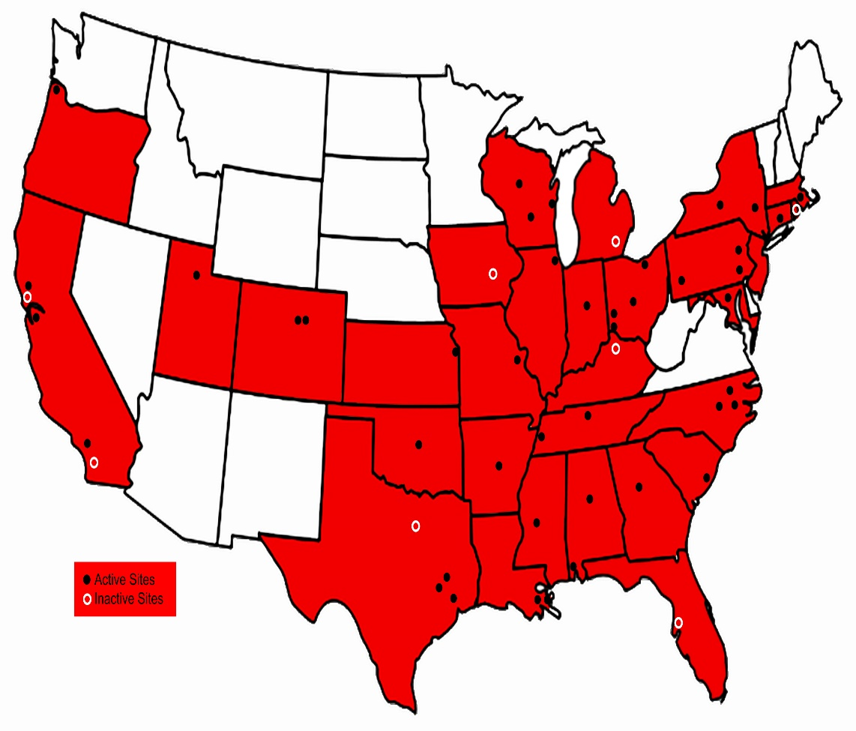
Chronic Hypertension and Pregnancy (CHAP) Project
Open-label RCT
>70 US centers
Clinical coordination (UAB CWRH/OBGYN)
Data coordination (UAB Biostatistics)
NHLBI
Drug DC (VA NM)

Slide 30
Hypothesis
Anti-hypertensive therapy to a BP goal <140/90 for non-severe CHTN during pregnancy reduces the frequency of adverse outcomes associated with CHTN without increasing SGA

Slide 31
Inclusion criteria
Mild CHTN
  New or preexisting
Singleton pregnancy
<23 weeks’ gestation

Slide 32
Exclusion Criteria
Severe CHTN
  SBPs ≥160 or DBPs ≥110
  ≥2 antihypertensive medications
Secondary CHTN / Kidney disease
High-risk medical co-morbidities
  DM White’s class D or end organ effects
Fetal death or major anomalies
Allergy to BP medications

Slide 33
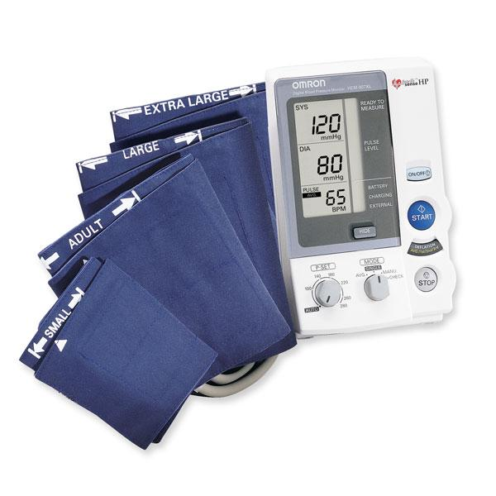
Randomization
Clinic BPs:
Untreated
  SBP140-159 or DBP 90-104
Treated (monotherapy):
  ≤159/104 if adherent within 24 hours;
  Same as untreated if non-adherent

Slide 34
Treatment Protocol (Guide)
Active arm: Target BP <140/90
Labetalol or nifedipine ER
  Others (methyldopa, amlodipine) OK, but not provided by study)
Meds titrated at visits if adherent; 2nd agent added if necessary

Slide 35
Treatment Protocol
Standard arm
Treatment withheld or discontinued
Initiated if BP ≥160/105 (similar medications as active arm)
Titrated to keep BP <160/105

Slide 36
CHAP RCT
CHTN
Severe CHTN, exclusions
Active
Target <140/90
Standard
Target: <160/105
Outcomes
Outcomes

Slide 37
Primary Outcome* – composite:
Preeclampsia - severe features
  Up to 2 weeks postpartum (ACOG)
Indicated PTB <35 weeks
Abruption
Fetal or neonatal death
*Centrally and blindly adjudicated

Slide 38
Preeclampsia with severe features*
BP ≥160/110 + proteinuria OR
Worsening HTN + any of:
  Seizures or headaches/visual symptoms
  Thrombocytopenia (platelets <100K)
  AKI (serum creatinine ≥1.2 mg/dL)
  ↑2-fold transaminases, HELLP or persistent RUQ pain
  Pulmonary edema
  * After 20 weeks gestation

Slide 39
Safety Outcome
SGA (small for gestational age)
<10th percentile
  <5th percentile

Slide 40
2º Outcomes
Maternal CV complications
  Death or ICU admission
  Stroke/Encephalopathy
  CHF/Pulmonary edema
  MI
  AKI
Preeclampsia

Slide 41
2º Outcomes
Preterm birth
Serious neonatal morbidities
  Bronchopulmonary dysplasia
  Retinopathy of prematurity
  Necrotizing enterocolitis
  Intraventricular hemorrhage grade III/IV

Slide 42
Sample Size & Analysis
N=2404
  ≥85% power, 25-33% relative reduction, 30% baseline incidence,
  10% crossover, 5% loss, 2-sided α =0.05
Statistical plan: ITT with imputation for missing values
  Sensitivity: Complete case analysis

Slide 43
Results

Slide 44
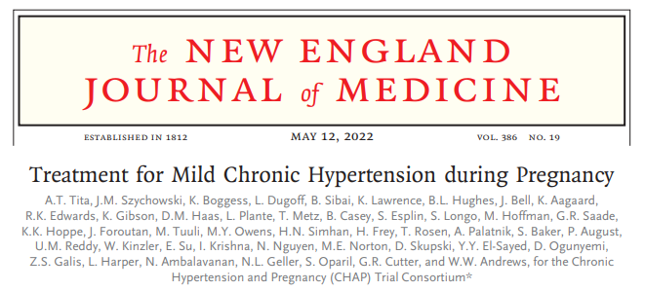

Slide 45
CHAP RCT
29771 Screened
27352 excluded
(66%↓BP or ↑GA)
N=2408, 61 sites
Active
1208
Standard
1200
1170 (97%) Outcomes
1157 (96%)
Outcomes

Slide 46
Baseline Characteristics: Balanced
Characteristic | Active (n=1208) |  | Standard (n=1200)
Chronic Hypertension Type
Newly diagnosed |  | 21.8% | 21.5%
Known - on medication |  | 56.0% | 56.8%
Known - not on medication |  | 22.2% | 21.8%
Age at Enrollment, years |  | 32.3 ± 5.6 | 32.3 ± 5.8
Race/Ethnicity
White, non-Hispanic |  | 28.7% | 27.2%
Black, non-Hispanic |  | 47.5% | 47.5%
Hispanic |  | 19.7% | 20.8%
Other |  | 4.1% | 4.5%
Mother's Insurance
Government assisted insurance/Medicaid |  | 55.7% | 54.7%
Private insurance |  | 38.0% | 38.6%
None/self-paid |  | 5.0% | 5.4%
BMI at Enrollment |  | 37.7 ± 10.0 | 37.5 ± 9.6
BMI < 30 |  | 24.4% | 21.6%
30 ≤ BMI < 40 |  | 38.1% | 43.1%
BMI ≥ 40 |  | 35.9% | 33.5%
Gestational Age <14 weeks at randomization |  | 41.1% | 40.1%
Diabetes Mellitus (%) |  | 15.8% | 15.8%
Current Smoker (%) |  | 7.6% | 6.8%
Aspirin Use (%) |  | 44.6% | 44.7%

Slide 47
Medication at Randomization - Active
Labetalol | 745 (61.7%)
Nifedipine | 430 (35.6%)
Amlodipine | 20 (1.7%)
Methyldopa | 4 (0.3%)
HCTZ | 3 (0.3%)
Other | 2 (0.2%)

Slide 48
Medications - last clinic visit
BP Medication | Active On Meds (n=1047) | Standard On Meds (n=284) | Active Overall (n=1178) | Standard Overall (n=1163)
Labetalol | 662 (63.2%) | 175 (61.6%) | 662 (56.2%) | 175 (15.1%)
Nifedipine | 350 (33.4%) | 87 (30.6%) | 350 (29.7%) | 87 (7.5%)
Amlodipine | 18 (1.7%) | 5 (1.8%) | 18 (1.5%) | 5 (0.4%)
Methyldopa | 5 (0.5%) | 4 (1.4%) | 5 (0.4%) | 4 (0.3%)
HCTZ | 3 (0.3%) | 1 (0.4%) | 3 (0.3%) | 1 (0.1%)
Metoprolol | 2 (0.2%) | 4 (1.4%) | 2 (0.2%) | 4 (0.3%)
Other | 7 (0.7%) | 8 (2.8%) | 7 (0.6%) | 8 (0.7%)
Not on Meds | - | - | 131 (11.1%) | 879 (75.6%)

Slide 49
Serial Clinic BPs
SBP
DBP

Slide 50

Primary Outcome
RR=0.82 (0.74-0.92)
P<0.001
NNT=14.7

Slide 51
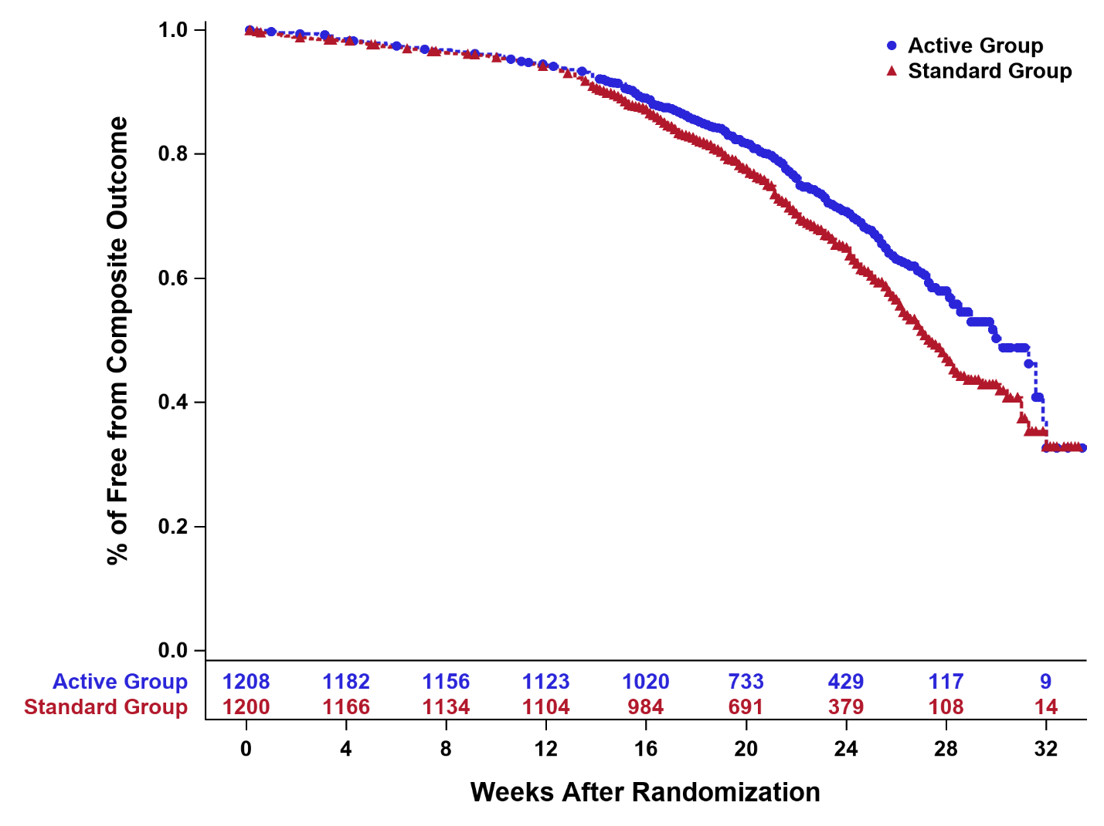
Primary Outcome
Survival Analysis (KM)
HR 0.79 (0.68-0.91)

Slide 52
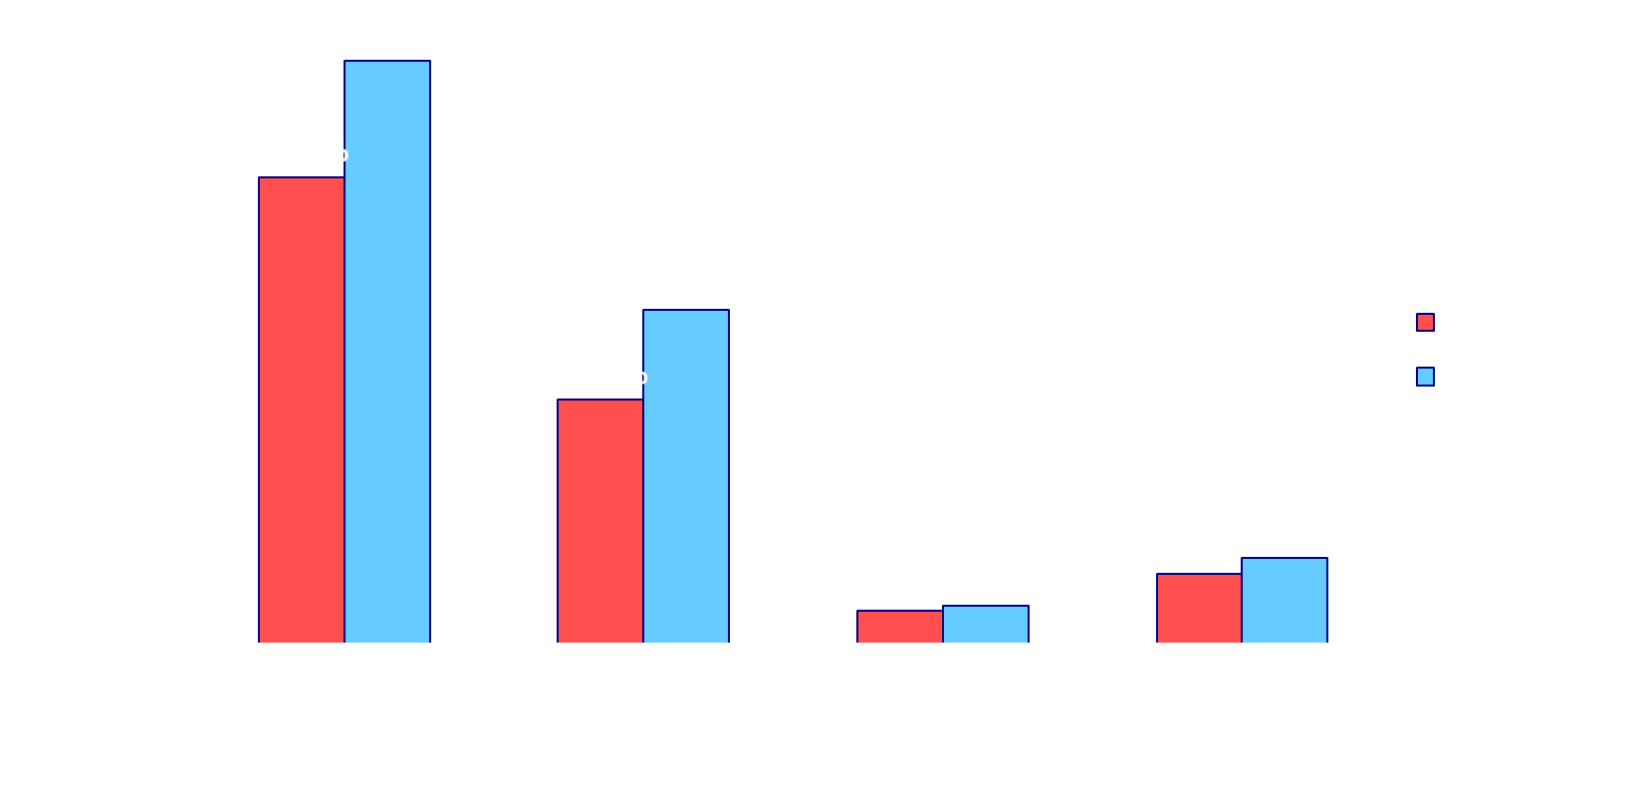
Primary Outcome (components)
RR=0.8
(0.7-0.9)
RR=0.7
(0.6-0.9)
RR=0.9
(0.5-1.6)
RR=0.8
(0.4-1.2)

Slide 53
Primary Outcome: Subgroups

Slide 54
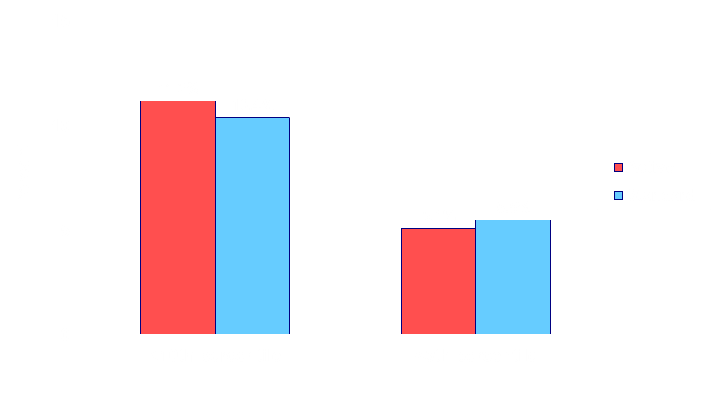
Safety Outcome (SGA)
RR=1.04
(0.85-1.3)
RR=0.89
(0.62-1.3)

Slide 55
Maternal Outcomes
Outcome | Active (n=1208) | Standard (n=1200) | RR (95% C.I.)*
Composite Morbidity | 2.1% | 2.8% | 0.75 (0.45-1.3)
Maternal Death | 0.1% | 0.2% | 0.50 (0.05-5.5)
Heart Failure | 0.1% | 0.1% | 0.99 (0.06-16)
Stroke | 0.0% | 0.0% | N/A
MI/Angina | 0.0% | 0.0% | N/A
Pulmonary Edema | 0.4% | 0.9% | 0.45 (0.16-1.3)
ICU admission | 1.0% | 1.3% | 0.75 (0.35-1.6)
Encephalopathy | 0.1% | 0.0% | N/A
AKI | 0.8% | 1.2% | 0.64 (0.28-1.5)

Slide 56
Maternal Outcomes
Outcome | Active (n=1208) | Standard (n=1200) | RR (95% C.I.)
Any Preeclampsia | 24.4% | 31.1% | 0.79 (0.69-0.89)
Severe HTN/proteinuria | 15.7% | 17.9% | 0.87 (0.73-1.04)
Eclampsia | 0% | 0.1% | N/A
HELLP | 0% | 0.3% | N/A
HTN/organ dysfunction | 11.3% | 15.1% | 0.75 (0.61-0.92)
Mild (non-severe) | 1.9% | 3.1% | 0.62 (0.37-1.03)
Worsening CHTN | 10.9% | 13.0% | 0.84 (0.68-1.04)
Severe Hypertension | 36.1% | 44.3% | 0.82 (0.74-0.90)

Slide 57
Neonatal Outcomes
Outcome | Active (n=1208) | Standard (n=1200) | RR (95% CI)
Composite Morbidities | 2.0% | 2.6% | 0.77 (0.45-1.3)
Bronchopulmonary D | 0.7% | 1.2% | 0.57 (0.24-1.4)
Retinopathy | 1.3% | 1.7% | 0.79 (0.41-1.5)
Nec. enterocolitis | 0.2% | 0.2% | 0.99 (0.14-7.1)
IV Hemorrhage III/IV | 0.3% | 0.3% | 0.75 (0.17-3.3)
PTB < 37 weeks | 27.5% | 31.4% | 0.87 (0.77-0.9)
LBW (< 2500g) | 19.2% | 23.1% | 0.83 (0.71-0.9)

Slide 58
Neonatal Outcomes
Outcome | Active (n=1208) | Standard (n=1200) | RR (95% CI)
NICU Admission | 30.5% | 33.5% | 0.91 (0.81-1.0)
Hypoglycemia | 15.8% | 16.3% | 0.97 (0.81-1.2)
Bradycardia | 2.6% | 2.9% | 0.88 (0.55-1.4)
Hypotension | 0.6% | 1.3% | 0.43 (0.18-1.1)
Respiratory D Syn | 12.3% | 14.3% | 0.87 (0.71-1.1)
Transient tachypnea | 5.8% | 5.3% | 1.10 (0.79-1.5)
Respiratory support | 18.1% | 20.3% | 0.90 (0.76-1.1)
Suspected sepsis Proven sepsis | 11.4% 1.7% | 13.8% 2.8% | 0.84 (0.68-1.04) 0.61 (0.36-1.05)

Slide 59
Summary
Treatment of CHTN to BP <140/90:
↓Adverse pregnancy 1º outcome
  NNT = 14.7
Does not impair fetal growth
No other maternal or perinatal harm

Slide 60
Conclusions
CHAP supports treatment of CHTN to BP <140/90 mmHg in pregnancy
  Continue established antihypertensive
Long-term studies will further clarify treatment effects
  Maternal (underway)
  Childhood outcomes

Slide 61
ACOG – 04/2022
“ACOG recommends utilizing 140/90 as the threshold for initiation or titration of medical therapy for chronic hypertension in pregnancy, rather than the previously recommended threshold of 160/110.”
  For patients on blood pressure medications at the start of pregnancy, in the absence of mitigating factors or side effects, they can be maintained on their medications, rather than discontinuing them and waiting to initiate treatment for blood pressures in the severe range.

Slide 62
SMFM – 04/2022
SMFM recommends treatment with antihypertensive therapy for mild chronic hypertension in pregnancy to a goal BP 140/90.
  Patients with treated chronic hypertension should continue established antihypertensive therapy during pregnancy or change to a regimen compatible with pregnancy to achieve this treatment goal.

Slide 63
Acknowledgments
NIH/NHLBI (Funding) – U01HL120338
DSMB
  Dudley D (Chair), Heller G, Roberson PK, Shankaran S, Wachbroit R
Patients, faculty, clinical trainees and staff at sites
Study teams at clinical sites, CCC, DCC, DDC and NHLBI

Slide 64
CHAP Co-Authors (and teams)
Jeff M. Szychowski, PhD
Kim Boggess, MD
Lorraine Dugoff, MD
Baha Sibai, MD
Kirsten Lawrence, MD
Brenna L. Hughes, MD
Joseph Bell, MD
Kjersti Aagaard, MD
Rodney K. Edwards, MD
Kelly Gibson, MD
David M Haas, MD
Lauren Plante, MD
Torri Metz, MD
Brian Casey, MD
Sean Esplin, MD
Sherri Longo, MD
Matthew Hoffman, MD
George R. Saade, MD
Kara K. Hoppe, DO
Janelle Foroutan, MD
Methodius Tuuli, MD
Michelle Y. Owens, MD
Hyagriv N. Simhan, MD
Heather Frey, MD
Todd Rosen, MD
Anna Palatnik, MD
Susan Baker, MD
Phyllis August, MD
Uma M. Reddy, MD
Wendy Kinzler, MD
Emily Su, MD
Iris Krishna, MD
Nicki Nguyen, MD
Mary E. Norton, MD
Daniel Skupski, MD
Yasser Y. El-Sayed, MD
Dotum Ogunyemi, MD
Zorina S. Galis, PhD
Lorie Harper, MD
Namasivayam Ambalavanan, MD
Nancy L. Geller, PhD
Suzanne Oparil, MD
Gary R. Cutter, PhD
William W. Andrews, PhD

Slide 65

THANKS

Slide 66
More Questions…
Superiority of labetalol vs. nifedipine?
Treatment goal BP: <140/90 vs. <130/80?
  All pregnancies
  Patients with DM
Preeclampsia epigenetics
Long-term outcomes of treatment
  Mothers
  Children

Slide 67
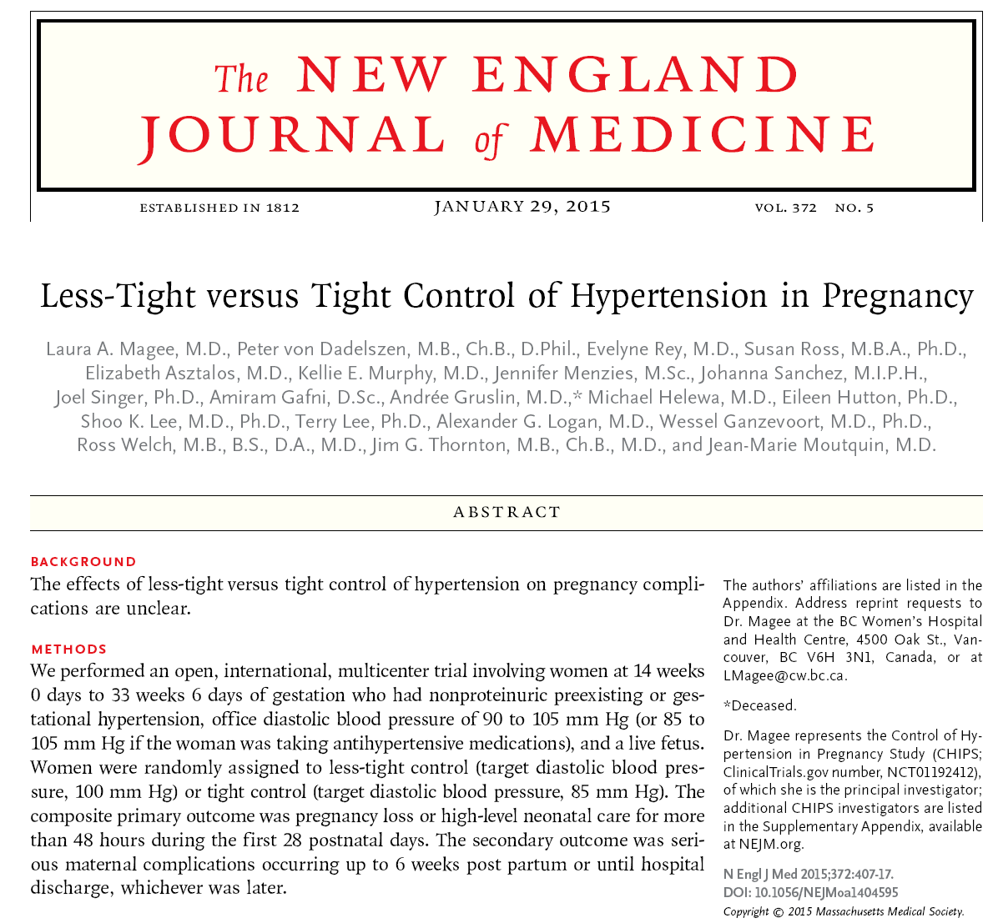

Slide 68
CHIPS Trial
Tight vs. less tight BP control
  Goal DBP 100 vs. 85 mm Hg
Chronic or Gestational HTN
  14-33 weeks
1º Outcome:
  Pregnancy loss or NICU admission >48 hrs
N=1030, 94 international sites
  <70 US patients

Slide 69
CHIPS Trial
 | Less-Tight (N = 493) | Tight Control (N = 488) | aOR (95% CI)
1⁰ outcome | 31.4% | 30.7% | 1.02 (0.77–1.35)
2⁰ outcomes* | 3.7% | 2.0% | 1.74 (0.79–3.84)
SGA < 10% | 16.1% | 19.7% | 0.78 (0.56–1.08)
< 3% | 4.7% | 5.3% | 0.92 (0.51–1.63)
SGA in CHTN | 13.9% | 19.7% | 0.66 (0.44-0.99)
Severe HTN | 40.6% | 27.5% | 1.80 (1.34–2.38)

Slide 70
