Slide 1
Medical Publishing in Dynamic Times : A View from JAMA and the JAMA Network
Kirsten Bibbins-Domingo, MD, PhD, MAS
Editor in Chief
JAMA and the JAMA Network
Professor of Epidemiology and Biostatistics and Professor of Medicine
University of California, San Francisco

Slide 2
Disclosures
No additional disclosures

Slide 3
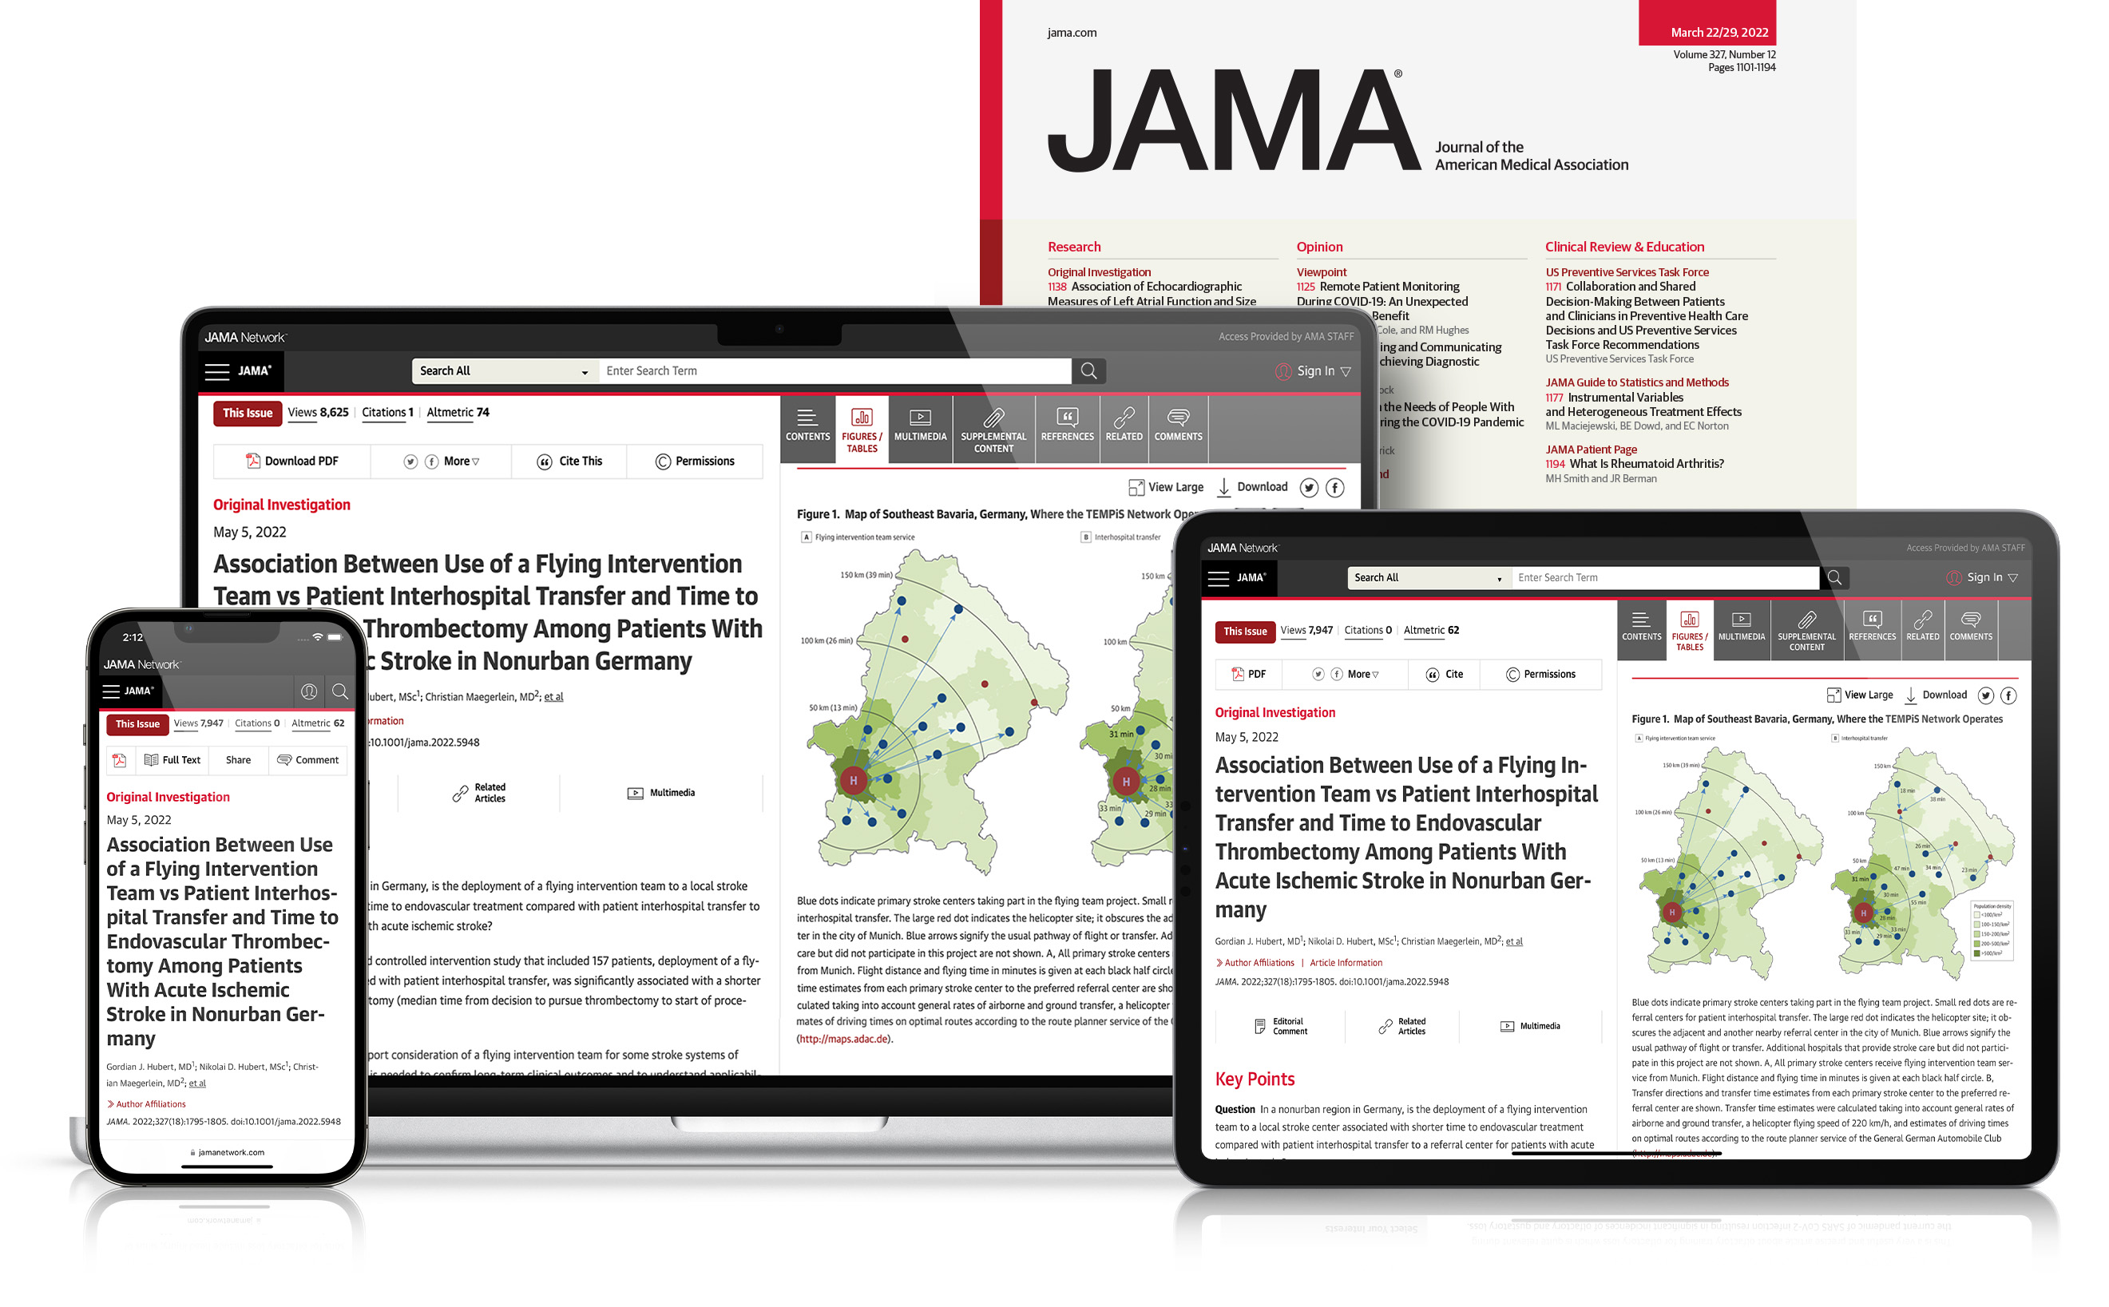
Publishing in JAMA
SPEED
REACH AND EXPOSURE
Online First publication of all articles
Extensive press coverage
Median time to first decision:
4 Days without review
+77,500
1
2
3
4
5
6
7
8
9
10
11
12
13
14
15
16
17
18
19
20
Media mentions in 2022
21
22
23
24
25
26
27
28
29
30
31
32
32 Days with review
Broad reach through author audio interviews, editor podcasts, email alerts, social media, and multimedia
IMPACT
Journal Impact Factor
157.3
One of the highest in medicine and science
+46 MILLION
Annual article views and downloads

Slide 4
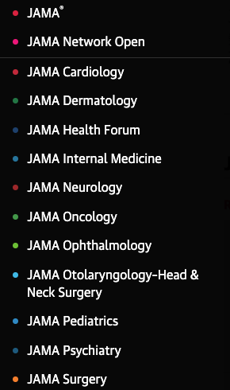
JAMA Network 13 journals: JAMA, 11 specialty journals, and JAMA Network Open 47,000 submissions in 2022 7,200 articles published/year 141 million article views/year 2.5 million social media followers 4.1 million podcast downloads 7.9 million video views 307,000 news media
JAMA Network Journals are top tier in their respective fields
Prioritize clinical trials

Slide 5
JAMA Network Editors in Chief
JAMA: Kirsten Bibbins-Domingo, PhD, MD, MAS
JAMA Network Open: Frederick P. Rivara, MD, MPH
JAMA Cardiology: Robert O. Bonow, MD, MS
JAMA Dermatology: Kanade Shinkai, MD, PhD
JAMA Health Forum: John Z. Ayanian, MD, MPP
JAMA Internal Medicine: Rita F. Redberg, MD, MSc (Incoming Sharon K. Inouye, MD, MPH, effective July 1, 2023)
JAMA Neurology: S. Andrew Josephson, MD
JAMA Oncology: Mary L. (Nora) Disis, MD
JAMA Ophthalmology: Neil M. Bressler, MD
JAMA Otolaryngology–Head & Neck Surgery: Jay F. Piccirillo, MD
JAMA Pediatrics: Dimitri A. Christakis, MD, MPH
JAMA Psychiatry: Dost Öngür, MD, PhD
JAMA Surgery: Melina R. Kibbe, MD

Slide 6
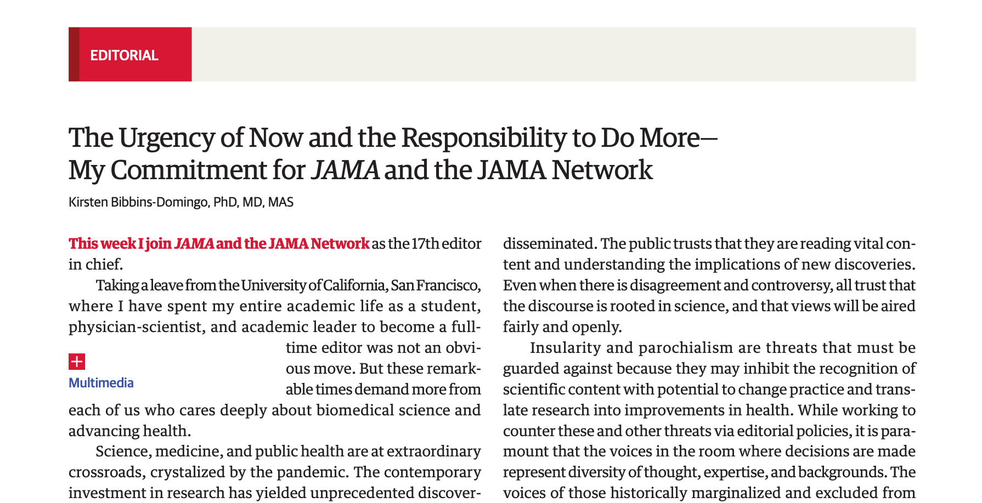
July 5, 2022

Slide 7
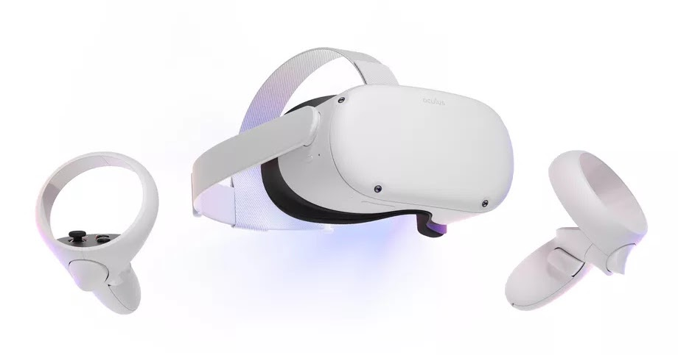
Trends and pressures driving change in the landscape medical publishing.
Information overload
Virtual reality
Open access
AUGMENTED REALITY
Preprint servers
multimedia
Clinician burnout
Timely, trusted data
New research methods
Millennials are majority of workforce¹
transparency
Changing content consumption habits
Data
Data
Data
Networks
Reproducibility
Reproducibility
Reproducibility
Artificial intelligence
misinformation
Pew Research – Millennials Overtake Boomers as Americas Largest Generation
Logo/icons by Unknown Author is licensed under CC BY-NC

Slide 8
Three issues facing medical journals
Need for rapid and broad dissemination of scientific findings
Mistrust IN science and mistrust ABOUT science
Re-evaluation of all parts of the academic, scientific, and medical enterprise

Slide 9
Rapid and broad dissemination of scientific findings
OR…. What traditional journals learned about preprints and open access

Slide 10
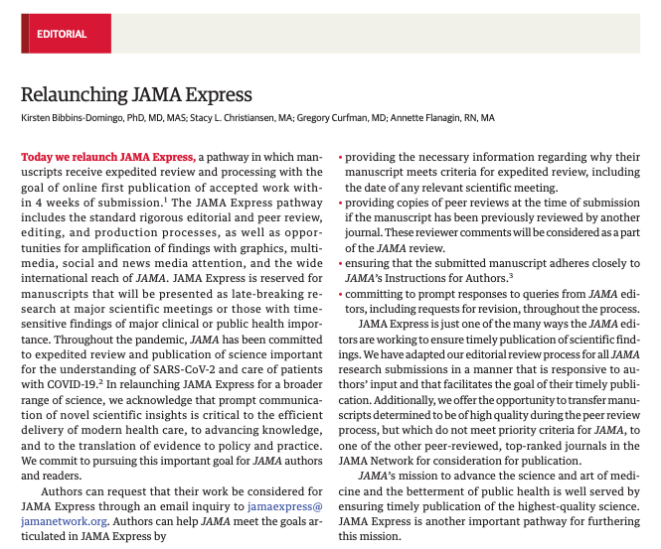
Timely dissemination of science
Editorial on the relaunch of JAMA Express published February 16, 2023.
JAMA Express is a pathway in which manuscripts receive expedited review and processing with the goal of online first publication of accepted work within 4 weeks of submission.

Slide 11
Manuscript Meeting
Associate/Senior/Deputy
Editors
Statistical Editors:
Roger Lewis, MD, PhD
(UCLA)
Issa Dahabreh, MD, ScD
(Harvard)
Patrick Heagerty PhD
(U Washington)
Peer Review

Slide 12
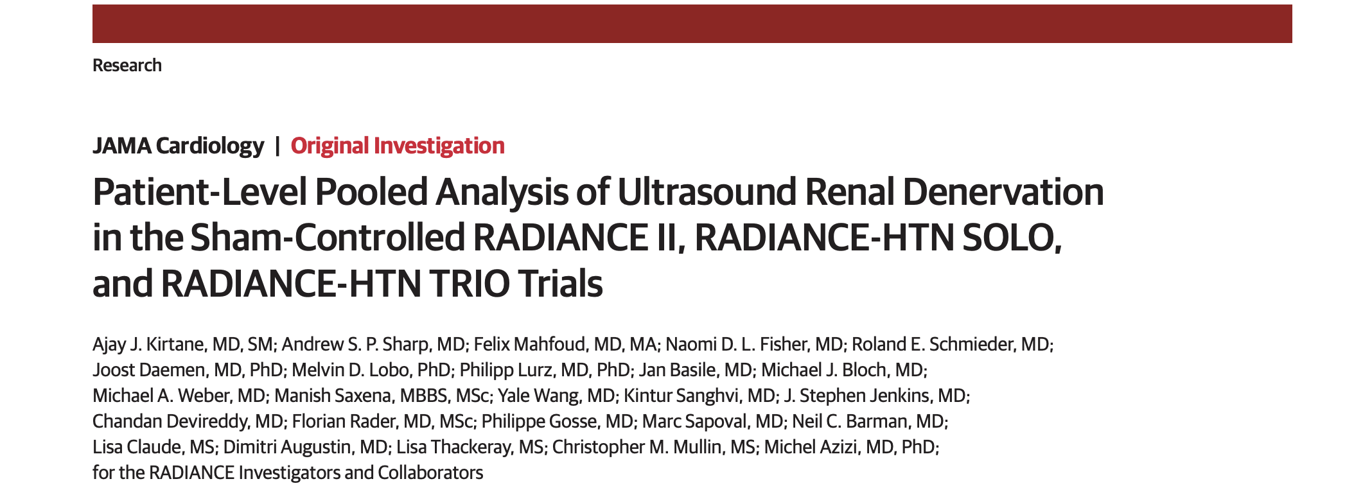
Simultaneous publication in JAMA
& JAMA Cardiology
February 28, 2023

Slide 13
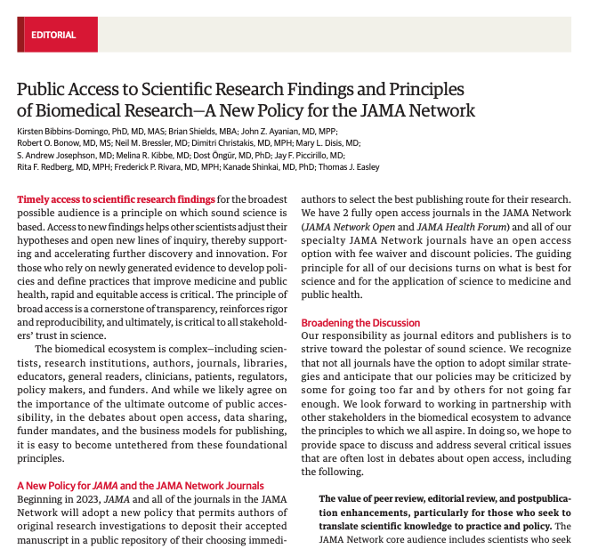
Accessible science
Editorial on public access
published on December 14, 2022
Authors may deposit accepted manuscript in
a public repository on the day the article is
published in JAMA
Often called “Green Open Access”
Draft policy of the NIH announced February 2023

Slide 14
Addressing (mis) trust in science

Slide 15
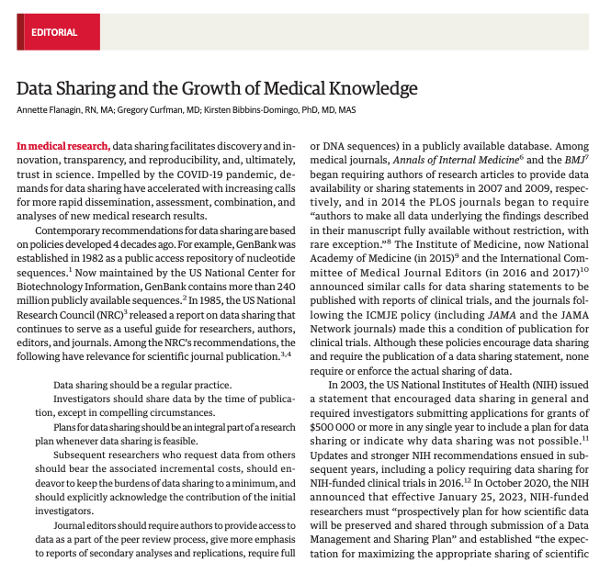
Supporting data sharing & reproducibility in science
Editorial published December 5, 2022 in JAMA
Endorses data sharing, enables authors to create data sharing statements, and promotes tools for data sharing. This editorial does not mandate data sharing as a requirement for publication.

Slide 16
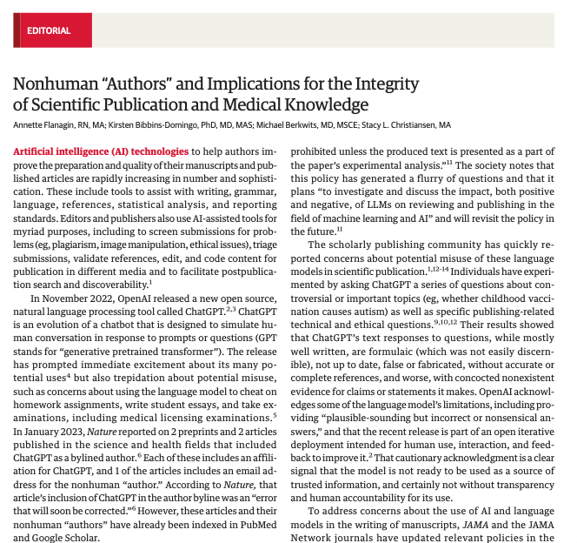
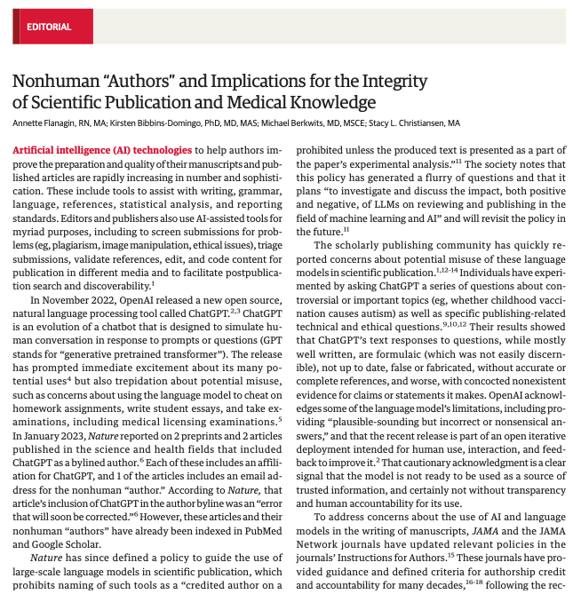
Keeping pace with the latest developments
Editorial addressing ChatGPT published January 31, 2023.
Excerpt:
”Responsible use of AI language models and transparent reporting of how these tools are used…are vital to promote and protect the credibility and integrity of medical research and trust in medical knowledge.”

Slide 17
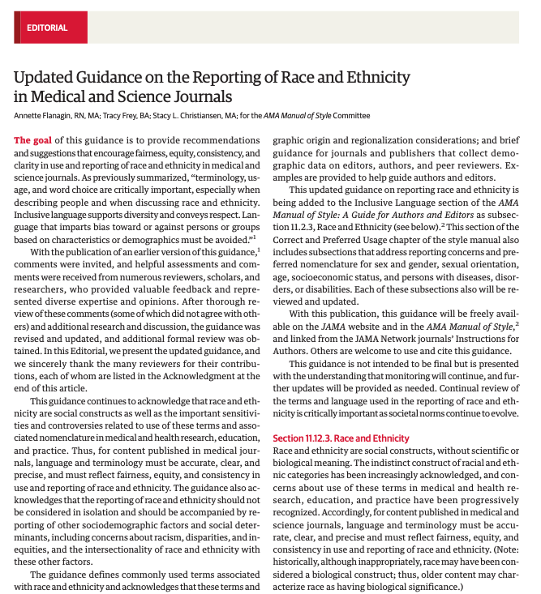
Providing guidance
Editorial to provide guidance that encourages fairness, equity, consistency, and clarity in use and reporting of race and ethnicity in medical and science journals published August 17, 2021.

Slide 18
Addressing (mis) trust IN science
and (mis) trust ABOUT science

Slide 19
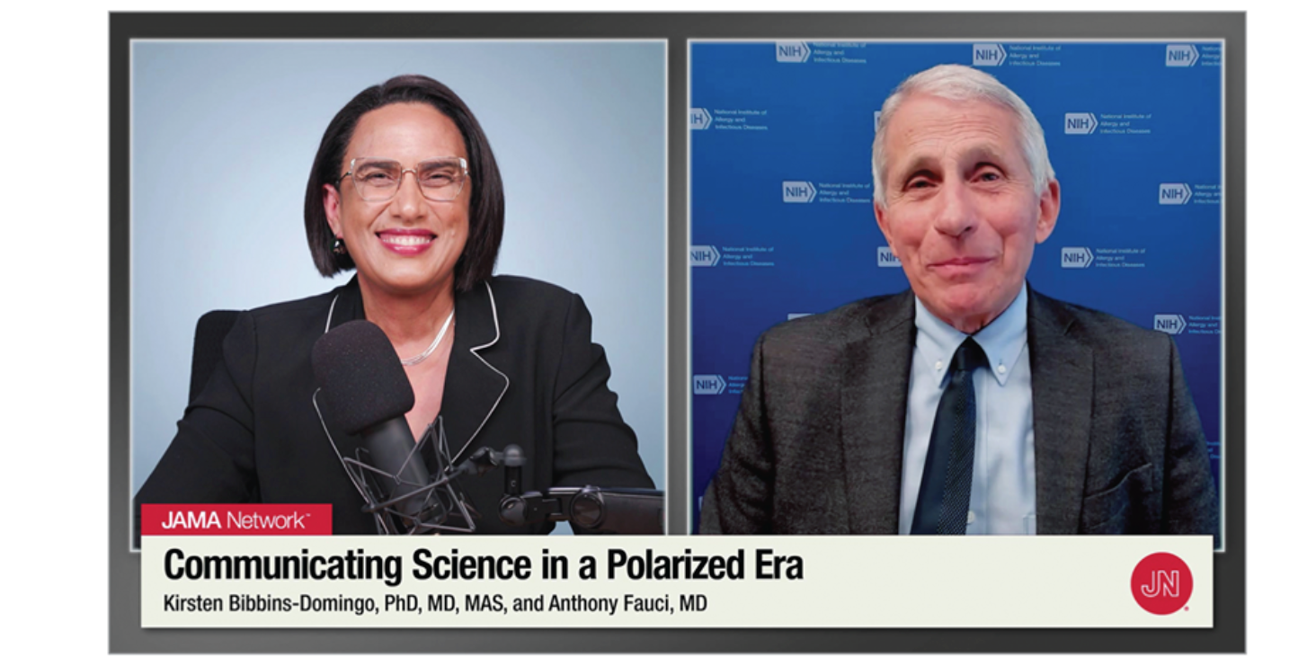
Addressing misinformation & disinformation
Interview September 9, 2022

Slide 20
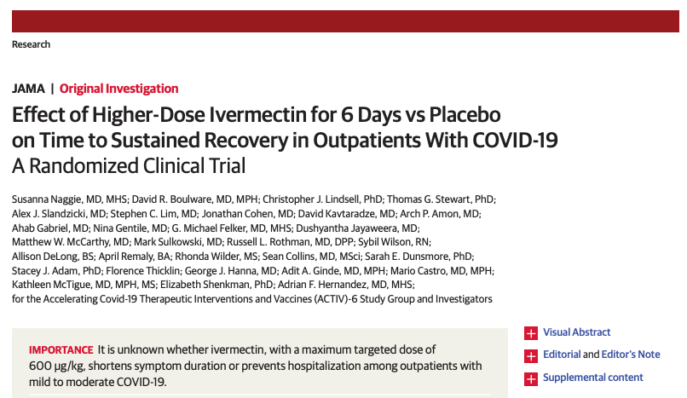
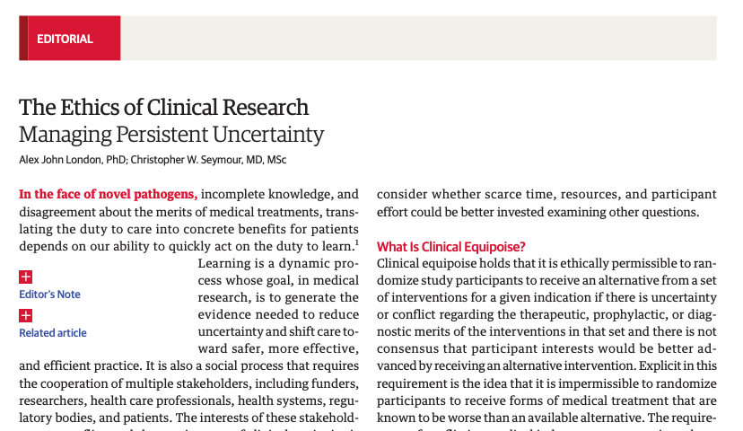
Addressing misinformation & disinformation
Published in JAMA February 20, 2023

Slide 21
Addressing misinformation & disinformation
Promoting accurate scientific information
“Pre-bunking”
building skills / anticipating misinformation
De-bunking false information

Slide 22
Engaging in the broader conversation about the issues facing science and medicine

Slide 24
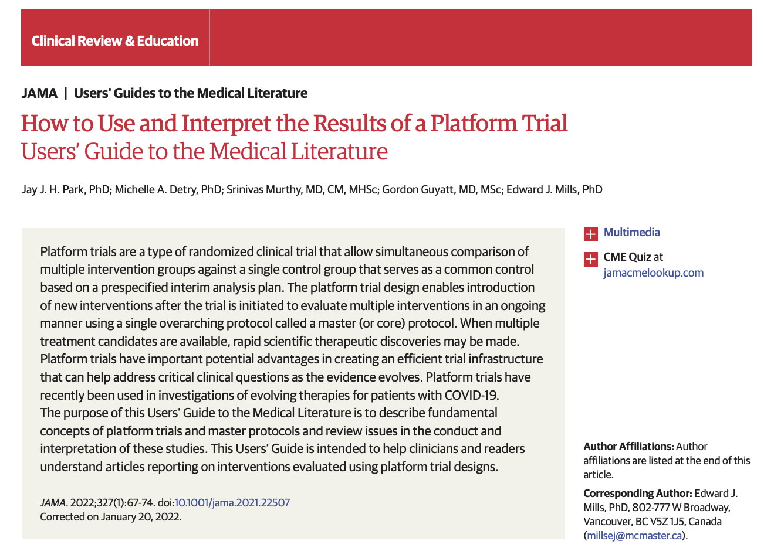
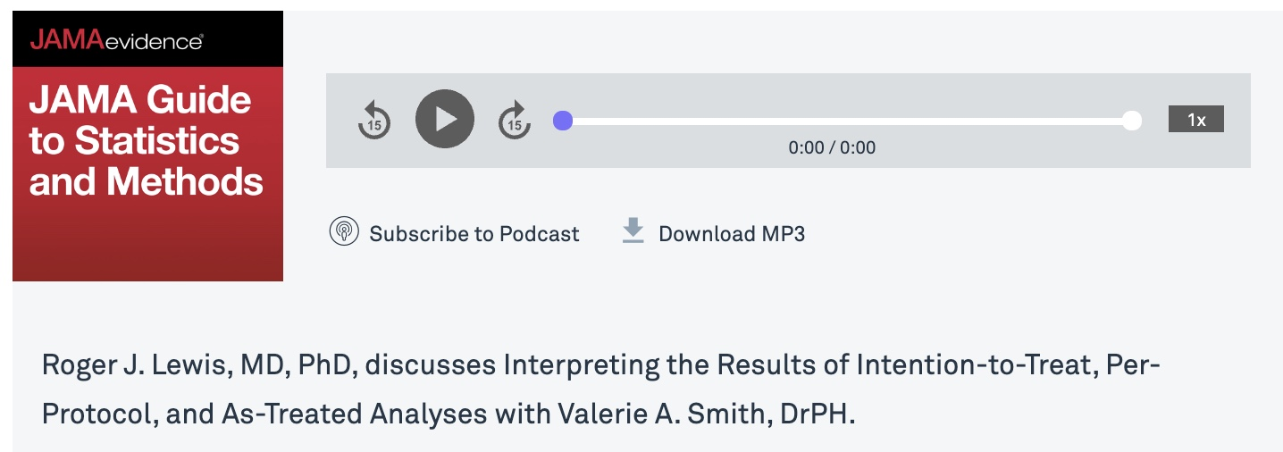
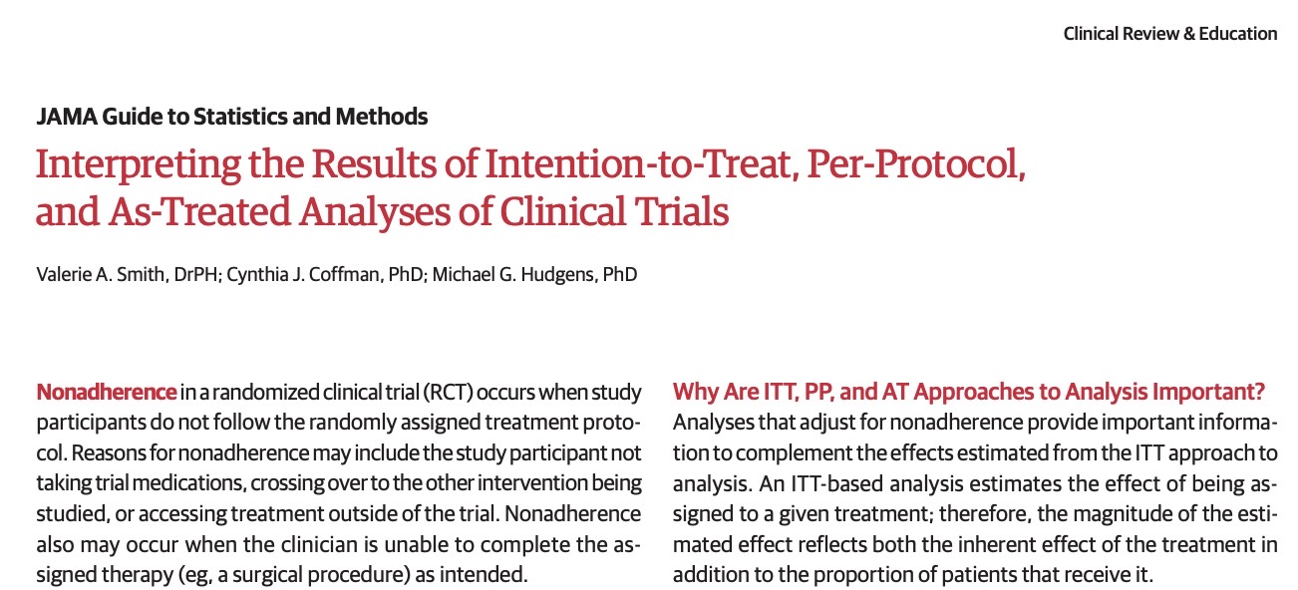
Published May 3, 2023
Published January 4, 2022

Slide 25
Advancing science & translation to health
Theme issues: Firearms and violence published September 27, 2022. Reproductive rights on November 1, 2022.

Slide 26
Driving key conversations
Coming soon…..
October 10-11 in Chicago
“Is the Clinical Trials Enterprise Broken? ………and How Can It Be Fixed?”

Slide 27
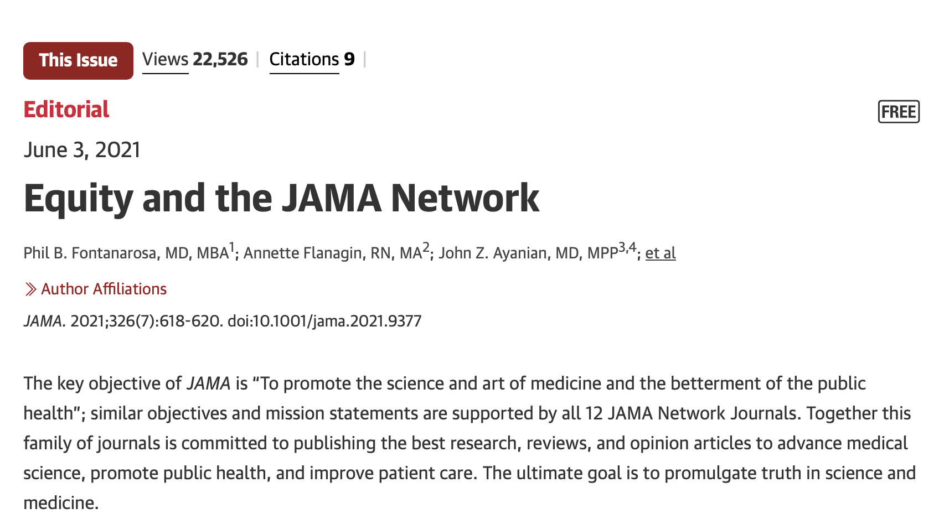
Who has access to read?
Who has access to publish?
How do we decide what and who to publish?
How do we expand capacity for editorial work?

Slide 28
Reflections
This is a dynamic time for science and medicine, as it is in medical publishing. New technologies, attention to equity, and the pace of publishing all offer significant opportunities and challenges.
Trust and mistrust IN science and ABOUT science are growing issues and will require rethinking on ways to address.
Medical journals must be an active force in driving these conversations that are important for the future of science and medicine.

