Slide 1

An Extended Bayesian Semi-Mechanistic Dose-Finding
Design for Phase I Oncology Trials Using
Pharmacokinetic and Pharmacodynamic Information
Chao Yang
This is a joint work with Yisheng Li
May 22 2023

Slide 2
Disclosures
No relevant disclosures

Slide 3
Introduction
Clinical cancer drug development had a high failure rate at each stage from phase I to III trials
Pharmacokinetics/pharmacodynamics (PK/PD) information reflects partially drug exposure and drug-receptor interaction, which may help identify the maximum tolerated dose (MTD)
Few designs incorporate both PK/PD information in dose escalation:
  Piantadosi et al (1998), Ursino et al (2017), Takeda et al (2018), Günhan et al (2020, 2021) incorporate only summary PK information
  Whitehead et al (2001) focus on PD endpoint only, for healthy volunteers (i.e., in non-cancer trials)
  Gerard et al (2021, 2022) incorporate both PK/PD information, use multi-stage estimation, at end of trial (for dose/regimen recommendation)

Slide 4
Introduction (cont’d)
Su et al (2022)’s semi-mechanistic dose-finding (SDF) design incorporates PK/PD information to guide dose-escalation:
  New, unified model framework incorporating dynamic PK, PD, and toxicity outcome
  1-compartment intravenous (IV) bolus PK model
  PD effect assumed latent
  Joint modeling of PK and DLT data
  Modest improvement in operating characteristics (OCs) over common designs
We wish to extend the SDF design by:
  Incorporating PD data for toxicity, when available (to address clinical motivation & modest OC improvement concerns)
  Maintaining the joint modeling feature (for PK, PD and DLT data)
  Focusing on drugs with more complex PK mechanisms (e.g., multiphasic decline in concentration)

Slide 5
A motivating trial
A phase Ib/II trial of anti-CD20/CD3 T-cell-dependent bispecific antibody in patients with non-Hodgkin lymphoma
Administered via IV infusion using 1-dosing regimen in a treatment cycle
The drug induces immune cell activation against CD20-expressing cells that will subsequently result in cytokine release syndrome (CRS), which is the dose-limiting toxicity (DLT)
Cytokine interleukin-6 (IL-6; PD marker) is a key mediator in CRS – elevated level of IL-6 is associated with CRS
In the trial, plasma drug concentration and cytokine were measured at multiple timepoints for each patient

Slide 6
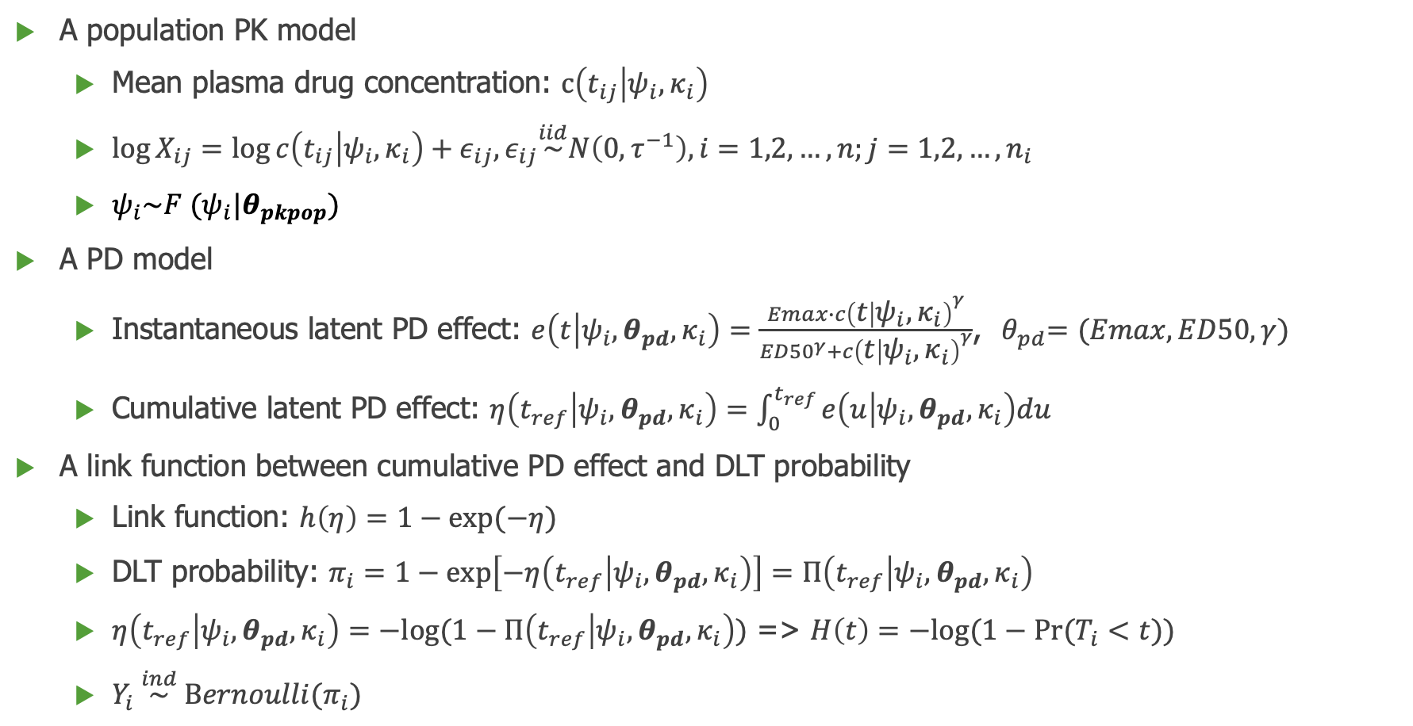
An extended SDF model framework
The original framework
A population PK model
  Mean plasma drug concentration: $c\left(t_{ij} | ψ_{i},κ_{i}\right)$
  $\log{X_{ij}=\log{c\left(t_{ij} | ψ_{i},κ_{i}\right)+ε_{ij},ε_{ij}\overset{iid}{\sim }N\left(0,τ^{−1}\right),i=1,2,…,n;j=1,2,…,n_{i} }}$
  $ψ_{i}\sim F (ψ_{i}|θ_{pkpop})$
A PD model
  Instantaneous latent PD effect: $e\left(t | ψ_{i},θ_{pd},κ_{i}\right)=\frac{Emax∙{c\left(t | ψ_{i},κ_{i}\right)}^{γ}}{{ED50}^{γ}+{c\left(t | ψ_{i},κ_{i}\right)}^{γ}}$,${ θ}_{pd}=(Emax,ED50,γ)$
  Cumulative latent PD effect: $η\left(t_{ref} | ψ_{i},θ_{pd},κ_{i}\right)=\int_{0}^{t_{ref}}{e\left(u | ψ_{i},θ_{pd},κ_{i}\right)du}$
A link function between cumulative PD effect and DLT probability
  Link function: $h\left(η\right)=1−exp⁡(−η)$
  DLT probability: $π_{i}=1−\exp\left[−η\left(t_{ref} | ψ_{i},θ_{pd},κ_{i}\right)\right]=Π\left(t_{ref} | ψ_{i},θ_{pd},κ_{i}\right)$
  $η\left(t_{ref} | ψ_{i},θ_{pd},κ_{i}\right)=−log⁡(1−Π\left(t_{ref} | ψ_{i},θ_{pd},κ_{i}\right))$ => $H\left(t\right)=−log⁡(1−Pr⁡(T_{i}<t))$
  $Y_{i} \overset{ind}{\sim } Bernoulli(π_{i})$

Slide 7
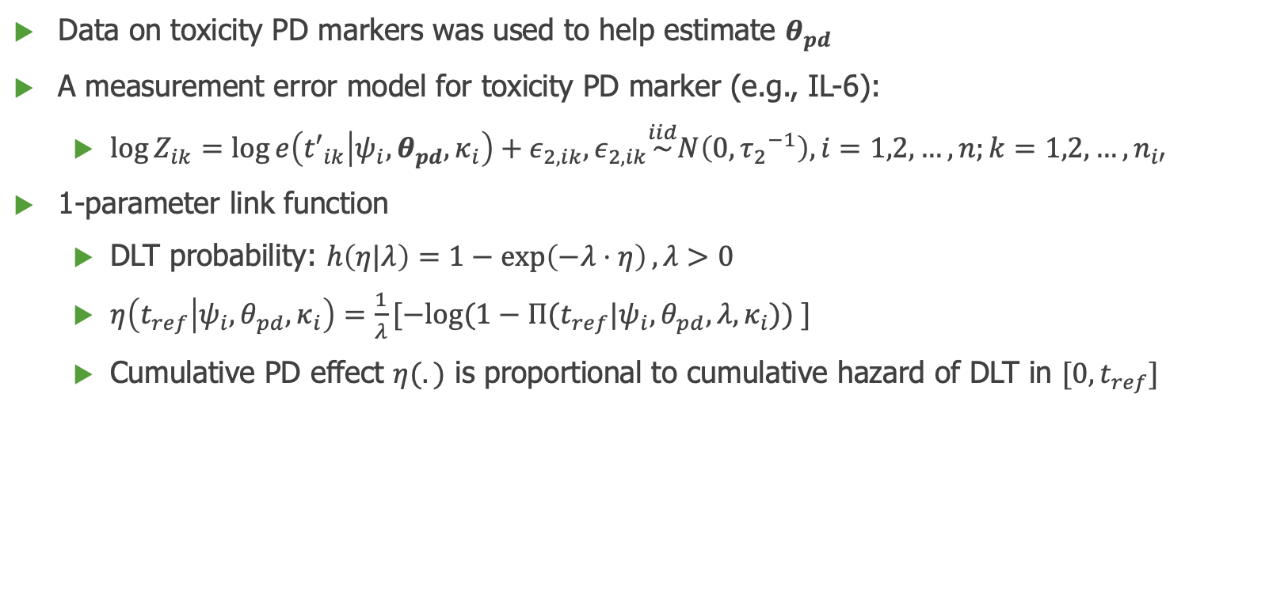
An extended SDF model framework (cont’d)
Data on toxicity PD markers was used to help estimate $θ_{pd}$
A measurement error model for toxicity PD marker (e.g., IL-6):
  $\log{Z_{ik}=\log{e\left({t′}_{ik} | ψ_{i},θ_{pd},κ_{i}\right)+ε_{2,ik},ε_{2,ik}\overset{iid}{\sim }N\left(0,{τ_{2}}^{−1}\right),i=1,2,…,n;k=1,2,…,n_{i′} }}$
1-parameter link function
  DLT probability: $h\left(η|λ\right)=1−\exp\left(−λ⋅η\right),λ>0$
  $η\left(t_{ref} | ψ_{i},θ_{pd},κ_{i}\right)=\frac{1}{λ}[−log(1−Π(t_{ref}|ψ_{i},θ_{pd},λ,κ_{i})) ]$
  Cumulative PD effect $η(.)$ is proportional to cumulative hazard of DLT in $[0,t_{ref}]$

Slide 8
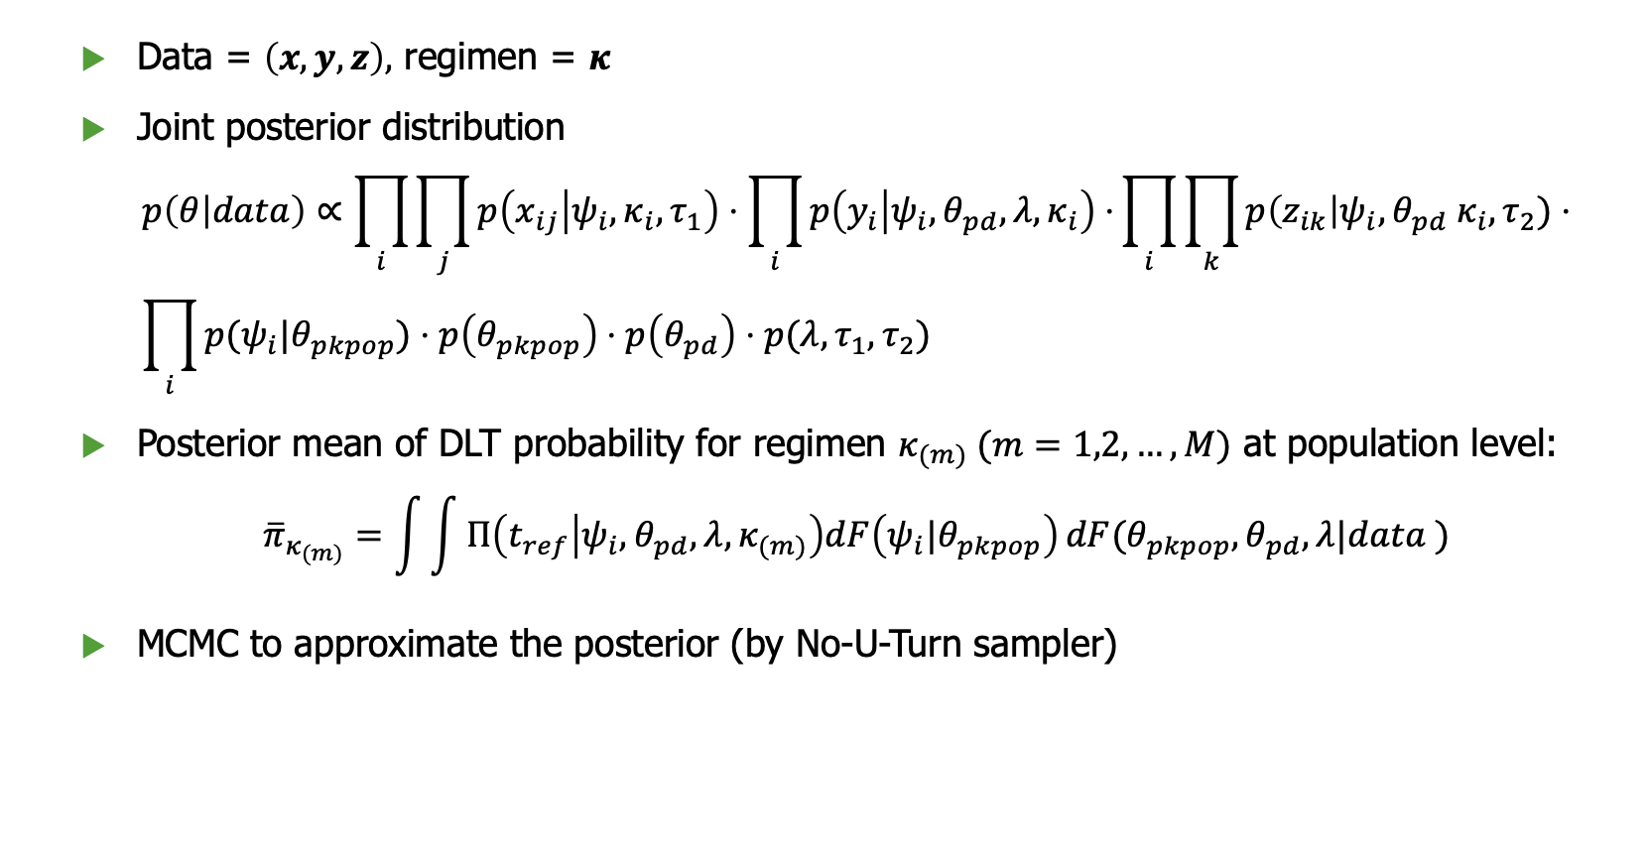
Posterior inference
Data = $\left(x,y,z\right),$ regimen = $κ$
Joint posterior distribution
$$p\left(θ | data\right)∝\prod_{i}{\prod_{j}{p\left(x_{ij} | ψ_{i},κ_{i},τ_{1}\right)⋅\prod_{i}{p\left(y_{i} | ψ_{i},{θ_{pd},λ, κ}_{i}\right)⋅}}}\prod_{i}{\prod_{k}{p\left(z_{ik}\right|ψ_{i},{θ_{pd} κ}_{i},τ_{2})⋅}} \\ \prod_{i}{p(ψ_{i}|θ_{pkpop})}⋅p\left(θ_{pkpop}\right)⋅p\left(θ_{pd}\right)⋅p(λ, τ_{1},τ_{2})$$
Posterior mean of DLT probability for regimen $κ_{(m)} (m=1,2,…,M)$ at population level:
$${\overline{π}}_{κ_{(m)}}=\int{\int{Π\left(t_{ref} | ψ_{i},θ_{pd},λ,κ_{(m)}\right)dF\left(ψ_{i}|θ_{pkpop}\right)}dF(θ_{pkpop}, θ_{pd}, λ|data )}$$
MCMC to approximate the posterior (by No-U-Turn sampler)

Slide 9
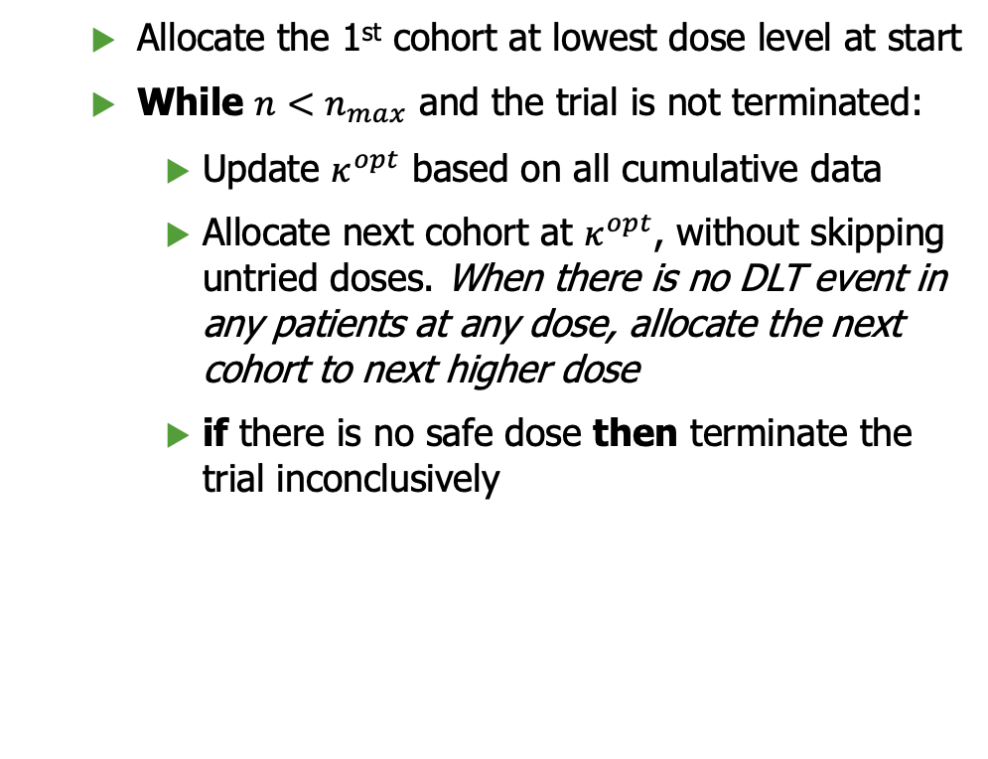
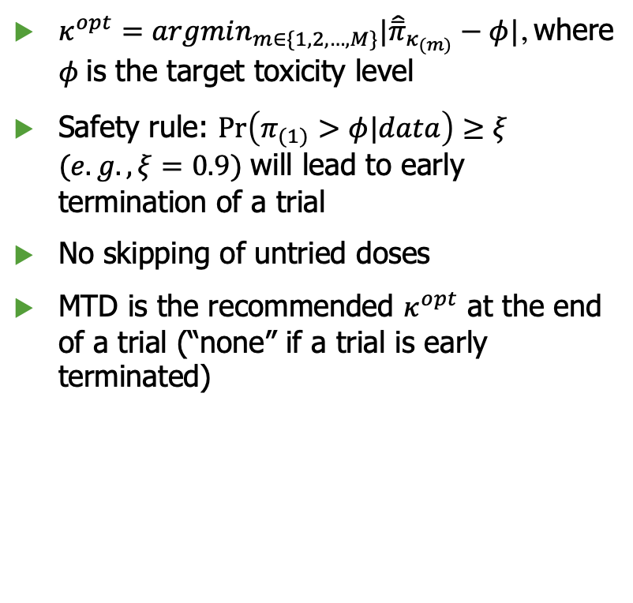
Dose-finding rules
Rules
Algorithm
$κ^{opt}=argmin_{m∈\{1,2,…,M\}}|{\hat{\overline{π}}}_{κ_{(m)}}−φ|$, where $φ$ is the target toxicity level
Safety rule: $\operatorname{Pr}\left(π_{(1)}>φ|data\right)≥ξ$ $(e.g., ξ=0.9)$ will lead to early termination of a trial
No skipping of untried doses
MTD is the recommended $κ^{opt}$ at the end of a trial (“none” if a trial is early terminated)
  Allocate the 1st cohort at lowest dose level at start
  While $n<n_{max}$ and the trial is not terminated:
    Update $κ^{opt}$ based on all cumulative data
    Allocate next cohort at $κ^{opt}$, without skipping untried doses. When there is no DLT event in any patients at any dose, allocate the next cohort to next higher dose
    if there is no safe dose then terminate the trial inconclusively

Slide 10
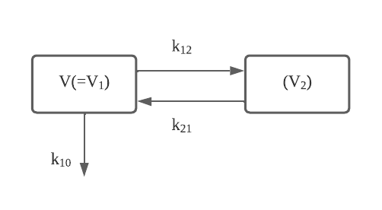
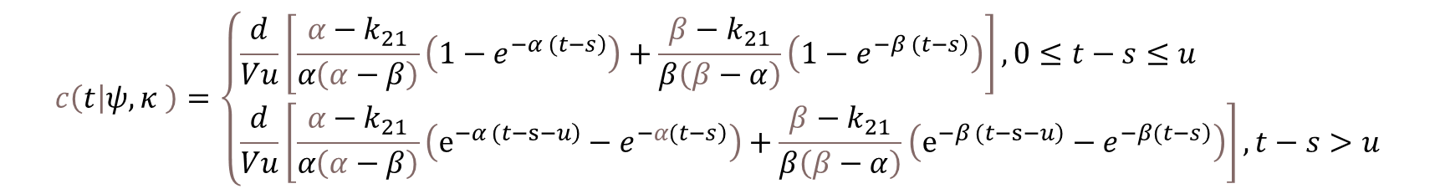
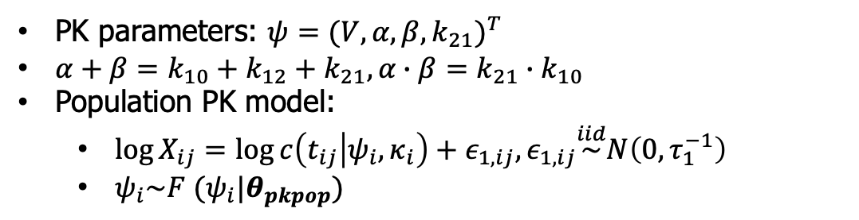
2-compartment IV infusion PK model
PK parameters: $ψ=({V,α,β,k_{21})}^{T}$
$α+β=k_{10}+k_{12}+k_{21},α∙β=k_{21}∙k_{10}$
Population PK model:
  $\log{X_{ij}=\log{c\left(t_{ij} | ψ_{i},κ_{i}\right)+ε_{1,ij},ε_{1,ij}\overset{iid}{\sim }N\left(0,τ_{1}^{−1}\right) }}$
  $ψ_{i}\sim F (ψ_{i}|θ_{pkpop})$
Mean plasma concentration at time $t$ with PK parameters $ψ$ and regimen $κ$:
$$c\left(t | ψ,κ \right)=\left\{\begin{aligned}&\frac{d}{Vu}\left[\frac{α−k_{21}}{α\left(α−β\right)}\left(1−e^{\left.−α (t−s\right)}\right)+\frac{β−k_{21}}{β\left(β−α\right)}\left(1−e^{\left.−β (t−s\right)}\right)\right],0≤t−s≤u \\ &\frac{d}{Vu}\left[\frac{α−k_{21}}{α\left(α−β\right)}\left(e^{\left.−α (t−s−u\right)}−e^{\left.−α(t−s\right)}\right)+\frac{β−k_{21}}{β\left(β−α\right)}\left(e^{\left.−β (t−s−u\right)}−e^{\left.−β(t−s\right)}\right)\right],t−s>u\end{aligned}\right.$$
Regimen $κ=\left(s,u,d\right),$ representing time point, duration, and dose of administration

Slide 11
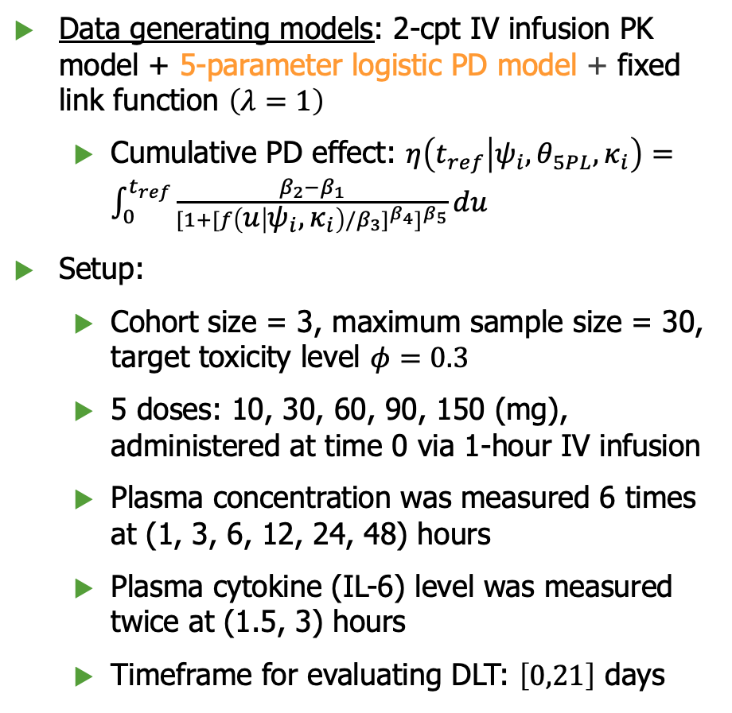
Simulation study
Data generating models: 2-cpt IV infusion PK model + 5-parameter logistic PD model + fixed link function $\left(λ=1\right)$
  Cumulative PD effect: $η\left(t_{ref} | ψ_{i},θ_{5PL},κ_{i}\right)=\int_{0}^{t_{ref}}{\frac{β_{2}−β_{1}}{{[1+{[f\left(u | ψ_{i},κ_{i}\right)/β_{3}]}^{β_{4}}]}^{β_{5}}}}du$
Setup:
  Cohort size = 3, maximum sample size = 30, target toxicity level $φ=0.3$
  5 doses: 10, 30, 60, 90, 150 (mg), administered at time 0 via 1-hour IV infusion
  Plasma concentration was measured 6 times at (1, 3, 6, 12, 24, 48) hours
  Plasma cytokine (IL-6) level was measured twice at (1.5, 3) hours
  Timeframe for evaluating DLT: $\left[0,21\right]$ days
The coefficient of variation (CV) is around 30% in AUC of concentration-time curve in these scenarios
For each scenario, operating characteristics (OCs) were summarized from 1000 simulations for each design

Slide 12
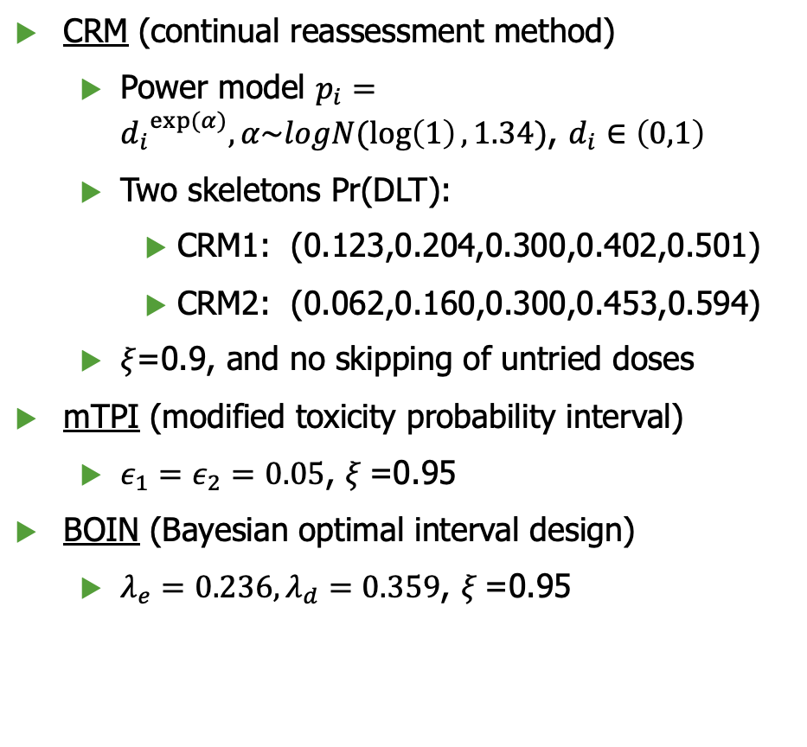
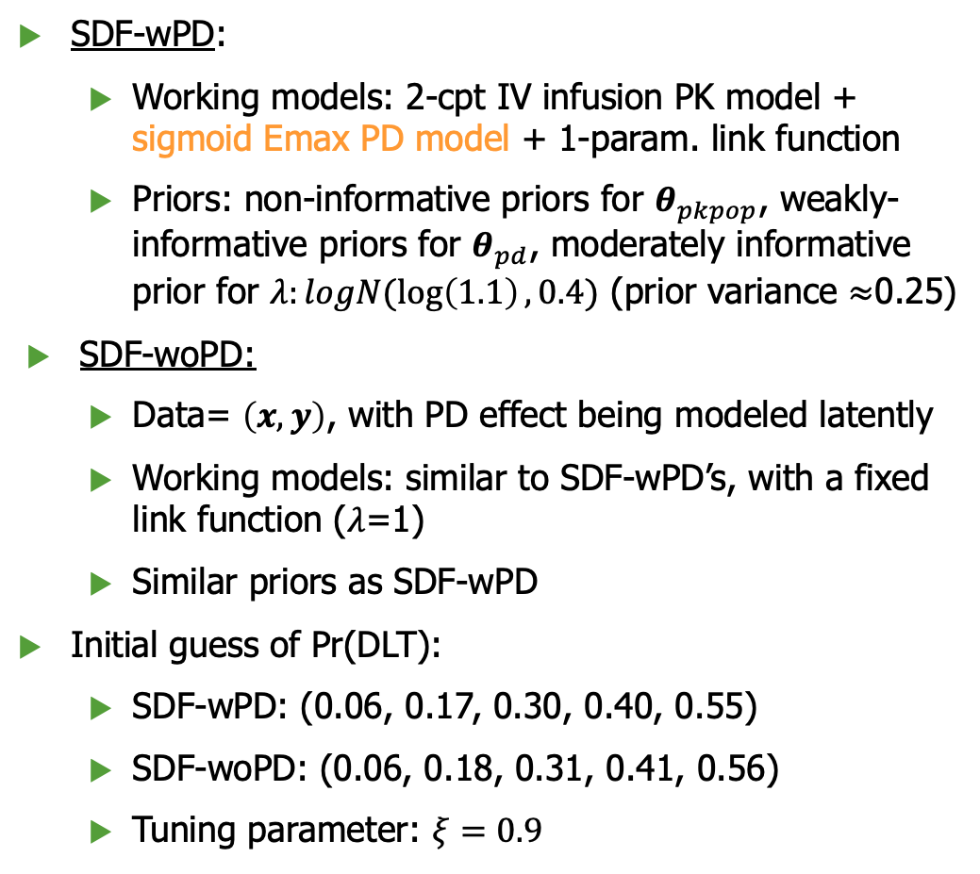
SDF-wPD and comparator designs
SDF-wPD:
  Working models: 2-cpt IV infusion PK model + sigmoid Emax PD model + 1-param. link function
  Priors: non-informative priors for $θ_{pkpop}$, weakly-informative priors for $θ_{pd}$, moderately informative prior for $λ:logN(\log\left(1.1\right),0.4)$ (prior variance $≈$0.25)
SDF-woPD:
  Data= $\left(x,y\right)$, with PD effect being modeled latently
  Working models: similar to SDF-wPD’s, with a fixed link function ($λ$=1)
  Similar priors as SDF-wPD
Initial guess of Pr(DLT):
  SDF-wPD: (0.06, 0.17, 0.30, 0.40, 0.55)
  SDF-woPD: (0.06, 0.18, 0.31, 0.41, 0.56)
  Tuning parameter: $ξ=0.9$
CRM (continual reassessment method)
  Power model $p_{i}={d_{i}}^{exp⁡(α)},α\sim logN(\log\left(1\right),1.34)$, $d_{i}∈\left(0,1\right)$
  Two skeletons Pr(DLT):
    CRM1: (0.123,0.204,0.300,0.402,0.501)
    CRM2: (0.062,0.160,0.300,0.453,0.594)
  $ξ$=0.9, and no skipping of untried doses
mTPI (modified toxicity probability interval)
  $ε_{1}=ε_{2}=0.05$, $ξ$=0.95
BOIN (Bayesian optimal interval design)
  $λ_{e}=0.236, λ_{d}=0.359$, $ξ$=0.95

Slide 13
Key OCs from different designs
Geometric mean of key OCs across scenarios
Design | PCS | Npts _{MTD}* | Tox. % | Npts _{>MTD}**
SDF-woPD | 58.3 | 10.5 | 27.8 | 7.2
SDF-wPD | 77.9 | 16.1 | 26.6 | 1.7
mTPI | 49.7 | 9.5 | 25.4 | 5.0
BOIN | 51.5 | 9.7 | 26.1 | 5.4
CRM1 | 57.0 | 10.6 | 28.2 | 8.0
CRM2 | 57.1 | 10.2 | 26.9 | 5.8
* Excluding scenario 5.
** Excluding scenarios 3 and 5.
On average SDF-wPD design outperforms comparator designs in terms of PCS (>10%) and patient allocation to MTD
All designs show similar overall toxicity rate
SDF-woPD design performs similarly as CRMs

Slide 14
Estimated dose-toxicity curve (with posterior mean at the end of a trial)
All designs provide fair estimate of dose-toxicity gradient around MTD
Estimated dose-toxicity curve from SDF-wPD design is closer to underlying truth, though showing an upward shift
Estimated DLT probability at MTD from SDF-woPD design shows large empirical variance
Estimation accuracy of DLT probability of
tried doses
MAE = mean absolute error, RMSE = root mean
squared error

Slide 15
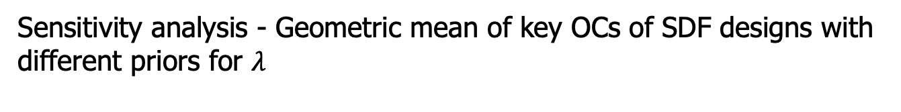
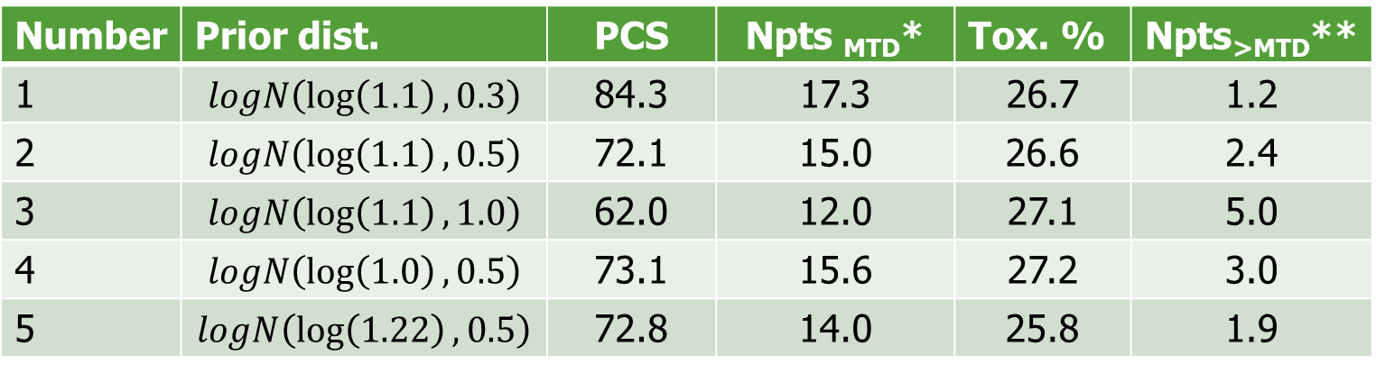
Sensitivity analysis - Geometric mean of key OCs of SDF designs with
different priors for $λ$
Number | Prior dist. | PCS | Npts _{MTD}* | Tox. % | Npts_{>MTD}**
1 | $$logN\left(\log\left(1.1\right), 0.3\right)$$ | 84.3 | 17.3 | 26.7 | 1.2
2 | $$logN\left(\log\left(1.1\right), 0.5\right)$$ | 72.1 | 15.0 | 26.6 | 2.4
3 | $$logN\left(\log\left(1.1\right), 1.0\right)$$ | 62.0 | 12.0 | 27.1 | 5.0
4 | $$logN\left(\log\left(1.0\right), 0.5\right)$$ | 73.1 | 15.6 | 27.2 | 3.0
5 | $$logN\left(\log\left(1.22\right), 0.5\right)$$ | 72.8 | 14.0 | 25.8 | 1.9
* Excluding scenario 5.
** Excluding scenarios 3 and 5.

Slide 16
Limitations
  When complex PK/PD models are used, posterior updating can be computationally intensive
  It is logistically challenging to have real-time PK/PD data available at each decision point
Conclusions
  The SDF-wPD design is applicable when the possible dose-concentration-cytokine-CRS pathway is reasonably understood, as in the context of our motivating trial
  Incorporating relevant PK/PD information related to DLT helps identify the MTD
  The prior specification for link parameter has an impact on design’s performance, but the proposed design still performs similarly as common designs when there is a moderate departure of its prior distribution from the truth

Slide 17
Extensions and future work
The performance of SDF design using multi-stage estimation method for PK/PD modeling is worth exploring in case of more complex PK/PD mechanisms
Straightforward extensions to other routes of drug administration (e.g., oral intake) and delivery systems (e.g., via nanoparticles)
Extensions of SDF design for phase I trials with multiple schedules or for drug combination trials
Extensions of SDF model framework to time-to-DLT outcome, incorporating an efficacy endpoint, etc.
Prior elicitation for PK and/or PD parameters using meta-analytic approach

Slide 18
Key references
Gerard, E., Zohar, S., Thai, H.T., Lorenzato, C., Riviere, M.K. and Ursino, M., 2022. Bayesian dose regimen assessment in early phase oncology incorporating pharmacokinetics and pharmacodynamics. Biometrics, 78(1), pp.300-312.
Su, X., Li, Y., Müller, P., Hsu, C.W., Pan, H. and Do, K.A., 2022. A semi‐mechanistic dose‐finding design in oncology using pharmacokinetic/pharmacodynamic modeling. Pharmaceutical statistics, 21(6), pp.1149-1166.
Yang, C. and Li, Y., An extended Bayesian semi-mechanistic dose-finding design for phase I oncology trials using pharmacokinetic and pharmacodynamic information. Manuscript under revision.

Slide 19
Thank you!
Questions?

Slide 20
Supplementary materials

Slide 21
Coverage probability (average length) of 95% credible interval for posterior
DLT probability at MTD and its neighboring doses
 | Scenario 1 |  |  |  | Scenario 3
Dose level | 3 | 4 | 5 | Dose level | 4 | 5
SDF-woPD | 0.979 (0.291) | 0.986 (0.337) | 0.937 (0.463) | SDF-woPD | 0.929 (0.302) | 0.944 (0.399)
SDF-wPD | 0.986 (0.179) | 0.985 (0.270) | 0.981 (0.354) | SDF-wPD | 0.989 (0.211) | 0.988 (0.267)
CRM1 | 0.978 (0.292) | 0.993 (0.322) | 0.853 (0.327) | CRM1 | 0.900 (0.293) | 0.874 (0.318)
CRM2 | 0.961 (0.281) | 0.947 (0.329) | 0.962 (0.323) | CRM2 | 0.755 (0.302) | 0.614 (0.321)
 | Scenario 2 |  |  |  | Scenario 4
Dose level | 1 | 2 | 3 | Dose level | 2 | 3 | 4
SDF-woPD | 0.941 (0.277) | 0.925 (0.340) | 0.940 (0.436) | SDF-woPD | 0.957 (0.284) | 0.962 (0.340) | 0.968 (0.411)
SDF-wPD | 0.965 (0.155) | 0.974 (0.253) | 0.973 (0.314) | SDF-wPD | 0.972 (0.173) | 0.973 (0.266) | 0.982 (0.316)
CRM1 | 0.893 (0.307) | 0.920 (0.333) | 0.936 (0.337) | CRM1 | 0.954 (0.284) | 0.974 (0.316) | 0.975 (0.325)
CRM2 | 0.889 (0.273) | 0.882 (0.322) | 0.842 (0.323) | CRM2 | 0.906 (0.261) | 0.905 (0.314) | 0.855 (0.317)
CP for DLT probabilities at MTD from SDF designs are close to 0.95
The average CrI length at MTD is smaller for SDF-wPD than CRM designs across these scenarios, and
similar at doses higher than the MTD

