Slide 1

Distribution-free Overlapping Indices for Efficient and Robust Information Borrowing in Bayesian Hierarchical Modeling
Xuetao Lu & J. Jack Lee
Department of Biostatistics

Slide 2

Outlines
Problem and assumption
Tasks and challenges
Overlapping indices and BHMOI
Simulation study and real data example
Conclusion

Slide 3
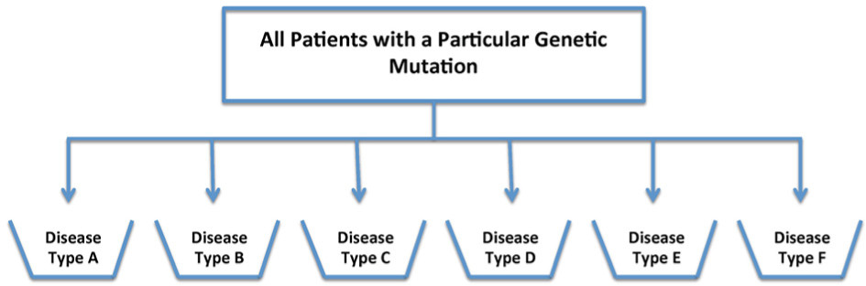

Problem and assumptions
1. External data is available
$$D_{E}= \left\{D_{E1}, …,D_{Em}\right\}$$
Power prior, Meta-analytic-predictive (MAP) prior, Commensurate prior, …
2. External data is not available + but the data includes multiple subgroups, e.g., basket trial data
Data:
$$y= \left\{ y_{1}, … … … … ,y_{n} \right\}$$
Parameter:
$$θ= \left\{ θ_{1}, … … … … ,θ_{n} \right\}$$

Slide 4
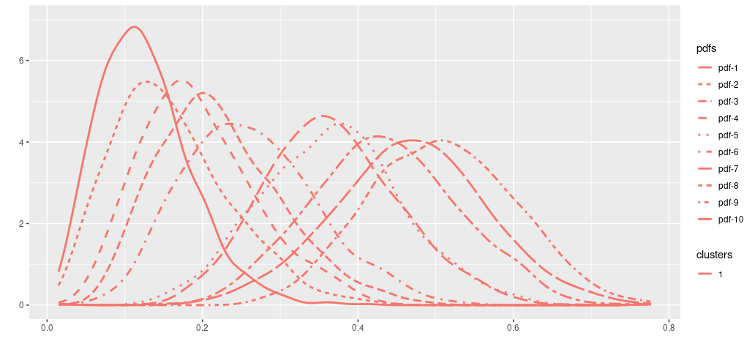


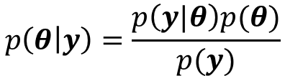



Problem and assumptions
Subgroups:
1 2 3 4 5 6 7 8 9 10
Simulated dataset 1:
$y=\frac{\text{\# }\text{responses}}{\text{\# }\text{patients}}$ :
{ 2/15, 0/3, 1/12, 6/28, 7/29, 3/29, 5/26, 1/5, 0/2, 3/20 }
$θ$:
$$\{ θ_{1} , … , { θ}_{10} \}$$
$$p\left(θ | y\right)=\frac{p\left(y|θ\right)p(θ)}{p(y)}$$
If $p(θ)$ is a non-informative prior
$$\left\{ {p(θ}_{1} | y\right), … ,{p(θ}_{10}\left|y\right) \}$$
Data:

Slide 5
Outlines
Problem and assumption
Tasks and challenges
Overlapping indices and BHMOI
Simulation study and real data example
Conclusion

Slide 6
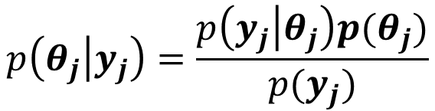
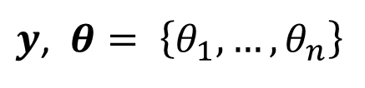
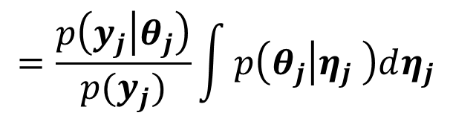
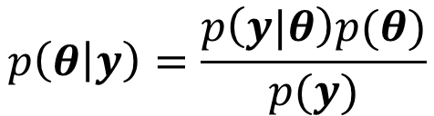
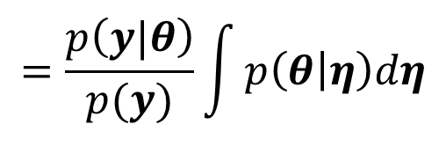



Within homogeneity and between heterogeneity
Exchangeability
$$p\left(θ | y\right)=\frac{p\left(y|θ\right)p(θ)}{p(y)}$$
$$=\frac{p\left(y|θ\right)}{p(y)}\int{p\left(θ | η\right)dη}$$
$y$, $θ= \left\{θ_{1}, …,θ_{n}\right\}$
Non-exchangeability
Between-cluster Non-exchangeability
Heterogeneous between $K$clusters
$$S : θ= \left\{θ_{1}, …,θ_{n}\right\}=\left\{θ_{1}, …,θ_{K}\right\}=\left\{\{θ_{11},…,θ_{1n_{1}}\}, …,\{θ_{K1},…,θ_{Kn_{K}}\}\right\}$$
Within-cluster exchangeability
Homogeneous within each cluster
$$p\left(θ_{j} | y_{j}\right)=\frac{p\left(y_{j} | θ_{j}\right)p(θ_{j})}{p(y_{j})}$$
$$=\frac{p\left(y_{j} | θ_{j}\right)}{p(y_{j})}\int{p\left(θ_{j} | η_{j} \right)dη_{j}}$$
$$θ_{j}=\{θ_{j1},…,θ_{jn_{j}}\}$$
$$j=1, …, K$$

Slide 7
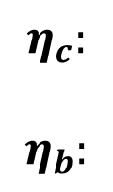
Tasks and challenges
$$η = \left\{ η_{c} {, η}_{b} , η_{o} \right\}$$
Clustering
Borrowing
All others for model specification
Tasks
Challenges
$$η_{c}:$$
$$η_{b}:$$
Heterogeneity identification with clustering
Trade-off between within-cluster homogeneity (higher, lower) and the efficient and robust information gain (weaker, stronger) in borrowing.
Dynamic information borrowing
Dynamically quantify borrowing strength in different clusters.

Slide 8
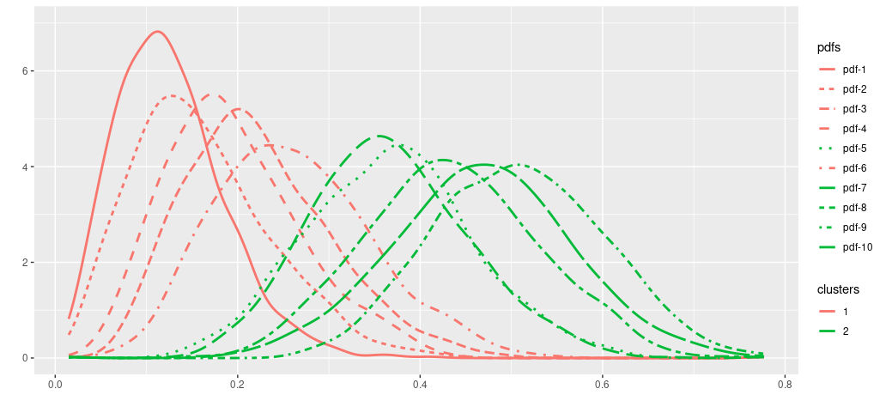
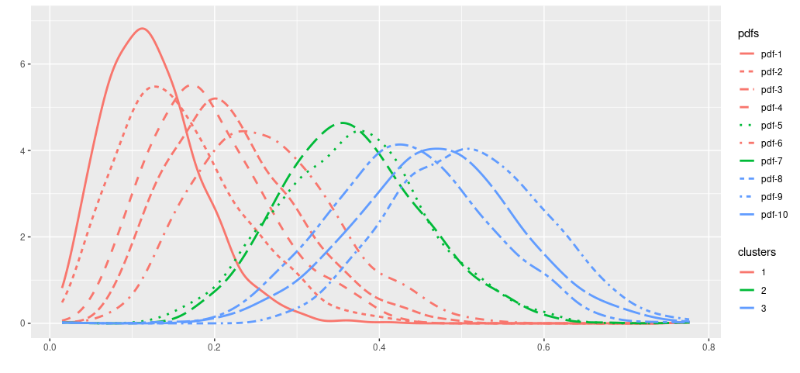

Borrowing strength (BS) in Cluster ?
Challenge 1: the trade-off
Simulated dataset 1:
$$\left\{ {p(θ}_{1} | y\right), …, { p(θ}_{10}\left|y\right) \}$$
BS in Cluster 1 ?
BS in Cluster 2 ?
Challenge 2:
quantifying borrowing strength
Data:
Efficiency and robustness of information gain in borrowing
Within-cluster homogeneity
BS in Cluster 1 ?
BS in Cluster 2 ?
BS in Cluster 3 ?

Slide 9


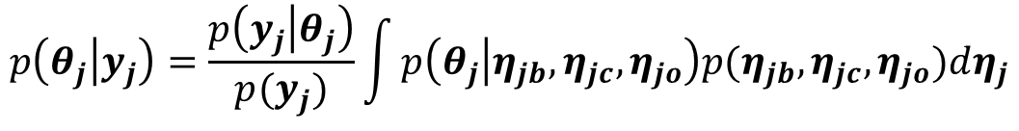
Tasks and challenges
$$η = \left\{ η_{c} {, η}_{b} , η_{o} \right\}$$
Clustering
Borrowing
All others for model specification
Tasks
Challenges
$$η_{c}:$$
$$η_{b}:$$
Heterogeneity identification with clustering
Trade-off between within-cluster homogeneity (higher, lower) and the efficient and robust information gain (weaker, stronger) in borrowing.
Dynamic information borrowing
Dynamically quantify borrowing strength in different clusters.
$$p\left(θ_{j} | y_{j}\right)=\frac{p\left(y_{j} | θ_{j}\right)}{p(y_{j})}\int{p\left(θ_{j} | η_{jb},η_{jc},η_{jo}\right)p(η_{jb},η_{jc},η_{jo})dη_{j}}$$
$$p\left(η_{jb},η_{jc}\right)p\left(η_{jo}\right)$$
$$p\left(η_{jb}|η_{jc}\right)p(η_{jc})$$

Slide 10
Outlines
Problem and assumption
Tasks and challenges
Overlapping indices and BHMOI
Simulation study and real data example
Conclusion

Slide 11
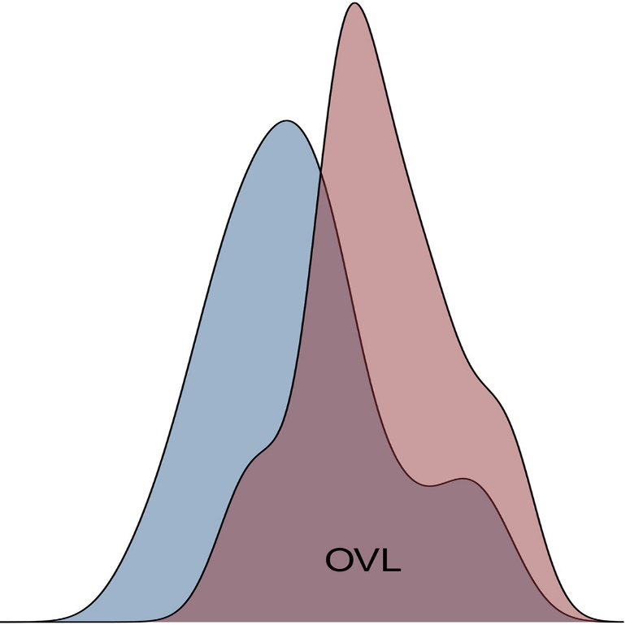


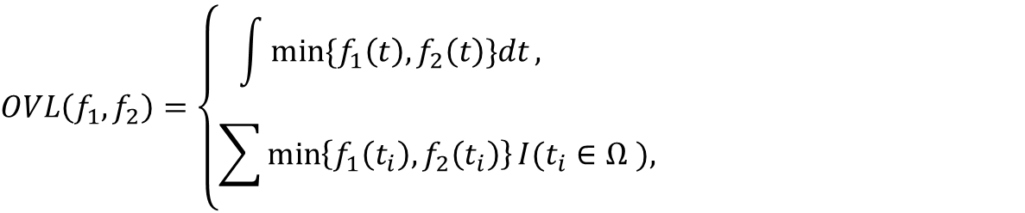
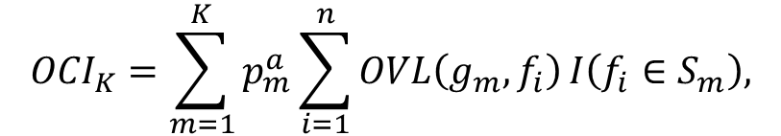






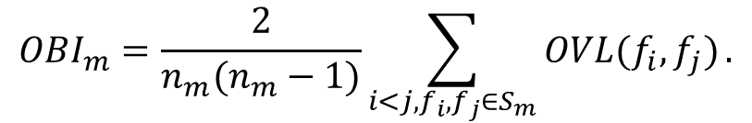
Overlapping indices
Overlapping Coefficient (OVL)
$$f_{1}$$
$$f_{2}$$
$$OVL\left(f_{1},f_{2}\right)=\left\{\begin{aligned}\int{min⁡\{f_{1}\left(t\right),f_{2}\left(t\right)\}dt}, \\ &\sum{\min\left\{f_{1}\left(t_{i}\right),f_{2}\left(t_{i}\right)\right\}}I(t_{i}∈Ω ), \end{aligned}\right.$$
$$pdf$$
$$Ω$$
$$pmf$$
$$Ω$$
Overlapping Clustering Index (OCI)
$${OCI}_{K}=\sum_{m=1}^{K}{p_{m}^{a}\sum_{i=1}^{n}{OVL\left(g_{m},f_{i}\right)}}I\left(f_{i}∈S_{m}\right),$$
$p_{m}=\frac{n_{m}}{n}$, $g_{m}=\frac{1}{n_{m}}\sum_{j=1}^{n_{m}}{f_{j}}$, $a∈\left(0,1\right].$
Overlapping Borrowing Index (OBI)
$${OBI}_{m}=\frac{2}{n_{m}(n_{m}−1)}\sum_{i<j,f_{i},f_{j}∈S_{m}}{OVL(f_{i},f_{j})}.$$
$${OBI}_{m}∈\left[0,1\right].$$
Notes:
We propose two novel overlapping indecis.

Slide 12


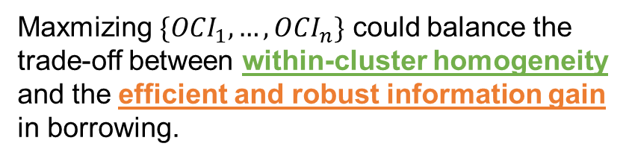


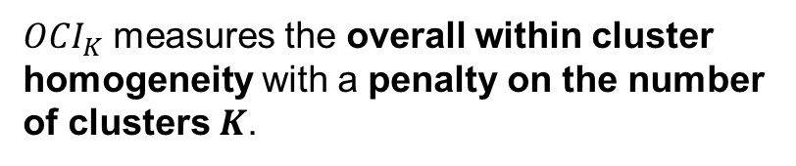




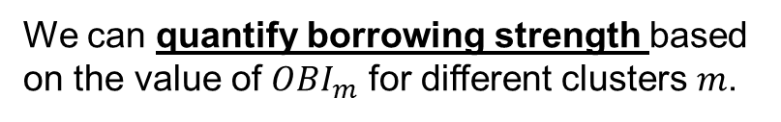


Simulated dataset 1:
$$\left\{ {p(θ}_{1} | y\right), …, { p(θ}_{10}\left|y\right) \}$$
${OCI}_{1}$ : 4.555
${OBI}_{1}$: 0.395
${OCI}_{K}$ measures the overall within cluster homogeneity with a penalty on the number of clusters $K$.
Maxmizing $\{{OCI}_{1},…,{OCI}_{n}\}$ could balance the trade-off between within-cluster homogeneity and the efficient and robust information gain in borrowing.
${OCI}_{2}$ : 5.397
${OBI}_{1}$: 0.632
${OBI}_{2}$: 0.648
Efficiency and robustness of information gain in borrowing
(Overall) Within-cluster homogeneity
${OBI}_{m}$measures the homogeneity in cluster $m$.
${OCI}_{3}$ : 5.100
${OBI}_{1}$: 0.632
We can quantify borrowing strength based on the value of ${OBI}_{m}$ for different clusters $m$.
${OBI}_{2}$: 0.852
${OBI}_{3}$: 0.767

Slide 13






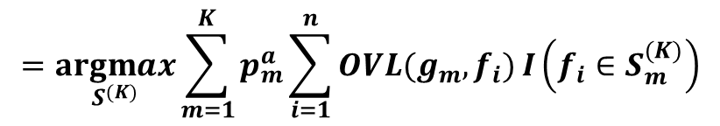

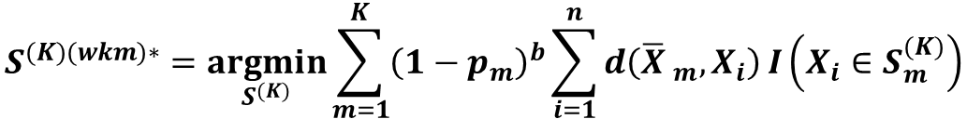


Simulated dataset 1:
$$\left\{ {p(θ}_{1} | y\right), …, { p(θ}_{10}\left|y\right) \}$$
Optimal $K$-partition
${OCI}_{1}$ : 4.555
$$S^{(1)(oci)∗}$$
$$S^{(K)(oci)∗}=\underset{S^{(K)}}{argmax}{ OCI}_{K}$$
$$=\underset{S^{(K)}}{argmax}{\sum_{m=1}^{K}{p_{m}^{a}\sum_{i=1}^{n}{OVL(g_{m},f_{i})}}}I\left(f_{i}∈S_{m}^{(K)}\right)$$
Weighted K-Means clustering
${OCI}_{2}$ : 5.397
$$S^{(K)(wkm)∗}=\underset{S^{(K)}}{argmin}{\sum_{m=1}^{K}{{\left(1−p_{m}\right)}^{b}\sum_{i=1}^{n}{d\left({\overline{X} }_{m},X_{i}\right)}}}I\left(X_{i}∈S_{m}^{(K)}\right)$$
$$S^{(2)(oci)∗}$$
$$S^{\left(K\right)\left(oci\right)∗} ≡{ S}^{\left(K\right)\left(wkm\right)∗}$$
Overall optimal partition
${OCI}_{3}$ : 5.100
$$S^{(2)(oci)∗}=S^{(oci)∗}$$
$$S^{(3)(oci)∗}$$
$${OBI}_{1}^{\left(oci\right)∗}=\text{0.632}$$
${OBI}_{2}^{\left(oci\right)∗}=$0.648

Slide 14




BHMOI
$p\left(η_{jb},η_{jc}\right)=p\left(η_{jb}|η_{jc}\right)p(η_{jc})≈$ $p\left(η_{jb}|S_{j}^{(oci)∗}\right)$ $=p\left(η_{jb}|{OBI}_{j}^{\left(oci\right)∗}\right)=p\left(η_{jb}|γ_{jb}=s({OBI}_{j}^{\left(oci\right)∗})\right)$
$$p\left(S^{∗} | y\right)≈1$$
$$p\left(η_{jb}|γ_{jb}\right)$$
$$γ_{jb}=s({OBI}_{j}^{\left(oci\right)∗})$$
$$p\left(θ_{j} | y_{j}\right)≈\frac{p\left(y_{j} | θ_{j}\right)}{p(y_{j})}\int{p\left(θ_{j} | η_{jo},η_{jb},η_{jc}\right)p\left(η_{jo}\right)p\left(η_{jb}|γ_{jb}=s({OBI}_{j}^{\left(oci\right)∗})\right)dη_{j}}$$
${S=S}^{(oci)∗}$,
BHMOI: Bayesian Hierarchical Model with Overlapping Indices

Slide 15
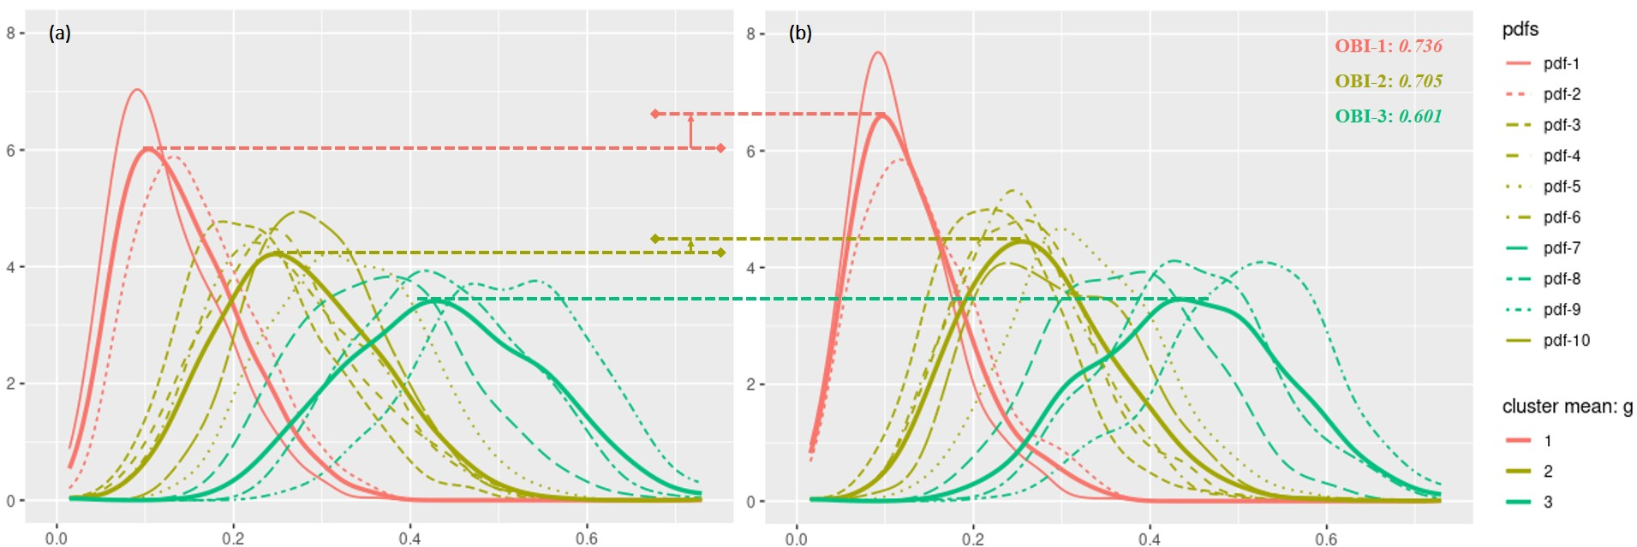

BHMOI – Dynamic Information Borrowing Example
Simulated dataset 2
$y=\frac{\text{\# }\text{responses}}{\text{\# }\text{patients}}$:
{ 2/25, 3/25, 5/25, 6/25, 8/25, 6/25, 9/25, 11/25, 13/25, 7/25}
Before information borrowing
After information borrowing
OBI-1: 0.736
OBI-2: 0.705
OBI-3: 0.601

Slide 16
Outlines
Problem and assumption
Tasks and challenges
Overlapping indices and BHMOI
Simulation study and real data example
Conclusion

Slide 17
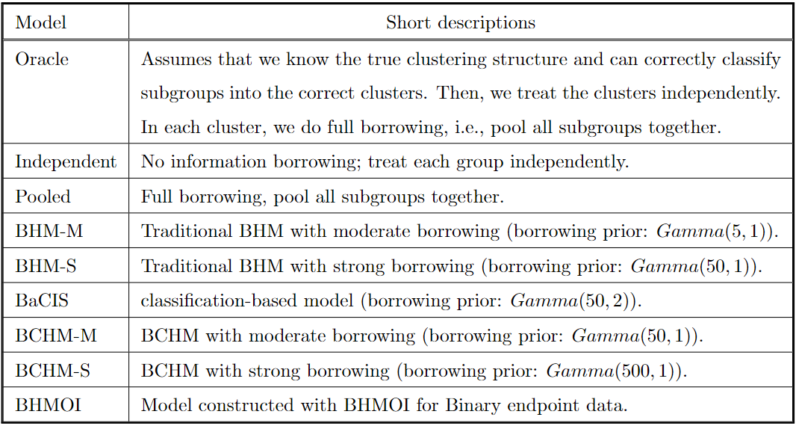
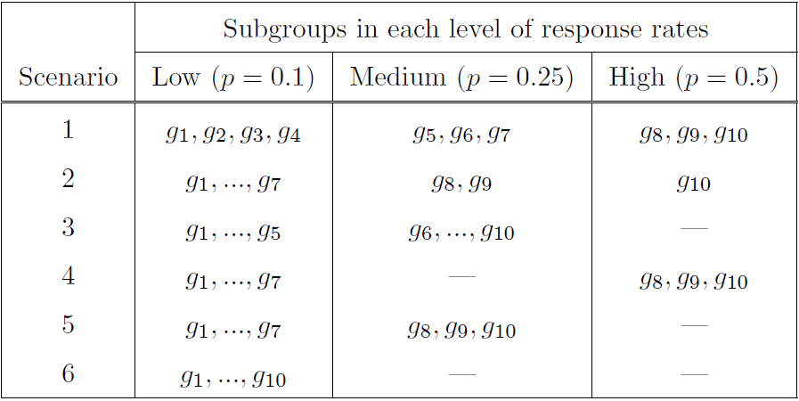
Simulation
3 clusters
2 clusters
1 cluster
Balanced clusters
Unbalanced clusters

Slide 18
Simulation
Criteria of comparison:
Operating Characteristics for Estimation (OCE): Mean Square Error (MSE).
Operating Characteristics for Hypothesis testing (OCH): type 1 error and power.

Slide 19
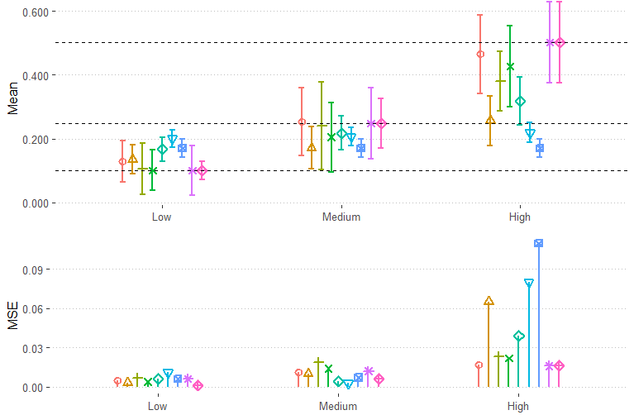
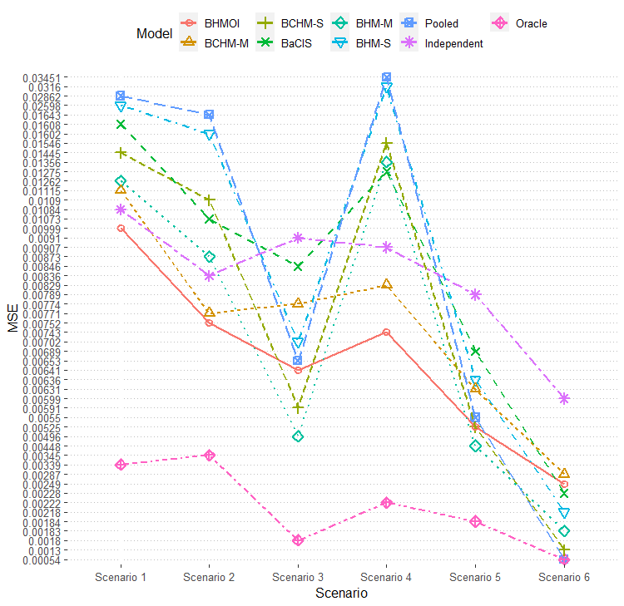
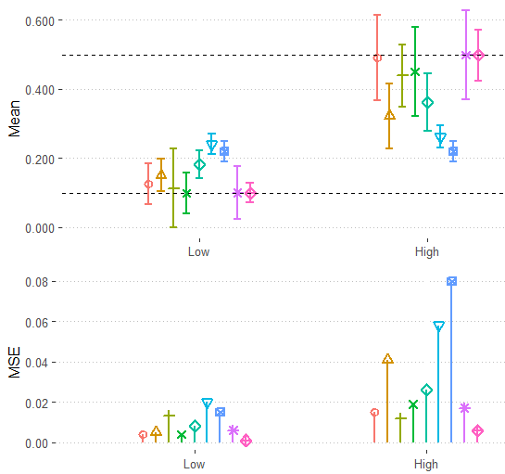
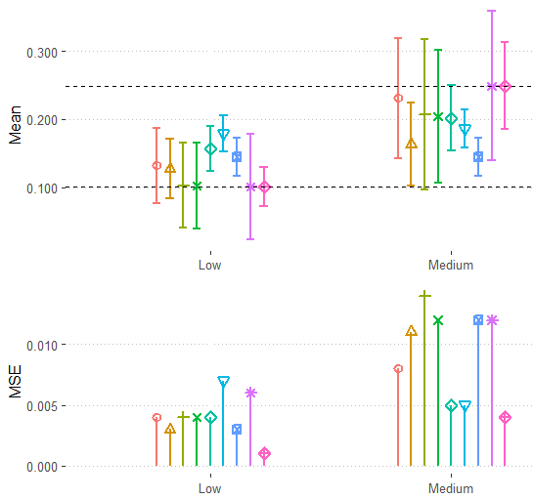






$$g_{1},⋯,g_{7}$$
$$g_{8},g_{9}$$
$$g_{10}$$
(b-2) Scenario 2
$$g_{8},g_{9},g_{10}$$
$$g_{8},g_{9},g_{10}$$
$$g_{1},⋯,g_{7}$$
$$g_{1},⋯,g_{7}$$
(b-4) Scenario 4
(b-5) Scenario 5

Slide 20
Simulation
Criteria of comparison:
Operating Characteristics of Estimation (OCE): Mean Square Error (MSE).
Operating Characteristics of Hypothesis testing (OCH): type 1 error and power.

Slide 21
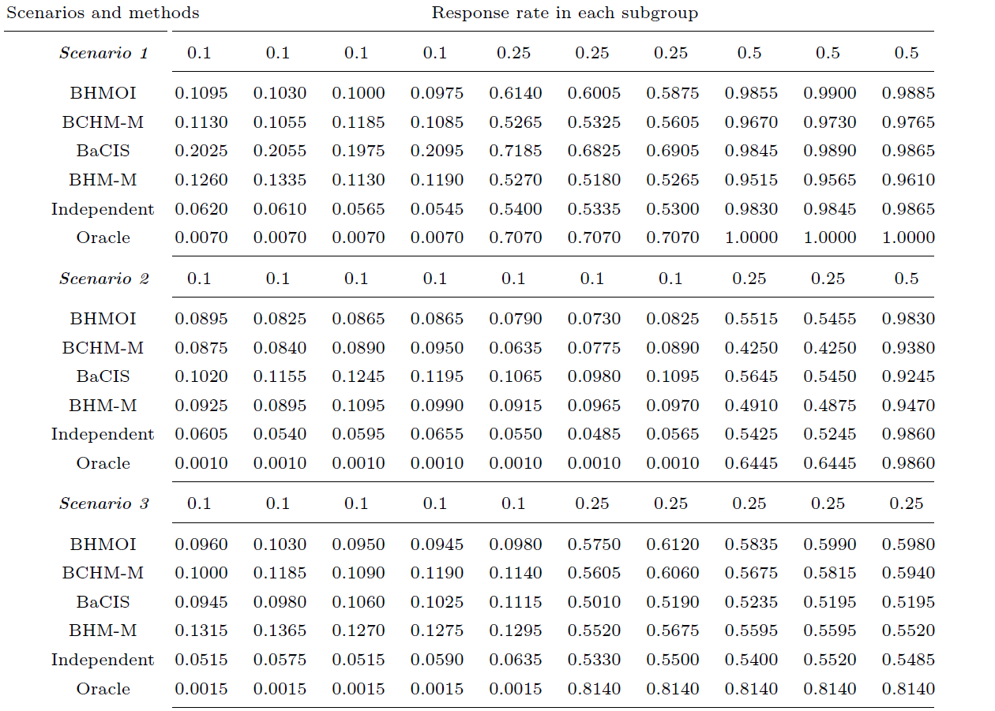
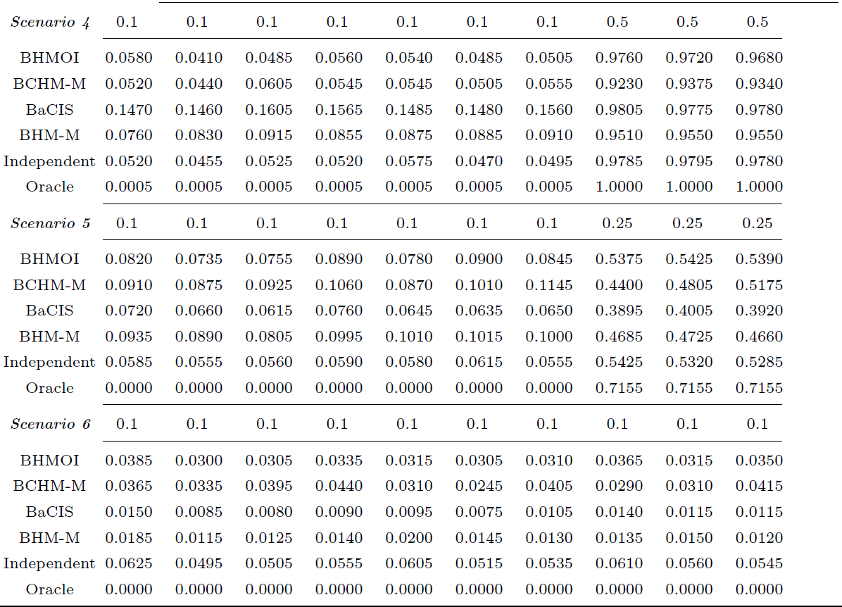
Response rates and clusters
Response rates and clusters
Note: the models, Pooled, BHM-S, and BCHM-S, are excluded due to their very poor performance.

Slide 22
Real data example
A phase II trial for testing the efficacy of imatinib in 10 different subtypes of advanced sarcoma: angiosarcoma, Ewing sarcoma, fibrosarcoma, leiomyosarcoma, liposarcoma, malignant fibrous histiocytoma, osteosarcoma, malignant peripheral nerve sheath tumor, rhabdomyosarcoma, and synovial subtypes.
[1]
Data:
Subgroups:
1 2 3 4 5 6 7 8 9 10
Responses / # patients in subgroup:
( 2/15, 0/3, 1/12, 6/28, 7/29, 3/29, 5/26, 1/5, 0/2, 3/20 )
BHMOI
Models:
BaCIS: Bayesian hierarchical Classification and Information Sharing
[2]
BCHM: Bayesian Cluster Hierarchical Model
[3]
[1] Chugh, R., Wathen, J. K., Maki, R. G., Benjamin, R. S., Patel, S. R., Myers, P. A., Priebat, D. A., Reinke, D. K., Thomas, D. G., Keohan, M. L., Samuels, B. L. & Baker, L. H. (2009), ‘Phase ii multicenter trial of imatinib in 10 histologic subtypes of sarcoma using a Bayesian hierarchical statistical model’, Journal of Clinical Oncology 27(19), 3148–3153.
[2] Chen, N. and Lee, J. J. (2019) Bayesian hierarchical classification and information sharing for clinical trials with subgroups and binary outcomes. Biometrical Journal, 61.
[3] Chen, N. and Lee, J. J. (2020) Bayesian cluster hierarchical model for subgroup borrowing in the design and analysis of basket trials with binary endpoints. Statistical Methods in Medical Research, 29, 2717–2732. PMID: 32178585.

Slide 23
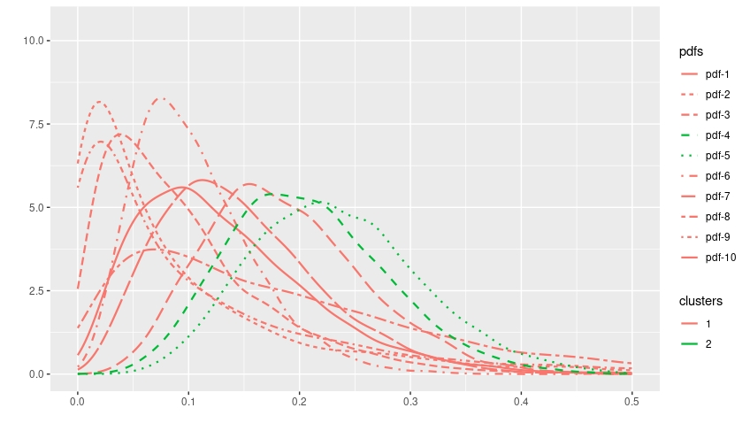
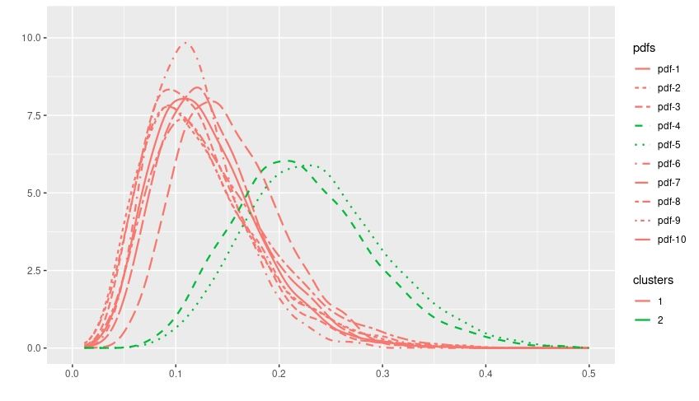
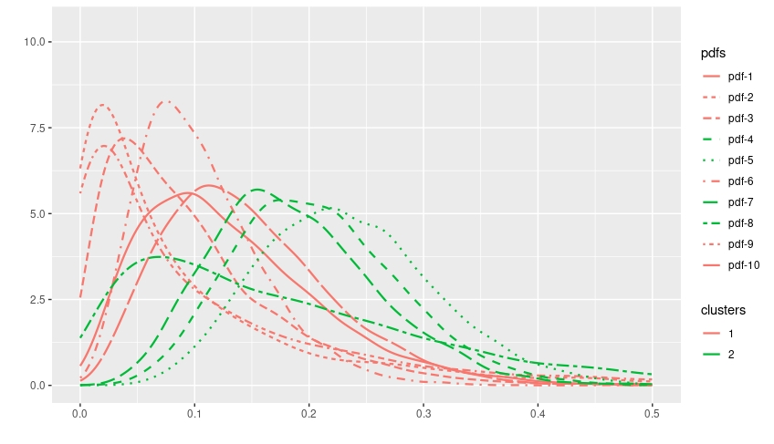
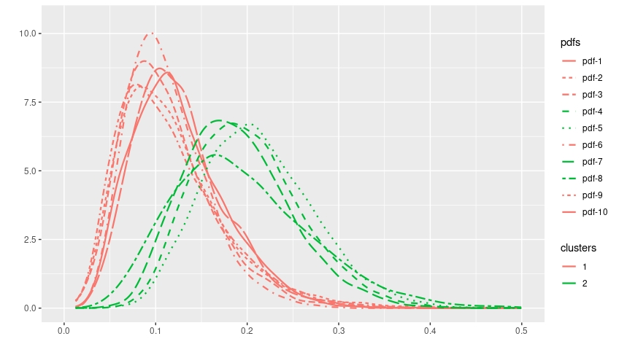
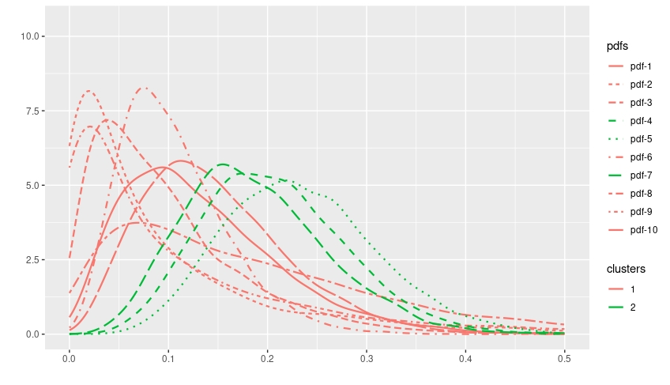
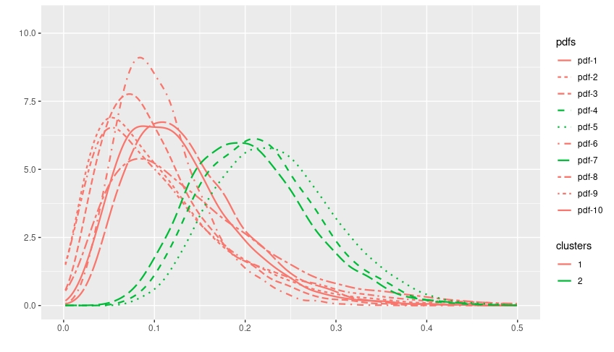





(a-1) Clustering without Borrowing
BaCIS
(a-2) After Information Borrowing
BaCIS
$$Gamma(α,β)$$
$$α=50,β=10$$
(b-1) Clustering without Borrowing
BCHM
(b-2) After Information Borrowing
BCHM
$$Gamma(α,β)$$
$$α=50,β=10$$
(c-1) Clustering without Borrowing
BHMOI
(c-2) After Information Borrowing
BHMOI
$$Gamma(α,β)$$
OBI-1: 0.818
OBI-2: 0.686
$$α=33.6,β=10$$
$$α=15.1,β=10$$

Slide 24
Outlines
Problem and assumption
Tasks and challenges
Overlapping indices and BHMOI
Simulation study and real data example
Conclusion

Slide 25
Conclusion
Contributions
Propose two overlapping indices (OCI and OBI) to address the problems and challenges of information borrowing in multiple subgroups data analysis.
Develop a novel method BHMOI by incorporating OCI and OBI with BHM to achieve efficient and robust dynamic information borrowing.
Future work
Apply BHMOI to synthesize priors by using heterogeneous external data.
Incorporate covariates (biomarkers) with BHMOI.

Slide 26
Thanks!

Slide 28
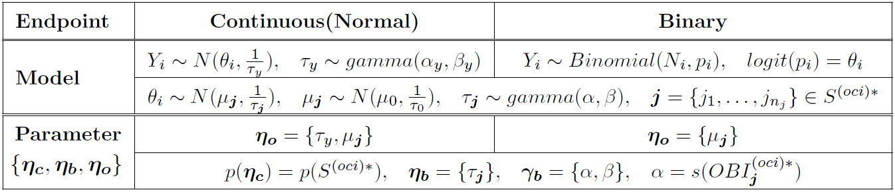

Slide 29

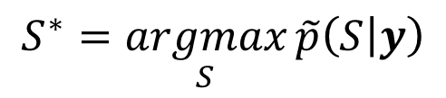

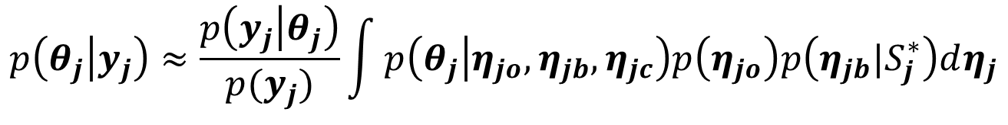


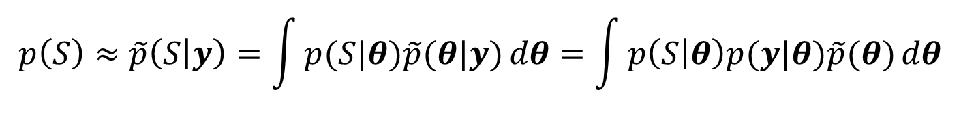

Heterogeneity identification
$$η_{b}→η_{c}$$
$$p\left(η_{jb}|η_{jc}\right)p(η_{jc})= ?$$
$$S : θ=\left\{θ_{1}, …,θ_{K}\right\}=\left\{\{θ_{11},…,θ_{1n_{1}}\}, …,\{θ_{K1},…,θ_{Kn_{K}}\}\right\}$$
$$p\left(η_{c}\right)=p\left(S\right)$$
$$p\left(S\right)≈\tilde{p}\left(S | y\right)=\int{p(S|θ)\tilde{p}(θ|y)}dθ=\int{p\left(S | θ\right)p(y|θ)\tilde{p}(θ)}dθ$$
$$p\left(S | θ\right) p\left(y | θ\right) \tilde{p}(θ)$$
Clustering algorithm
Data
Noninformative prior
$$\tilde{p}\left(S^{∗} | y\right)≈1$$
$$S^{∗}=\underset{S}{argmax}{\tilde{p}\left(S | y\right)}$$
$p\left(η_{jb}|η_{jc}\right)p(η_{jc})≈$ $p\left(η_{jb}|S_{j}^{∗}\right)$
$$p\left(θ_{j} | y_{j}\right)≈\frac{p\left(y_{j} | θ_{j}\right)}{p(y_{j})}\int{p\left(θ_{j} | η_{jo},η_{jb},η_{jc}\right)p\left(η_{jo}\right)p\left(η_{jb}|S_{j}^{∗}\right)dη_{j}}$$

Slide 30
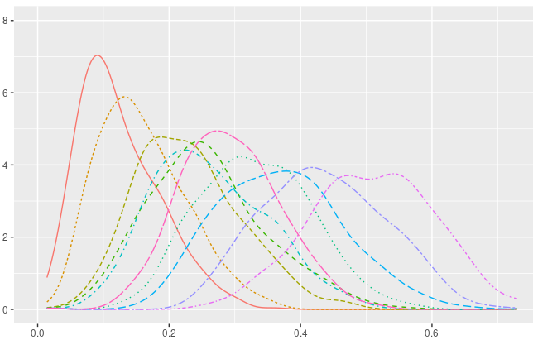
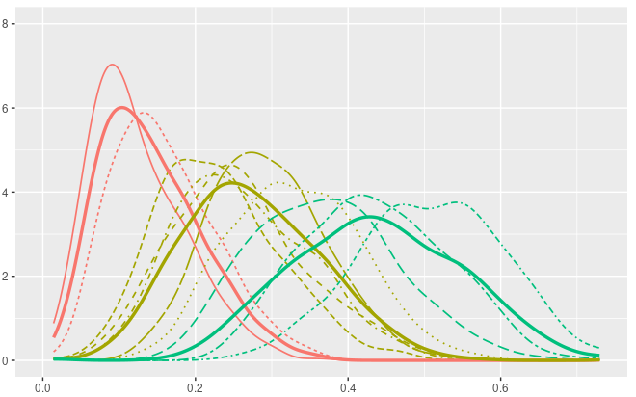
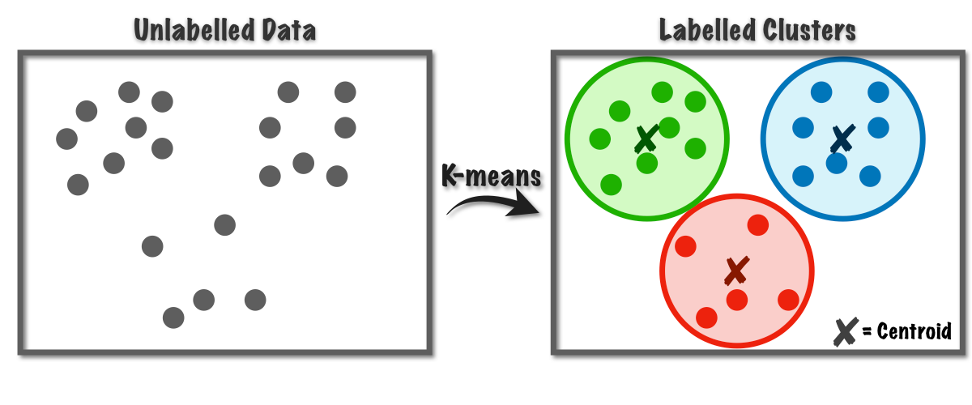
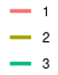



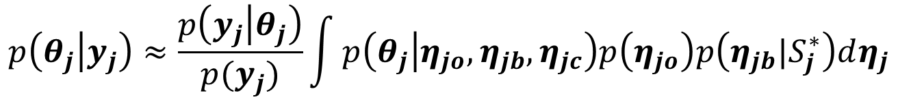
Heterogeneity identification
$$η_{b}→η_{c}$$
$$p\left(η_{jb}|η_{jc}\right)p(η_{jc})= ?$$
$$S : θ=\left\{θ_{1}, …,θ_{K}\right\}=\left\{\{θ_{11},…,θ_{1n_{1}}\}, …,\{θ_{K1},…,θ_{Kn_{K}}\}\right\}$$
$$p\left(η_{c}\right)=p\left(S\right)$$
$$p\left(S^{∗} | y, clustering algorithm\right)≈1$$
$p\left(η_{jb}|η_{jc}\right)p(η_{jc})≈$ $p\left(η_{jb}|S_{j}^{∗}\right)$
$$S^{∗}$$
$$p\left(θ_{j} | y_{j}\right)≈\frac{p\left(y_{j} | θ_{j}\right)}{p(y_{j})}\int{p\left(θ_{j} | η_{jo},η_{jb},η_{jc}\right)p\left(η_{jo}\right)p\left(η_{jb}|S_{j}^{∗}\right)dη_{j}}$$

Slide 31


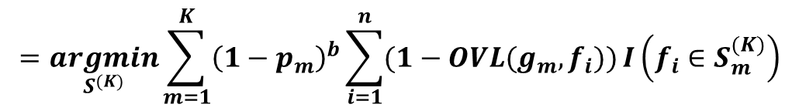
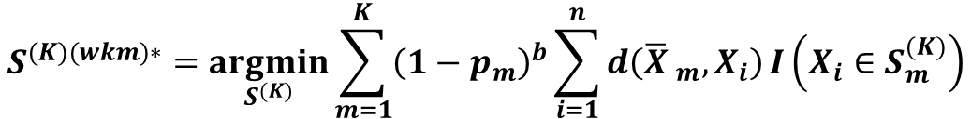
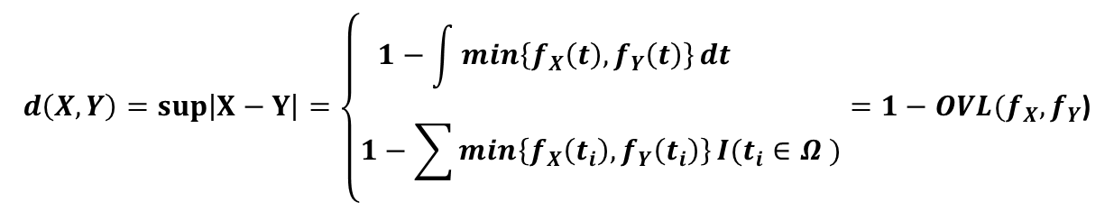
Maximizing ${OCI}_{K}$ and Weighted K-Means clustering
Maximizing ${OCI}_{K}$
$$S^{(K)(oci)∗}=\underset{S^{(K)}}{argmax}{ OCI}_{K}=\underset{S^{(K)}}{argmax}{\sum_{m=1}^{K}{p_{m}^{a}\sum_{i=1}^{n}{OVL(g_{m},f_{i})}}}I\left(f_{i}∈S_{m}^{(K)}\right)$$
$$d\left(X,Y\right)=sup\left|X−Y\right|=\left\{\begin{aligned}1−\int{\min\left\{f_{X}\left(t\right),f_{Y}\left(t\right)\right\}dt } \\ 1−\sum{\min\left\{f_{X}\left(t_{i}\right),f_{Y}\left(t_{i}\right)\right\}}I(t_{i}∈Ω )\end{aligned}\right.=1−OVL(f_{X},f_{Y}\text{)}$$
Total variance:
Weighted K-Means clustering
$$S^{(K)(wkm)∗}=\underset{S^{(K)}}{argmin}{\sum_{m=1}^{K}{{\left(1−p_{m}\right)}^{b}\sum_{i=1}^{n}{d\left({\overline{X} }_{m},X_{i}\right)}}}I\left(X_{i}∈S_{m}^{(K)}\right)$$
$$S^{(K)(oci)∗}=S^{(K)(wkm)∗} ‼!$$
$$=\underset{S^{(K)}}{argmin}{\sum_{m=1}^{K}{{\left(1−p_{m}\right)}^{b}\sum_{i=1}^{n}{(1−OVL(g_{m},f_{i}))}}}I\left(f_{i}∈S_{m}^{(K)}\right)$$

Slide 32
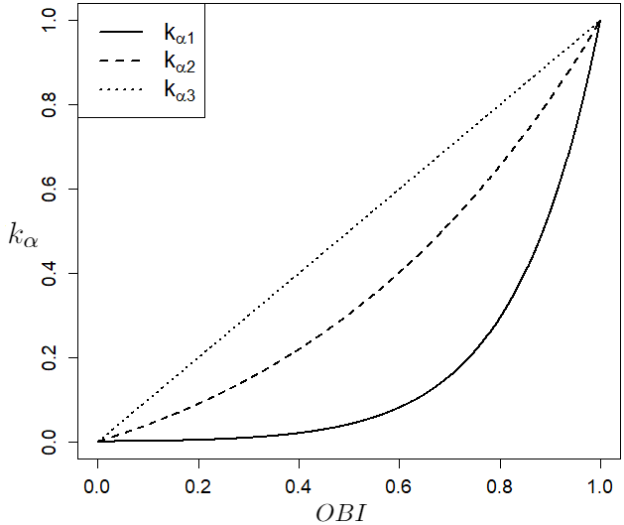

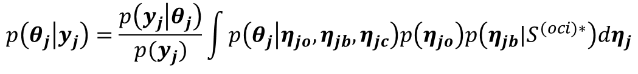





Embedding OBI into BHM
$$p\left(θ_{j} | y_{j}\right)=\frac{p\left(y_{j} | θ_{j}\right)}{p(y_{j})}\int{p\left(θ_{j} | η_{jo},η_{jb},η_{jc}\right)p\left(η_{jo}\right)p\left(η_{jb}|S^{(oci)∗}\right)dη_{j}}$$
$$p\left(η_{jb}|S^{(oci)∗}\right)=p\left(η_{jb}|{OBI}_{j}^{\left(oci\right)∗}\right)$$
$$p\left(η_{jb}|γ_{jb}\right)$$
$$γ_{jb}=s({OBI}_{j}^{\left(oci\right)∗})$$
For example :
$$p\left(η_{jb}|γ_{jb}\right)=Gamma(α,β)$$
$$γ_{jb}=\{α,β\}$$
Optimistic
$$\left\{\begin{aligned}β=10 \\ α=s\left(OBI\right)=α_{min}+k_{α}(OBI)(α_{max}−α_{min}) \end{aligned}\right.$$
Conservative
= 1
= 100
No borrowing
Full borrowing

Slide 33





The effects of parameters $a$ and $b$
(a-1)
(b-1)
a = 0.41
b = 0
a = 0.41
b = 5
(a-2)
(b-2)
a = 0.20
b = 0
a = 0.20
b = 5

Slide 34


Scenario 3
Response rates and clusters
Scenario 5
Response rates and clusters
Note: the models, Pooled, BHM-S, and BCHM-S, are excluded due to their very poor performance.

Slide 35






3-clusters
(a) Clustering without Borrowing
BHMOI
OBI-1: 0.926
OBI-2: 0.741
OBI-3: 0.818
(b) After Information Borrowing
BHMOI
$$Gamma(α,β)$$
$$α=64.3,β=10$$
$$α=21.1,β=10$$
$$α=33.6,β=10$$

