Slide 1
2018 Trial of the Year Award
SCT Annual Meeting
May 19 – 22, 2019

Slide 2
David Sackett Trial of the Year
Since 2008, the SCT annually awards the Trial of the Year to a randomized, controlled trial published in the previous calendar year that best fulfills the following standards:
It improves the lot of humankind;
It provides the basis for a substantial, beneficial change in health care;
It reflects the expertise in subject matter, excellence in methodology, and concern for study participants;
It overcomes obstacles in implementation; and
The presentation of its design, execution, and results is a model of clarity and intellectual soundness.

Slide 3
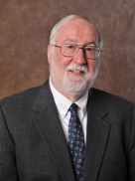
David Sackett
“Be loyal to people, not institutions.”
“Serve the young.”
“You become what you pretend to be.”
Notes:
Named after Dr. David SackettLong-time member and fellow of the Society for Clinical Trials, for his profound influence on the design, practice, analysis, and reporting of clinical trials; his leadership in the education of young clinical trialists, and his service to the society.

Slide 4
David Sackett Trial of the Year
Nominations come from Society members, investigators, and interested scholars from around the world.

Slide 5
The 2018 Trial of the Year Committee
Toshimitsu Hamasaki
Frank Rockhold
Yves Rosenberg
Dan Rubin
Marc Buyse
Bob Dworkin
Susan Ellenberg
Scott Evans, Chair
Dean Follmann

Slide 6
David Sackett Trial of the Year
HISTORY

Slide 7
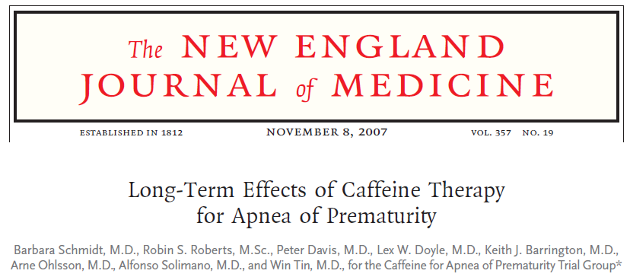
2007 Trial of the Year
A randomized placebo-controlled trial that demonstrated caffeine therapy for apnea of prematurity improves the rate of survival without neurodevelopmental disability.

Slide 8
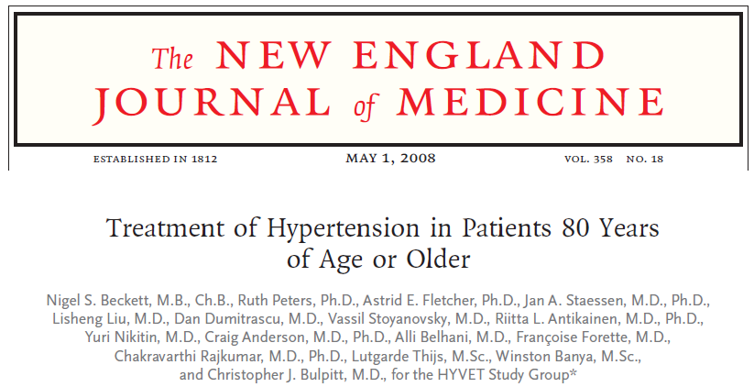
2008 Trial of the Year
A randomized placebo-controlled trial that demonstrated antihypertensive treatment with indapamide in persons 80 years of age or older reduced the rates of mortality, stroke, and heart failure.

Slide 9
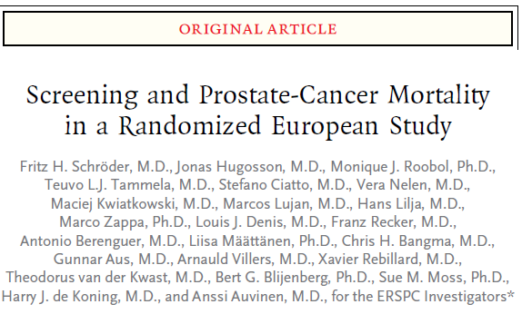
2009 Trial of the Year
A randomized controlled trial that demonstrated PSA-based screening reduced the rate of death from prostate cancer by 20% though was associated with a high risk of overdiagnosis.

Slide 10
2010 Trial of the Year
A cluster-randomized randomized controlled trial that demonstrated a participatory intervention reduced the neonatal mortality rate.

Slide 11
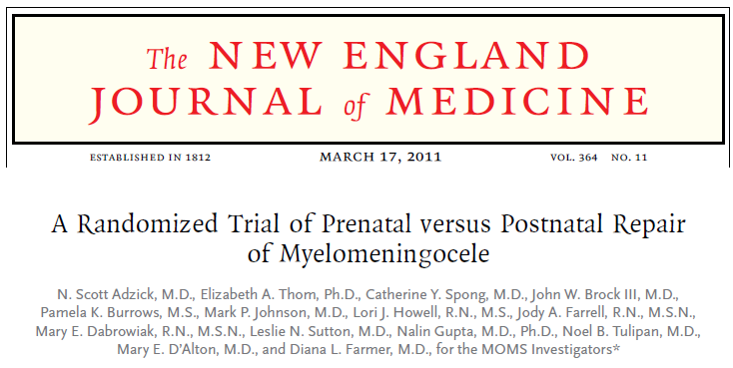
2011 Trial of the Year
Advances in prenatal screening/diagnosis provided the opportunity to compare prenatal vs. postnatal correction.
Pre-natal surgery reduced the need for shunting and improved motor outcomes.
Prenatal surgery is now available at several specialist centers in the US.
The most common and serious form of spina bifida occurs when the spinal cord and surrounding nerves push through the vertebrae and protrude from the fetus’ back.
The standard treatment was to close the defect soon after birth.

Slide 12
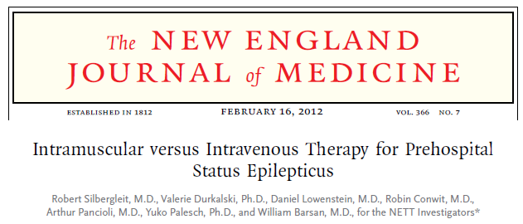
2012 Trial of the Year
A randomized double-blind noninferiority trial that demonstrated for subjects in status epilepticus, intramuscular midazolam is at least as effective as intravenous lorazepam for prehospital seizure cessation.

Slide 13
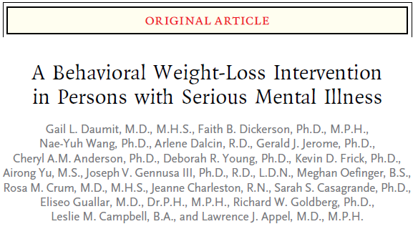
2013 Trial of the Year
A randomized controlled trial that demonstrated a behavioral weight-loss intervention significantly reduced weight in overweight and obese adults with serious mental illness.

Slide 14
2014 Trial of the Year
A pragmatic, cluster-randomised trial that demonstrated in subjects with non-traumatic, out-of-hospital cardiac arrest, mechanical CPR devices for routine use does not improve survival.

Slide 15
2015 Trial of the Year
A randomized controlled trial that demonstrated that early introduction of peanuts significantly decreased the frequency of the development of peanut allergy among children at high risk for this allergy and modulated immune responses to peanuts.

Slide 16
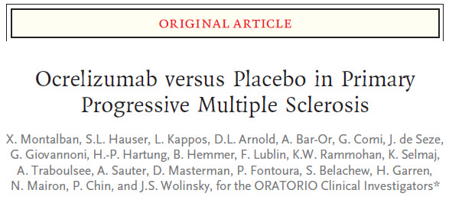
2016 Trial of the Year
Primary progressive multiple sclerosis (PPMS) accounting for 10-15% of all MS, is a characterized by progression of disability from disease onset.
The ORATORIO trial demonstrated that ocrelizumab, a humanized anti-CD20 monoclonal antibody directed against CD20-expressing B-cells, delayed neurological worsening compared to placebo in patients with PPMS. It is the first FDA-approved therapy for the treatment of PPMS.

Slide 17
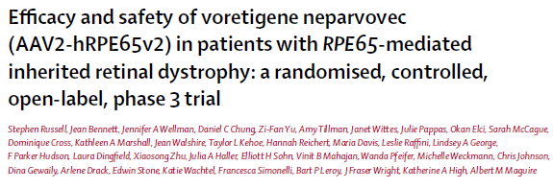
2017 Co-Trial of the Year
A randomized controlled trial that demonstrated that Voretigene neparvovec was superior to controls with respect to the change in functional vision in patients with an inherited retinal dystrophy. It represented the first available treatment for these patients who would otherwise progress to blindness.
As the first trial providing the basis for US regulatory approval for a gene-based therapy, it provided an important break-through in the development of gene-based therapies for inherited genetic diseases.

Slide 18
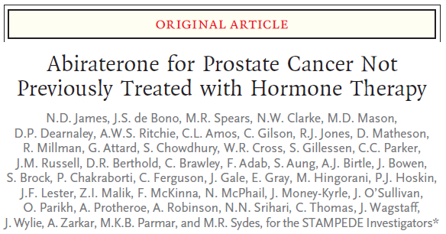
2017 Co-Trial of the Year
STAMPEDE demonstrated improved survival by adding: (i) docetaxel chemotherapy, and (ii) abiraterone to the five-decade standard-of-care of long-term hormone therapy.
STAMPEDE is the first implementation of the multi-arm multi-stage (MAMS) platform design allowing for the contemporaneous evaluation of multiple treatments compared to a common control.
Prostate cancer is the most common male cancer.
STAMPEDE is a trial for men who have a high-risk metastatic disease or has other aggressive features.

Slide 19
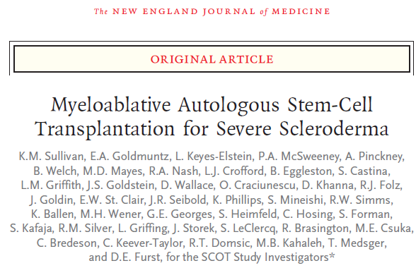
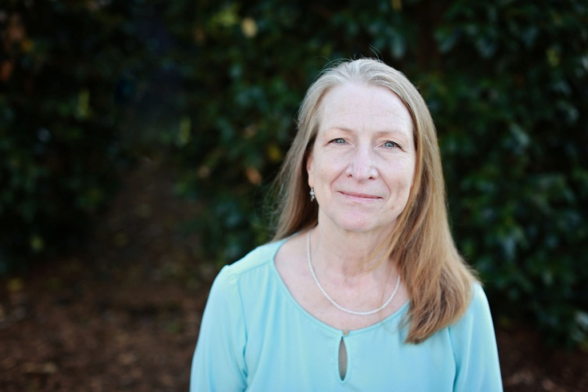
2018 Trial of the Year
Scleroderma: Cyclophosphamide or Transplantation (SCOT)
•
Lynette Keyes-Elstein
Principal Statistical Scientist
Rho Federal Systems

Slide 20
The Society for Clinical Trials
Discussants
•
Lesley Ann Saketkoo
Doctor of the Year
Scleroderma Foundation
Dean Follmann
Biostatistics Research Branch
NIAID / NIH

