Slide 1
Developing a hospital-integrated system for electronic patient-reporting, detection and management of symptoms and complications after surgery
Kerry Avery, Hollie Richards, Amanda Portal, Trudy Reed, Ruth Harding, Rob Carter, Kate Absolom, Galina Velikova, Jane Blazeby
Centre for Surgical Research, University of Bristol, UK
Notes:
… work we are undertaking at the CSR in Bristol to develop a HIE system for the DM…
-------------------------------------------------------------------------------------------------------------------------------
Data Management, Session #13 at the upcoming SCT meeting on Tuesday, May 21st @ 2:00 PM. As a reminder, each presenter will have 15 min allotted including any questions from the audience. It’s very important that we stay on time, so I would aim for roughly a 12 minute presentation with about 2-3 minutes for questions.
In order keep the session talks as cohesive as possible, I would appreciate it if you could send me your slides by the close of business on Tuesday, May 14th. They don’t have to be 100% final. This will allow me time to review prior to the session and generate relevant questions in case the audience doesn’t have any. Also, please send me a short introduction sentence that I can use to introduce your presentation.
I’m looking forward to the meeting and hearing each of your talks.
Thanks!
Julia

Slide 2
Major abdominal surgery for UGI cancer
Gullet, stomach, liver, pancreatic, biliary cancer
Significant impact on patients’ quality of life
30% of patients experience complications or require community care post-discharge
20% of gullet/stomach cancer patients die < 12m
Notes:
Major abdominal surgery for upper gastrointestinal (upper GI) cancer, such as…, significantly impacts on many aspects of patients’ QOL.
Up to 30% of UGI surgery patients experience complications or require community care.
And 20% of pts die within first 12m after surgery.

Slide 3
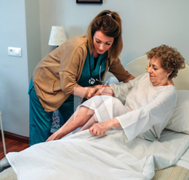
The ERAS era
“Enhanced recovery after surgery” (ERAS):
… counselling, nutrition, early mobilisation…
Shorter hospital stays → reduced information → poor pain management & anxiety
Fragmented care after discharge
Once at home:
Distinguish typical vs atypical symptoms
Delayed help-seeking
Late detection → poor outcomes, impaired QOL, emergency admissions
Notes:
In recent years, Enhanced Recovery After Surgery/ERAS protocols have been increasingly introduced. Key elements of ERAS protocols include pre-operative counselling, optimised nutrition and early mobilisation, with the aim of achieving early recovery after surgery. This means that patients are increasingly discharged from hospital sooner. While earlier discharge may be feasible and safe, shorter hospital stays are associated with reduced provision of patient information and symptom SMA. As a result, patients recovering at home may report unsatisfactory pain management and increased anxiety. Also, ERAS protocols are not standardised and do not routinely encompass the post-discharge recovery period, meaning that post-discharge care is often fragmented. In some hospitals, patients may be followed-up through phone calls from nurse specialists, but this practice varies between hospitals. Once at home, detection of problems and complications relies on the patient’s ability to distinguish between typical and atypical symptoms and accessing appropriate clinical services. However, patients may lack confidence about when to contact a health professional outside of routine clinical appointments, which can delay them seeking help. Late detection of complications after discharge can lead to poor outcomes, impaired health-related quality of life and increased emergency department admissions.
----------------------------------------------------
Advances in peri-operative Enhanced Recovery After Surgery (ERAS) protocols mean that patients are increasingly discharged from hospital sooner.
Fragmented between different hospital departments and areas of primary and secondary care
With patients increasingly being discharged within a week or 10 days of surgery, it is vital that early discharge is safe, because complications occurring at home may go undetected.
And late detection and treatment may lead to poor outcomes, impaired QOL and increased emergency admissions. Prompt identification of serious complications and AEs is therefore important to improve patient safety and outcomes.
Even without clinical complications patients are still going to be experiencing troublesome symptoms and many will have to adapt to new eating habits or make changes to their lifestyle as a result of their surgery. They’re likely to experiencing a lot of uncertainty about how to manage symptoms and can feel unsure about how to make sense of the information they’ve received.
Currently, reporting of potential AEs relies on the patient being able to distinguish between these typical symptoms such as shortness of breath after being physically active, and those symptoms which are clinically significant, such as shortness of breath at rest.
The routine collection of PRO data during the initial stages of recovery could be one way to improve the early detection of AEs and support patients in managing typical symptoms.

Slide 4
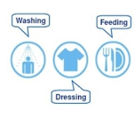
Integration of PROMs into clinical practice
Symptom monitoring & detection of complications (cancer)
Prompt intervention & symptom management (cancer)
Improved quality of life & survival (chemotherapy)
Quicker return to usual activities after surgery (benign conditions)
Notes:
Studies shows that incorporating patient-reported outcome measures/PROMs into routine CP can enhance symptom monitoring and the detection of complications in cancer pts, enabling prompt intervention and improved symptom management.
There is also some evidence that routine use of PROMs can improve HRQL and survival in patients undergoing chemotherapy.
There are fewer studies in surgery, but emerging evidence from pts undergoing surgery for benign conditions shows that the use of PROMs results in a quicker return to usual activities.

Slide 5
Benefits of electronic PROMs (ePROM)
Remote data capture post-discharge
Algorithms & severity-dependent clinician alerts
Individually-tailored patient feedback
Real-time integration with electronic records
Consider PROs alongside clinical data
Offer prompt intervention
Plan appropriate care
But… no ePROM for surgical oncology patients
Notes:
Use of electronic platforms to administer PROMs offers several benefits.
They allow data to be captured remotely after pts have left hospital.
They can incorporate clinical algorithms to evaluate data in real time, and alert healthcare providers when severity reaches a pre-determined threshold.
These clinical algorithms may also take into account individual pt/clinical characteristics (e.g. disease stage, surgical procedure, time since operation) to provide patients with the most relevant individually-tailored advice to support their recovery.
Finally, integration of PROMs with EPR can provide clinicians with access to ‘real-time’ data, enabling clinicians to consider patient-reported symptoms alongside other clinical data, offer prompt intervention, and optimally plan appropriate care.
To date, however, such a fully-functional system for patients undergoing MACRS, is lacking.
-------------------------------------------------------------------
Several of the ePRO systems developed to date are intended for the oncology setting [26-28]. Most, however, are targeted to patients undergoing chemotherapy, including the STAR system for patients with breast, genitourinary, gynaecological or lung cancer in the US [26] and the ASyMS system for patients with lung, breast and colorectal cancer in the UK [27]. Comparably, few ePRO systems have been developed specifically for patients undergoing surgery for cancer.
an ePRO system for patients undergoing surgery for cancer with the functionality to integrate with hospital EHR and apply clinical algorithms to alert clinicians and provide individually-tailored self-management advice to guide patient management is lacking [19, 20, 29].

Slide 6
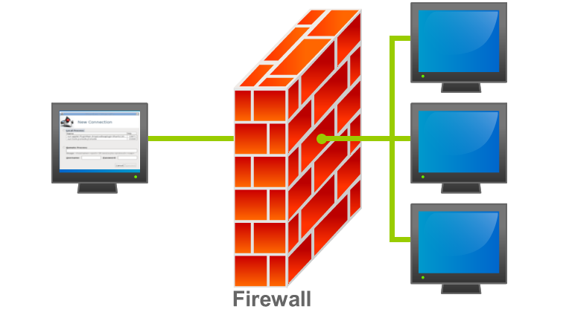
New ePRO surgery system
ePROM (symptom-report questionnaire)
References:
Avery et al, In press BMC Cancer May 2019
Holch et al, Ann Oncol 2017;28:2305
Notes:
In response to this, we have developed a new ePRO surgery system at the UoB.
The platform used to develop the ePRO system was adapted from the model developed for the eRAPID study at the UoL, which has been reported previously.
Essentially, the IT elements include a patient website hosting the ePROM symptom-report questionnaire and a web application for securely transferring the patient data to hospital EPR, where it can be viewed by clinicians.

Slide 7
Clinical algorithms & “actions”
Patient
symptom-report
Expected
Concerning
Possible complication
Advice: self-management advice
Advice: contact clinician
Clinician alert
Notes:
A key additional feature of the system is that it uses clinically-derived algorithms to trigger different actions depending on the severity of Ss pts report.
Expected (green) Ss trigger tailored self-management advice, concerning (yellow) Ss trigger prompts to contact a HCP and Ss indicative of possible complications (red) trigger immediate automated alerts to a clinician.

Slide 8
ePRO surgery pilot study
Aim:
To explore the feasibility of an RCT to evaluate the impact of real-time, remote electronic monitoring on patients’ physical wellbeing after discharge following cancer-related major abdominal surgery
Specific objectives:
Explore participant eligibility & recruitment;
Examine ePRO questionnaire response rates;
Examine frequency of symptoms & system actions;
Explore patient and clinician perspectives
Notes:
The aim of this pilot study was to evaluate the feasibility of an RCT to evaluate the impact of using the system on…
Specific objectives were to...

Slide 9
UGI surgery
Recruited at discharge
Discharge
Baseline symptom-report
Week 1-8
Week 4, 8
EQ-5D
FACT-G
Resource use
Interviews
Week 8
Usual care
Interview (patients, clinicians)
Notes:
Pts undergoing UGI surgery were recruited at the point of discharge, where they were demonstrated the system and completed their first symptom-report Q.
Pts then discharged home received reminders (text/email) to complete the SRQ twice in first week, and then weekly for up to 8 weeks post-discharge.
Pts were also interviewed weekly by a researcher.
Additional PROMs measuring HRQL including the EQ-5D and FACT-G questionnaires and a HCRU measure completed wk 4/8.
The study ran in parallel with UC, and so pts were receiving FU phone calls from CNS at the same TPs.
A sample (10%) of patients and all the clinicians (3) were interviewed at the end of the study.

Slide 10
Eligibility and recruitment
Screened for potential eligibility (n=109)
Excluded (n=34)
Not meeting inclusion criteria (n=24)
Participant in another study (n=10)
Screened for full eligibility (n=75)
Excluded (n=34)
Not meeting inclusion criteria (n=34)
Eligible and invited to participate (n=41, 55%)
Declined (n=12)
Refused (n=10)
Not confident on PC/mobile device (n=2)
Consented (n=29, 71%)
Withdrawn (n=7)
Felt too tired/unwell (n=6)
Prolonged readmission to hospital (n=1)
Analysed (n=29)
Notes:
So, the results. Of 109 pts screened for potential eligibility before they had their surgery, 75 were screened for full eligibility, of which 41 (55%) were eligible and invited.
29 (71%) consented and all were followed-up. 2/3 male, mean age 64 (range 43-81). Most common reason for pts not meeting IC was that the pt did not undergo their planned procedure or was discharged unexpectedly. Most common reason for pts declining was because they refused, or were too tired/unwell.
------------------------------------------------------------------------
(Rage range 43-81)
ª including: not undergoing planned procedure (n=17), discharged home unexpectedly early or not discharged to home (n=4), missed due to administration errors (n=2), patient was under 18 (n=1)
^{b} including: no home access to a PC/internet (n=15), discharged home unexpectedly early or not discharged to home (n=11), not fluent in English (n=3), missed due to administration errors (n=2), unable to comply with follow up (n=3)

Slide 11
Symptom-report response rates
Non-completion:
Withdrawn from study
Started chemotherapy
Did not want to
Admin failure
Readmitted to hospital
Too busy
Too unwell
n=29, 197 symptom-reports:
Median 9, range 1-11
Notes:
RRs for the SRQ exceeded 70% at all timepoints (range 72-93%), excluding day 2-3 post-discharge (55%) – not surprising as feeling their most poorly.
29 participants completed the ePRO questionnaire a total of 197 times (median 9, range=1-11).
Reasons for non-completion included participants withdrawing, starting chemotherapy (12%) or reporting that they did not want to complete the questionnaire at that timepoint (10%).
-------------------------------------------
Between 30/08/2017 and 17/04/2018.
¹ Baseline completion takes place at the point of hospital discharge. All subsequent timepoints are length of time since hospital discharge.
² The design of the ePRO system ensures all items are completed, except for completions that were abandoned prior to submission.
³ Patients halted completion of ePRO if they commenced chemotherapy during follow-up.
⁴ 8 baseline completions triggering a Level 3 action were removed from the dataset post-hoc because they were later determined to be clinically irrelevant by participants and clinicians (as they were retrospectively reporting symptoms experienced immediately post-surgery that had resolved). This will inform the next iteration of algorithms to be using in a full RCT.
⁵ The ePRO system allows multiple completions at each timepoint.

Slide 12
% symptom-reports triggering system actions (n=197)
Notes:
% of times a patient’s symptom-report triggered an action by the ePRO system across the whole 8 weeks (n=197).
Starting with the blue triangle, we can see that ~1/5 pts self-reports triggered no action – because their Ss were absent or mild.
In red, we can see that ~40% Ss triggered SMA – these Ss were expected but were significant enough that this advice was considered beneficial.
With the green, we can see that over a third of Ss were potentially concerning, triggering advice to contact a clinician.
While the purple triangle shows that 5% of the time, pts were reporting severe enough symptoms suggesting a possible complication and triggering a clinician alert.

Slide 13
Frequency of system actions over time
Notes:
To break this all down, this figure shows the freq of system actions over time for the first 3w post-discharge.
Starting with the blue line at the bottom, we can see that the frequency of Ss that triggered no action (no/mild Ss) starts to increase over time – which fits with pts starting to recover from their surgery as time goes on.
It’s a similar story for Ss triggering SMA (expected symptoms, red).
Most common, however, were potentially concerning Ss triggering ePRO system actions to contact a clinician (green).
Ss triggering clinician alerts (concerning Ss, purple) are not that frequent but there are a few.

Slide 14
Frequency of system actions over time
Notes:
If we look at what happens we can later in recovery, we can see that the number of absent/mild Ss (blue) continues to increase over time, while the number of severe Ss triggering clinician alerts (purple) or concerning Ss triggering advice to contact a clinician (green) continues to decrease over time.
This pattern fits with what we’d expect during recovery, and mirrors that observed in recent clinical audit data (NOGCA Annual Report 2017).
However, Ss triggering SMA (red) remain common after 3 weeks. In fact, patients were still experiencing symptoms requiring SMA up to two months after leaving hospital. This highlights a potentially unmet need for the monitoring of symptoms and provision of self-management advice to patients after the acute phase of recovery has passed.
------------------------------------------------
Nearly half of all self-management advice and advice to contact a clinician triggered between four- and eight-weeks post-discharge.
Most Level 3 alerts (automated email to CNS team) (n=7, 78%) were generated in the first three weeks following discharge from hospital (Figure 2). Over half of Level 2 actions (participant advice to call an HCP) (n=43, 60%) were triggered within the first two weeks post-discharge, with a further 15% (n=11) triggered after six weeks post-discharge. Most Level 1 actions (self-management advice) (n=48, 63%) were triggered after three weeks post-discharge, the majority of which were triggered at weeks four and five. Most Level 0 feedback (no participant advice required) (n=27, 68%) was triggered after five weeks post-discharge.
An additional eight Level 3 alerts were generated at baseline data completion pre-discharge. These were removed from the dataset post-hoc following consultation with clinicians as these email alerts were deemed to be unnecessary while patients were still in hospital.

Slide 15
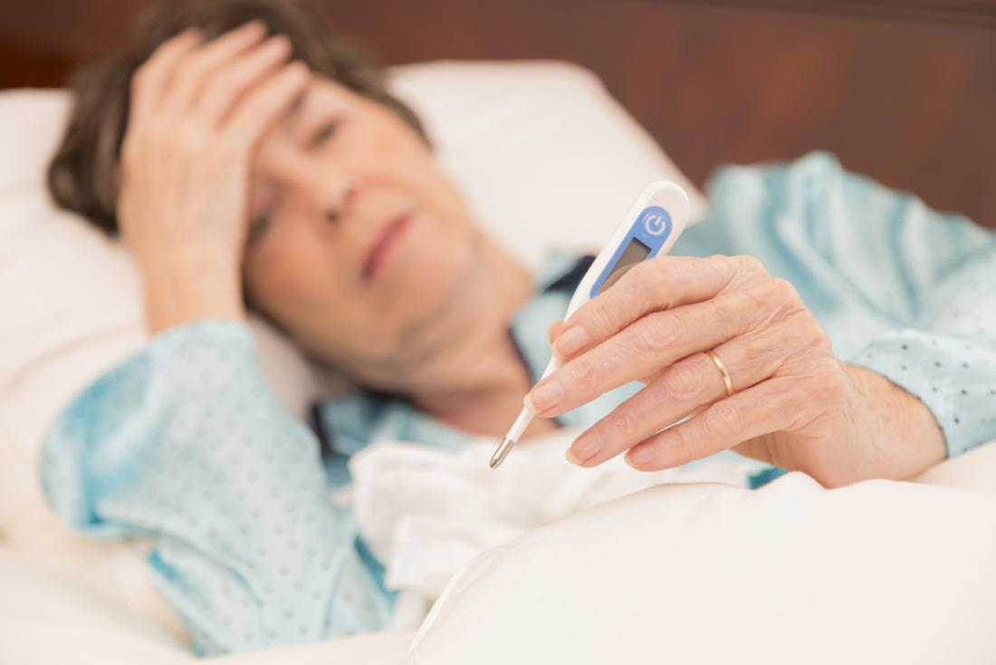
Symptoms triggering clinician alerts
Notes:
Main Ss triggering clinician alerts were severe pain, which can indicate an underlying complication, and fever and chills, which could indicate an infection that would require prompt Rx.
(n=9 times, by 3 pts)

Slide 16
Symptoms triggering contact clinician advice
Notes:
Most common symptoms generating advice to contact a clinician.
Most frequently related to wound problems (n=32 actions, 44%) and appetite loss (n=26, 36%). Additional symptoms generating contact clinician advice included fever (n=18 actions), probs with PF (n=10) and NV (n=8).
---------------------------------------------------------------------------------
In total, 72 Level 2 actions (advice to contact an HCP) were triggered by 24 (83%) participants in Bristol.

Slide 17
Symptoms triggering self-management advice
Notes:
Most common symptoms generating SMA.
Most frequently related to fatigue and pain, but advice was also triggered for Ss of problems with PF, NV, constipation.
-----------------------------------------------
Level 1 (self-mangement advice) - Number of completions and most common symptoms (N=76)
Each Level 1 action triggered provided self-management advice for up to six symptoms, ranked in terms of clinical significance (Avery, 2019). Typically, advice was provided for three symptoms (median=2.5, range=1-6) per Level 1 action triggered. Advice was generated most frequently for fatigue (n=58 actions) and pain (n=27). Additional symptoms generating Level 1 advice included physical function (n=22 actions), nausea or vomiting (n=20) and constipation (n=20).

Slide 18
Interviews (n=109)
Notes:
Now onto the results of the interviews.
In total, we conducted 109 weekly telephone interviews with our 29 participants, with most reporting positive experiences of using the ePRO system.

Slide 19
Reassurance
“It’s all about a bit of reassurance really. The minute you get a bit of reassurance, everything else seems a bit easier.”
Notes:
Many participants described how they found using the system reassuring. This pt, for example, says... The SMA in particular, was useful to confirm that their symptoms were typical for their stage of recovery and in helping them manage their Ss by themselves at home.
---------------------------------------
(63%)

Slide 20
A watchful eye
“… you get monitored so much in hospital… and then you come out and there’s nothing at all. It’s like a sudden drop off a cliff... you go well, am I OK?... you know they’ve been checking for all this time.”
Notes:
Participants also discussed reassurance in terms of the system keeping a watchful eye over them and their recovery. This also helped them overcome feelings of isolation following discharge from hospital…
Quote also nicely illustrates how uncertain pts would normally be about the significance of their Ss – and how, without such a system detection of problems and complications relies on the patient’s ability to distinguish between typical and atypical symptoms and seeking appropriate treatment.

Slide 21
Self-tracking recovery
“It was telling me that I was getting better… which is what I was hoping for. That was quite informative… looking at the graphs at the end, that was quite good.”
Notes:
Participants discussed the graphs produced by the ePRO system, which displayed their individual symptom-report scores over the course of the study and described these as useful for tracking their progress over time.
Again, participants spoke about the reassurance they gained from being able to objectively see that their symptoms were improving.

Slide 22
Enhanced symptom management
“Things like not drinking too much coffee… I didn’t think that would affect the issue but apparently it does, so I’ll abide by that advice”
“…it just reminded me of all those things… although they weren’t adding anything new, again they were reassuring”
Notes:
Additionally, participants valued being provided with new symptom management advice to help them better manage their own symptoms.
Participants also found the ePRO system advice useful for reminding them to follow advice they may have forgotten and reinforced the guidance they had received from HCPs.

Slide 23
Clinical relevance
Providing detailed overview of development and severity of individual patients’ symptoms
Advice to contact clinician and clinician alerts considered timely and appropriate
Directly informed clinical decision-making and patient management
Notes:
Clinicians described the ePRO symptom-reports as clinically relevant and useful, providing a detailed overview of the development and severity of patients’ symptoms during their recovery at an individual pt level. Clinicians also felt that the majority of ePRO initiated contact from/with participants was considered timely and appropriate.
In some cases, these directly informed the clinical decision-making and the management of patients.

Slide 24
Signposting
“I’m not sure he would have thought to ring us, as his first port of call (otherwise). And we were able to sort of triage what the problem was and make sure he spoke to the right person.”
Cancer Nurse Specialist
Notes:
For example, clinicians felt that the system helped to signpost patients towards contacting appropriate help…

Slide 25
A useful adjunct to routine care
“I found [the ePRO system] particularly useful on the phone… to guide the conversation… make sure that things aren’t overlooked
Dietician
Notes:
Overall, clinicians described the system as a useful adjunct to care, for example – this clinician describes how it allowed them to tailor their telephone consultations with participants around Ss the system had detected.

Slide 26
Hospital integration and accessibility
“It’s just like in clinic, sometimes we can’t always access a computer to look at [patient results] before [patients] come in.”
Cancer Nurse Specialist
Notes:
The CNS team commented that full integration of the ePRO system into hospital EHR was appropriate and useful. However, they acknowledged that use of the ePRO system may be influenced by existing complexities of hospital systems.

Slide 27
Summary & next steps
Hospital-integrated, electronic system for remote real-time patient monitoring after surgery
Clinical algorithms to trigger severity-dependent patient advice and clinician alerts
Feasible and acceptable to patients and clinicians
Future RCT needed to evaluate impact of system on patients’ physical wellbeing after hospital discharge
Notes:
A novel HIE system for the remote, real-time monitoring of pts symptoms after discharge from hospital has been developed.
System uses clinically-derived algorithms to distinguish between expected and concerning symptoms to optimally inform patient self-management and appropriate clinical input throughout patients’ recovery.
Patients’ find the system reassuring and clinicians consider the system a useful adjunct to routine clinical care.
A future RCT is now needed to evaluate the impact of the system on physical wellbeing after discharge from hospital following cancer-related major abdominal surgery.

Slide 28
Acknowledgements
This work presents independent research funded by the National Institute for Health Research (NIHR) under its Programme Grants for Applied Research Programme (Reference Number RP-PG-0611-20008). This work was undertaken with the support of the Medical Research Council ConDuCT-II (Collaboration and innovation for Difficult and Complex randomised controlled Trials In Invasive procedures) Hub for Trials Methodology Research (MR/K025643/1) (http://www.bristol.ac.uk/social-community-medicine/centres /conduct2/). The views and opinions expressed therein are those of the authors and do not necessarily reflect those of the NIHR HTA programme, the NIHR, NHS, Department of Health (UK) or MRC.
This study was supported by the NIHR Biomedical Research Centre at the University Hospitals Bristol NHS Foundation Trust and the University of Bristol. The views expressed in this presentation are those of the author(s) and not necessarily those of the NHS, the National Institute for Health Research or the Department of Health.

Slide 29
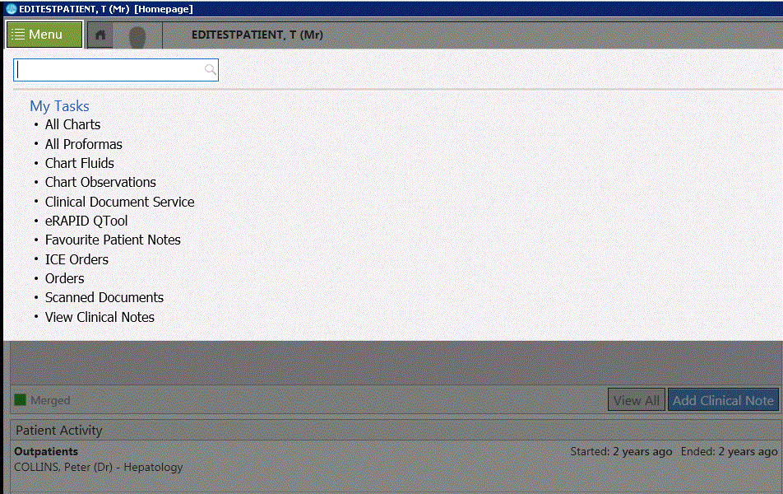
Data stored securely in hospital EPR
Data viewable within routine health records
Integration time-consuming but valuable
Notes:
Specifically, the eRAPID questionnaire data is stored securely within pts’ routine hospital EPR for ready access by clinical staff (surgeons, nurses, dieticians), using the same record system that they would use to view other routine pt records, as you can see from this screenshot.
This integration of the eRAPID Q scores within routine hospital EPRs was no mean feat – as you can imagine - and took us the best part of 18m to set up.
But we got there, and it’s a really valuable feature of the eRAPID system, enabling HCPs real-time access to pt PRO data.

Slide 30
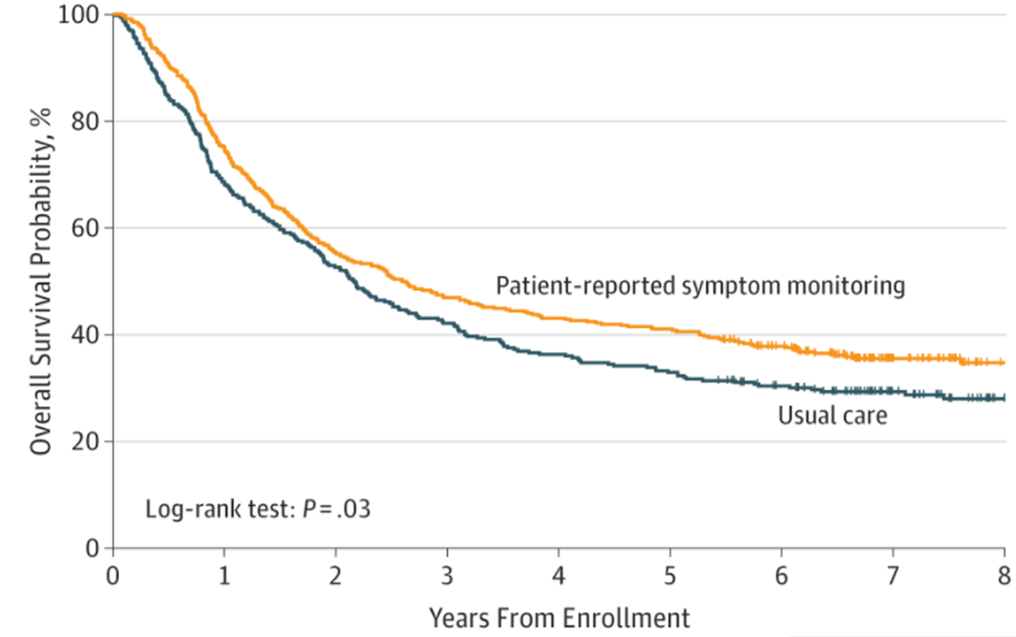
Integrating PROs into cancer care can improve survival
Basch et al., JAMA 2017
Median survival difference = 5 months (P=.03)
Notes:
Indeed, some exciting work recently published by Ethan Basch’s team in the US, has shown that integrating PROs into cancer care and surveillance can improve patient survival.
--------------------------------------------------------------
Assessed overall survival associated with electronic patient-reported symptom monitoring vs usual care based on follow-up from a randomized clinical trial.
Consecutive patients initiating routine chemotherapy for metastatic solid tumors at Memorial Sloan Kettering Cancer Center in New York between September 2007 and January 2011 were invited to participate in a randomized clinical trial. Participants were randomly assigned either to the usual care group or to the PRO group, in which patients provided self-report of 12 common symptoms from the National Cancer Institute’s Common Terminology Criteria for Adverse Events at and between visits via a web-based PRO questionnaire platform. Participation was continuous until cessation of cancer treatment, voluntary withdrawal from the trial, transition to hospice care, or death.
Overall survival was assessed in June 2016 after 517 of 766 participants (67%) had died, at which time the median follow-up was 7 years (interquartile range, 6.5-7.8). Median overall survival was 31.2 months (95% CI, 24.5-39.6) in the PRO group and 26.0 months (95% CI, 22.1-30.9) in the usual care group (difference, 5 months; P = .03) (Figure). In the multivariable model, results remained statistically significant with a hazard ratio of 0.83 (95% CI, 0.70-0.99; P = .04).
Stepped-wedge cluster RCT because XXX.
The National Institute for Health Research Collaboration for Leadership in Applied Health Research and Care West (NIHR CLAHRC West) works with partner organisations, including the NHS, local authorities and universities, to conduct applied health research and implement research evidence, to improve health and healthcare across the West.

Slide 31
Phase 2 Results – Developing Algorithms
Nurse-patient consultations
(n=15, n=8 patients)
Clinician interviews
(n=4)
Patient information leaflets
(n=28)
Expert meetings (n=2, 10 participants)
eRAPID participant questionnaire data (n=444 completions, n=59 patients)
Patient information websites
(n=3)
Typical/atypical recovery
Notes:
It was important that these action thresholds were evidence-based as well as meaningful to both clinicians and pts.
And so we used a mixed methods approach to develop these action thresholds, gathering information from multiple sources, [CLICK x6] including interviews with clinicians, audio-recorded consultations with patients post-discharge, content analysis of hospital PILs and pt support websites and expert meetings with nurses, surgeons, dieticians and patient representatives.
Interviews and expert meetings resulted in additional questionnaire sub-items, branching logic and refined algorithms to improve advice and alert accuracy
The symptom alert thresholds were then further refined by testing them using existing patient data collected in the eRAPID study.
[CLICK] The aim of this was to agree on Ss or clusters of Ss that would be considered concerning in the context of ‘typical’ and ‘atypical’ recoveries...
[CLICK} and then develop algorithms for Ss severity thresholds that would [CLICK] trigger actions of some sort for clinicians or patients.
Comparisons between ePRO questionnaire data, telephone consultations and clinical events/outcomes from 27 patients further refined clinical algorithms.
-------------------------------------------------------
Development of symptom severity thresholds was informed by two expert meetings (6 nurses, 2 dieticians, 1 surgeon, 1 patient representative) and eRAPID questionnaire data from 59 patients (34 men, mean age 61 years). Interviews with participants were conducted in order to understand what advice or input they had received from HCPs in response to the severity of their symptoms. This information was used to further understand appropriate thresholds and feedback for the eRAPID system. Patient feedback for symptom self-management advice was developed by. Thematic analysis was used to further develop self-management advice and reassurance from 15 phone consultations by a CNS with 8 patients (5 men, mean 62 years) and 4 clinician interviews (3 surgeons, 1 CNS). In phase two, a full version of the eRAPID questionnaire which included patient feedback, advice and the capacity to alert HCPs about potential AEs was developed, refined and launched.

Slide 32
Overview OPTION 1
Symptom severity level | ePRO system action(s)
Level 1: expected symptom(s) | Patient advice: self-management advice
Level 2: potentially concerning symptom(s) | Patient advice: contact a health care professional today if symptom is new or unreported
Level 3: symptom(s) indicative of a complication | (i) Patient advice: contact a health care professional immediately (ii) Clinician alert: automated email to a health care professional

Slide 33
Phase 1 Results
Patient Cognitive Interviews
7 EORTC questionnaire modules identified
Expert Clinical Input
Acceptability & feasibility of items
Shortlisted to 30 items
Inclusion of 5 additional items
Patient care pathway analysis
95 items selected
Final 35 item eRAPID questionnaire
Notes:
(From paper 1) 95 items from 7 validated EORTC questionnaires were identified. Cognitive interviews with patients (n=18, 16 men, mean age 66 – Table 1) refined the long list of items and confirmed the acceptability and feasibility of items. The final short list of 30 items to be included in the developmental version of the ePRO symptom-report questionnaire were taken from the following EORTC core questionnaire and modules: C30, OG25, OES18, LMC21, and HCC18. Consideration by clinical study team members (JB, TR) resulted in 5 additional items not already included in EORTC questionnaires being added (e.g. wound problems), resulting in an ePRO symptom-report comprising 35 items

