Slide 1
History of the SCT: A Look at the Beginnings; Annual Program Evolution
O. Dale Williams, MPH, PhD, FAHA, FSCT
Curtis Meinert, PhD, FSCT
Genell Knatterud, PhD, FSCT

Slide 2
Acknowledgements
Thanks to all those, named and unnamed, who worked to make the creation of the SCT and its ongoing evolution and growth possible
Special thanks to Genell and Curt
Special thanks to Betty Collison, Wanda Riggie, my staff and the staff in the SCT office, Fernley & Fernley, for all their help and support

Slide 3
Approach to Presentation
Start with the Greenberg Report, 1967
The first Coordinating Centers Meeting, 1973
The first joint meeting of the Coordinating Centers and the SCT, 1980
Annual meeting program evolution

Slide 4
1967
IBM sales personnel saying, in essence, that if PCs made sense, we would all have brains on our finger tips
One year before Hewlett Packard began marketing the first PC
One year before the first Internet node was created at UCLA
First heart transplant

Slide 5
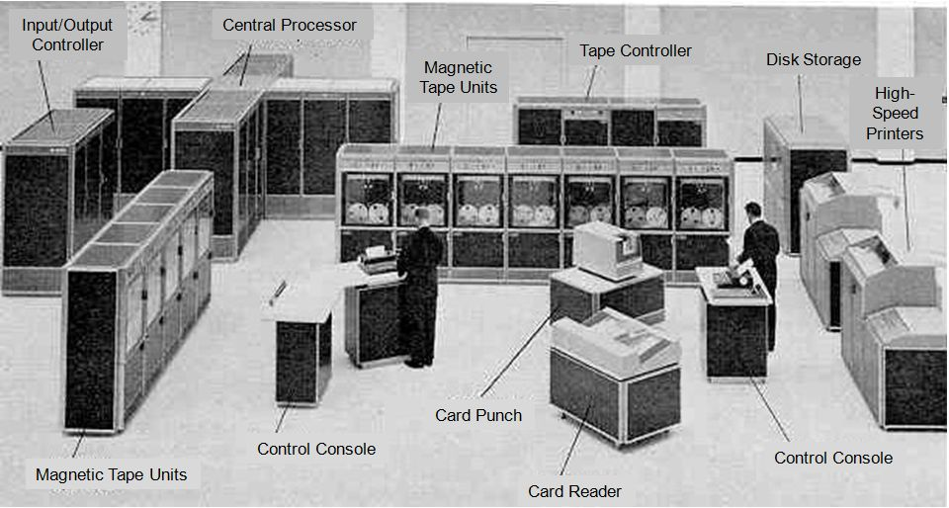
1967: Typical Computer Setup

Slide 6
The Greenberg Report, May 1967
Organization, Review, and Administration of Cooperative Studies: A Report from the Heart Special Project Committee to the National Advisory Heart Council
Three essential steps
  Organization of local units under good leadership
  Establishment of a coordinating center
  Critical “interrogation” of the data
Guidelines for organizational structure and operations
Does not reference a DSMB-type role
Controlled Clinical Trials 9:137-148 (1988)

Slide 7
Donald Fredrickson (1924-2002, Director, National Heart Institute 1966-1974, Director of NIH 1975-1981) in an address to the NY Academy of Science on January 23, 1968:
Field trials are indispensable. They will continue to be an ordeal. They lack glamor, they strain our resources and patience, and they protract the moment of truth to excruciating limits. Still, they are among the most challenging tests of our skills. I have no doubt that when the problem is well chosen, the study is appropriately designed, and that when all the populations concerned are made aware of the route and the goal, the reward can be commensurate with the effort. If, in major medical dilemmas, the alternative is to pay the cost of perpetual uncertainty, have we really any choice?

Slide 8
Key Precursors to SCT Creation
Annual meetings of Coordinating Centers, beginning in 1973
1976 Meeting with NIH Clinical Trials Committee
National Conference on Clinical Trials Methodology in 1977
Background work leading to publication of Controlled Clinical Trials, May 1980

Slide 9
Coordinating Center Meetings
1973: 1st , Univ of MD, Columbia, MD
1974: No meeting
1975: 2nd, Univ of MN, Minneapolis area
1976: 3rd , Univ of Texas, Houston
1977: 4th , UNC, Chapel Hill
1978: 5th , GWU, Arlington, VA
1979: 6th , Boston
1980: 7th and 1st SCT Meeting, Philadelphia
1981: 8th and 2nd SCT Meeting, San Francisco

Slide 10
1973
Radio telephone system patented, so we now have cell phones
Two years before Microsoft and BASIC

Slide 11
First Coordinating Centers Meeting
1973
This initial 1.5-day meeting started the sequence of events that ultimately led to the creation of the SCT
Strategy fostered by NIH, especially NHLBI, to enhance the pool of expertise needed for coordinating large scale trials
>60 attendees, 9 from NIH
11 Institutions represented

Slide 12
Mostly a show and tell from major NHLBI Coordinating Centers:
  Lipid Research Clinics Program
  Hypertension Detection and Follow Up
  Multi-Risk Factor Intervention Trial
  Hypertension, Thrombolysis and Exercise
  Coronary Drug Project
Sponsored by NIH /NHLBI primarily through existing awards

Slide 13
Coordinating Center Models Project
1976-1979
Curtis Meinert, Principal Investigator
National Heart, Lung, and Blood Institute funded
Purpose: Study coordinating centers for large, multicenter trials with the aim of establishing guidelines and standards for coordinating centers

Slide 14
CCMP Objectives
Formulation and elucidation of CC policies, objectives, roles, responsibilities, and authority, both independently and as related to other study groups
Establishment of CC cost and other management data for initiating, planning, operating, and evaluating clinical trials
Reduction in duplication of effort, relearning and redevelopment of CC technology and methods

Slide 15
1976 NIH Clinical Trials Committee
Fred Ederer, Curtis Meinert, Dale Williams + Harold Roth met with committee
Proposed creating a clinical trials society
Committee interested but lacked evidence for widespread participatory support
Suggested holding a conference to test support
Conference held October 1977
> 700 participants

Slide 16
National Conference on Clinical Trials Methodology, October 1977
Welcome: Donald S. Fredrickson, NIH Director
Program Components
  When and how to stop a clinical trial
  Who will be effective as a clinical trials investigator and what are adequate incentives
  Patient recruitment: problems and solutions
  Quality assurance of clinical data
  Ethical considerations in clinical trials
  PLUS
  Clinical Pharmacology and Therapeutics, 1979; 25

Slide 17
Communications: Should mechanisms be established for sharing among clinical trial investigators experience in handling problems in design, execution and analysis?
Discussion leaders: Harold Roth, Genell Knatterud with Louis Lasagna, Curt Meinert, Barbara Hawkins, Harold Schoolman and Fred Mosteller
This conference and this session played a key role in the creation of the SCT

Slide 18
1977
Apple Computer incorporated
Oracle founded

Slide 19
Fourth CC Meeting
May 1977, Chapel Hill, NC
40 multicenter studies participated
166 attendees
Focus on quality assurance, computer operations and cost, survival analysis included
Introduction to Coordinating Center Models Project
Guest speaker: Robert I. Levy, Director, NHLBI “Decision Making in Large-Scale Clinical Trials”

Slide 20
Workshops
Programming techniques for data management and data analysis
Quality assurance in programming, data analysis, clinic monitoring, monitoring central facilities
Data flow procedures, data security control and storage
Coordinating center management

Slide 21
Society for Clinical Trials, Inc
Incorporated September 1978
To provide an educational forum … in which individuals engaged in the field of conducting clinical trials, epidemiological studies and research using similar methods may communicate and consult with one another and exchange information and ideas about matters of common concern.
To promote the exchange and dissemination of information about methods and procedures for the design and conduct of such studies and to encourage the development of new methods for such research.

Slide 22
Initial Board
Thomas C. Chalmers, Curtis L. Meinert, Harold Conn, Charles Moertel, Fred Ederer, Thaddeus Prout, Robert S. Gordon, Jr, Harold P. Roth, Christian R. Klimt, O. Dale Williams, Paul Meier
Four new members, elected by the Board, subsequently
selected

Slide 23
1980
First issue of Controlled Clinical Trials published
A year before IBM announced its PC, running on the new MS-DOS, costing $1,565 or $4,366 today
Two years before WordPerfect introduced

Slide 24
First SCT Meeting
May 5-8, 1980, Philadelphia
4 Day meeting
Sponsors
    NHLBI
    NINCDS
    NEI
    NIAID
    Maryland Medical Research Institute

Slide 25
Special Presentations
Donald Fredrickson, Director, NIH
  Sorting out the doctors bag
Seymour Perry, Director National Center for Health Care Technology
  Introduction to the National Center for Health Care Technology
Charles Moertel, Chair, Comprehensive Cancer Center, Mayo Medical School
  How to succeed in clinical trials without really trying

Slide 26
Plenary Session I
The impact of the Freedom of Information Act and the Privacy Act on Clinical Trials
  Robert S Gordon, Jr. NIH
  Paul Meier
  James Childress

Slide 27
Plenary Session II
Issues in Cancer Trials: Comparisons between the US and Europe, Charles Moertel, Chair
Issues in the US, Franco Muggia
Issues in Europe, M Staquet, Belgium
Issues in Scandinavia, Neils Tygstrup, Denmark
Discussants
  Stephen Carter and B. W. Brown, Jr.

Slide 28
Plenary Session III
A scientific dilemma: Similar trials with different results, Paul Meier, Chair
AMIS and PARIS, Christian R. Klimt
AMIS and PARIS, Paul Canner
Is there really a dilemma, Sam Greenhouse
Overview of the trials of Aspirin, Richard Peto, England

Slide 29
Sessions and Chairs
Experimental Design and Statistics, Edmund Gehan
Recruitment and Adherence Issues, John Singleton
Statistical Report Generation, James Neaton
Early Termination, Mitchell Gail
Data Quality, Argye Hillis
Data Management, Dennis Dixon
Ethics and Design, Gerry Hill
Prognostic Factors, Sam Greenhouse

Slide 30
Training and Certification, Fredrick Ferris
Subgroup Analyses and … Multiplicity in Clinical Trials, James Ware
Assessing Clinical Trials, Curt Meinert
Preparing for the Final Phases … Closeout and Termination, Barbara Hawkins
General Issues, David Curb
Organization and Management, Robert Benfari

Slide 31
Otogeny of Clinical Trials
Chair: Armand Littmand, VA
Academe: Curtis Meinert, Johns Hopkins U
NIH: William Friedewald, NHLBI
VA: James Hagans, VA Administration
FDA: William Bachrach, Baylor
Industry: Roger Crossley, Smith, Kline and French

Slide 32
This Brings us to Today
34th Annual Meeting
This year’s program
  > 500 attendees
  Multifaceted program with broad involvement
  Old things continue, sometimes with a new name
  New things emerge
  Pre-Meeting workshops have become a key feature
Clearly a very vibrant, meaningful meeting

Slide 33
The Path to Here
Coordinating centers
Support from NHLBI, then NIH more generally
Innumerable contributions from an innumerable number of persons and institutions
Too many to highlight here, many in the audience today

Slide 34
We Are Fortunate
The SCT is vibrant and important
The field has grown from a small handful of trials in the late 1960s, early 1970s to 145,076 studies listed in ClincalTrials.gov last week.
The variety, complexity, nature and purpose continues to expand and evolve

Slide 35
So the Beat Goes On
As it Should
As it Must
War drums for the battle to successfully complete and report on, in a timely manner, high quality studies that provide answers for important questions
THANK YOU

