Slide 1
34th Meeting of the Society for Clinical Trials
May 19-22, 2013 Boston, Massachusetts
Welcome

Slide 2
Welcome
As of May 3rd . . .
553 Meeting Attendees
49% Members
44% New or returning members
3% Students
3% Exhibitors

Slide 3
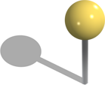
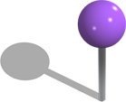
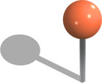
2013 Attendees
Canada
Denmark
United States
Thailand
Belgium
Israel
Brazil
China
Germany
Saudi Arabia
Australia
France
India
Mexico
Italy
Japan
South Africa
Switzerland
Netherlands
New Zealand
Russia
Norway
Republic of Korea
Notes:
3

Slide 4
Program Committee Chair: Christopher Coffey
Program Committee Members:
David W. Wright
Dean A. Fergusson
Domenic J. Reda
Paul A. Thompson
Wendy R. Parulekar
Yili Lu Pritchett
John Speakman
Kathleen McWilliams
Ken Cheung
Kristine M. Nelson
Leslie Ain McClure
Li Chen
Marianne Keaey
Mike Hale
Mithat Gönen
Valerie Durkalski
William E. Elgie

Slide 5
Workshop Registrations
274 Workshop Registrations
178 Attendees
1 Session — 104
2 Sessions — 68
3 Sessions — 6

Slide 6
Education Committee Co-Chairs: Stan Shapiro and Domenic J. Reda
Education Committee Members:
Carol Baker
Jingyee Kou
Wendy R. Parulekar
Yves D. Rosenberg
Elizabeth Fricks
Emily Van Meter
Jodi DeStefano
Kristel Aman
Li Chen
Oscar Moreno
Paul G. Wakim
Peter Guarino
Roberta W. Scherer
Tassos Kyriakides
Virginia J. Howard

Slide 7
Battle of the Budget

Slide 8
Half of all clinical trials
have never been published.
|
|
alltrials.org

Slide 9
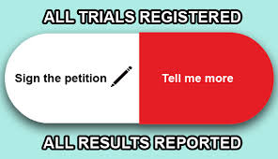
SCT signed the AllTrials Petition as follows:
Half of all clinical trials
have never been published.
This is a scandal.
Transparency of clinical trial study design and results is important to researchers, physicians and the public. In order to design the highest quality and most ethical clinical trials in the future, we need to learn from and incorporate all past experience. The Society for Clinical Trials has signed this petition because each study participant deserves to have the data he or she contributed yield the maximum benefit to society. These and other topics are discussed during our annual May meetings and in our Journal. See www.sctweb.com for details of both.
|
|
alltrials.org

Slide 10
What are you doing to Celebrate?
1747: James Lind
International Clinical Trials Day . . .
Six men, grouped into pairs
Trial lasted twelve days
Given a variety of dietary supplements from cider to oranges and lemons
is celebrated around the world near the 20th of May to commemorate the day that James Lind started his famous trial.

Slide 11
Notes:
11

Slide 12
Monday: General Reception at 6:30 PM
Tuesday:
12:30 PM Business Meeting: Sylvan Green Award
4:00 PM Thomas Chalmers Winners Announced
6:30 PM Affinity Group Receptions
CRA(48)
Industry/FDA(100)
IT(24)
Physicians(21)
European Trialists(48)
Meeting
Announcements

Slide 13
SAVE THE DATE
SCT/FDA Benefit-Risk Workshop: Bridging Qualitative and Quantitative Assessments
October 22-23, 2013
Universities at Shady Grove Conference Center, Rockville, MD
Meeting
Announcements

Slide 14
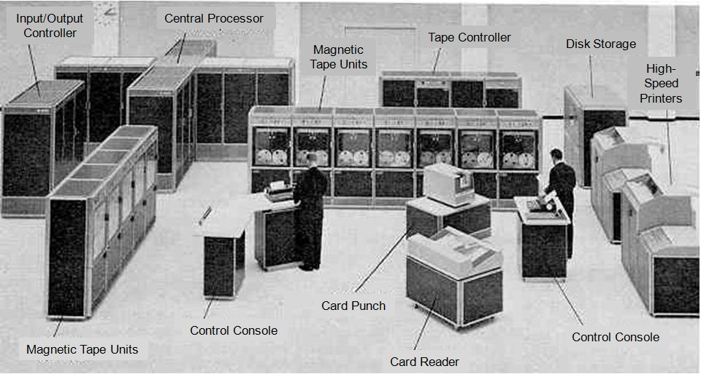
We’ve come a long way from . . .

Slide 15
We’ve come a long way from . . .

Slide 16
To. . .
Like Us!
Go mobile! — website on your smartphone
Like us on Facebook
Tweet!
Tweet at #SCTorg
We’ve come a long way from . . .
Connect!
Connect and start a discussion

Slide 17
Free to SCT Members
"Elements of the Clinical Trial Protocol" Presented by Robert Nussenblatt
"Randomization Strategies for Large, Multicenter, Clinical Trials" Presented by Kathryn Tucker
"Prevention of Missing Data" Presented by Scott Emerson
"Challenges in Designing Small Clinical Trials" Presented by Chris Coffey

Slide 18
So as Annie Dillard’s Pilgrim at Tinker Creek reminds us . . .
“Spend the afternoon. You can’t take it with you.”
Thank you

Slide 19
2013 Fellows

Slide 20
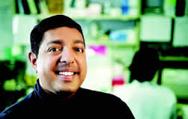
Atul Butte, MD, PhD
Chief of the Division of Systems Medicine and Associate Professor of Pediatrics, Medicine, and by courtesy, Computer Science, at Stanford University and Lucile Packard Children's Hospital.

Slide 21
Selected Honors
Top 10 Biotech Techies, FierceBiotech IT (2012)
NIH Director's Lecture, National Institutes of Health (2012)
Genomic Advance of the Month, National Human Genome Research Institute (NHGRI) (2011)
Young Investigator Award, Society for Pediatric Research (2010)
Elected Fellow, American College of Medical Informatics (2009)
New Investigator Award, American Medical Informatics Association (2008)

Slide 22
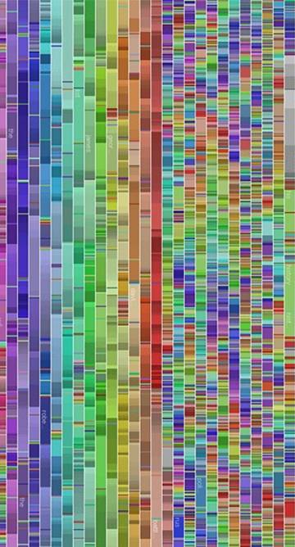
Transforming 300 Billion Points of Data into Diagnostics, Therapeutics, and New Insights into Disease
Curtis Meinart Lecture

