Slide 1
Asian Clinical Trial Trends
by
Sponsor - Trial Phase -
Disease Area - Country
Johan PE Karlberg, MD, PhD, BSc (stat)

Slide 2
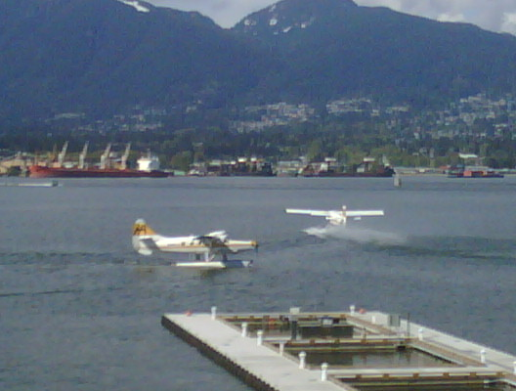

Slide 3
Sources: This Presentation
Clinical Trial Magnifier
2009 Dec – Global Publication Trends
2010 Oct – WHO Trial Registry Platform
2011 Feb – Emerging Clinical Trial Regions
2011 Apr – Asian Clinical Trial Trends

Slide 4
Asia & Life-Science
Academia Performance Measure
# articles in Medline in 2000 and 2009
Times Higher Education 2010 World University Ranking.

Slide 5
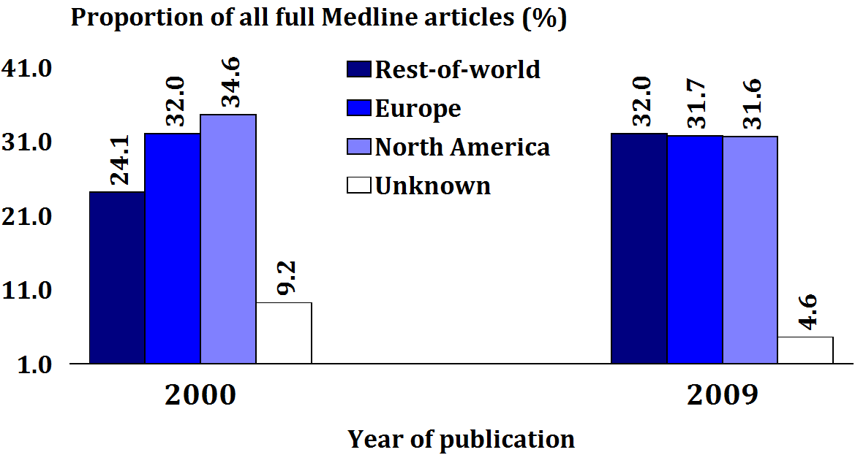
Asia & Life-Science

Slide 6
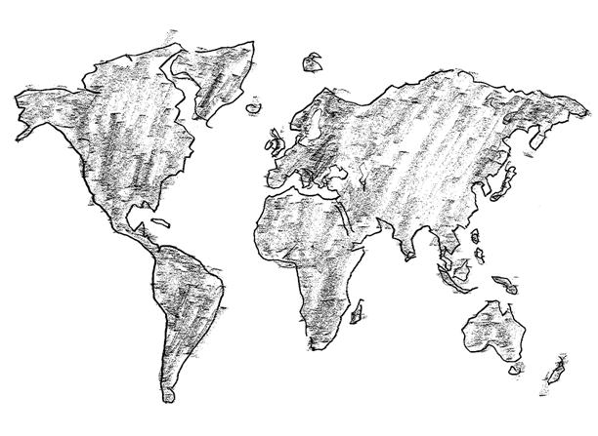
Asia & Life-Science
Increase
2000 to 2009
RoW +7.9%
NE Asia 5.5%
SE Asia 0.0%

Slide 7
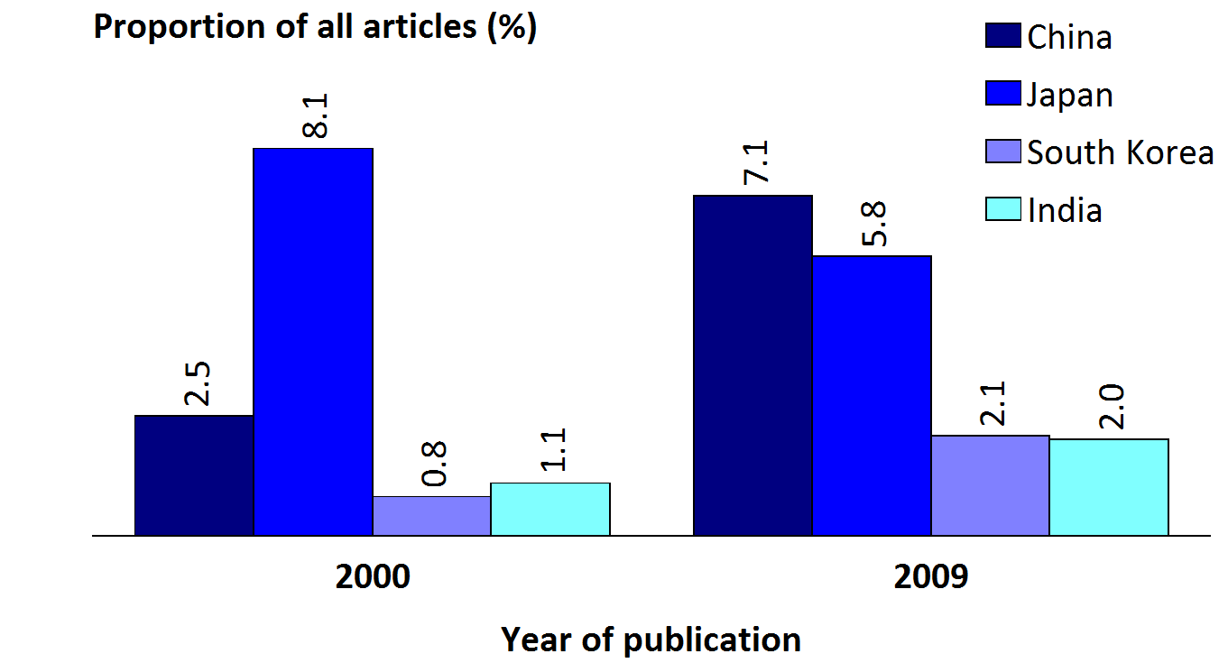
Asia & Life-Science

Slide 8
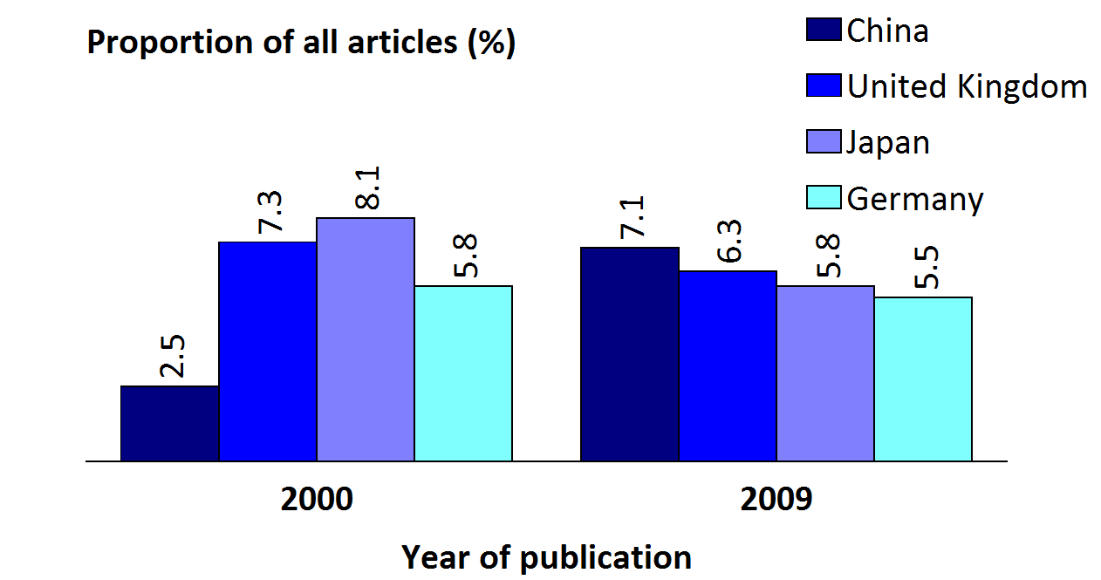
Asia & Life-Science
US: about 28.0%

Slide 9
Asia & Academia
23
12
8
1
Top 50 Universities - Times Higher Education 2010 World University Ranking.
5

Slide 11
Identifying Clinical Trials
Source
Data

Slide 12
Identifying Clinical Trials
Source
Data
Publications

Slide 13
Identifying Clinical Trials
Source
Data
Publications
28,000 trials initiated annually
<50% ever published
“17% of the Phase I studies were published in scientific journals compared to 43% of the Phase II–IV studies”
Recent French study on industry sponsored trials

Slide 14
Identifying Clinical Trials
Source
Data
Publications
GSK Open Trial Registry
Approved Drugs
Phase N Publ. N
Phase I 22 17% 3.7
Phase II/III 6 43% 2.6
Total 28 6.3 23%
“17% of the Phase I studies were published in scientific journals compared to 43% of the Phase II–IV studies”
Recent French study on industry sponsored trials

Slide 15
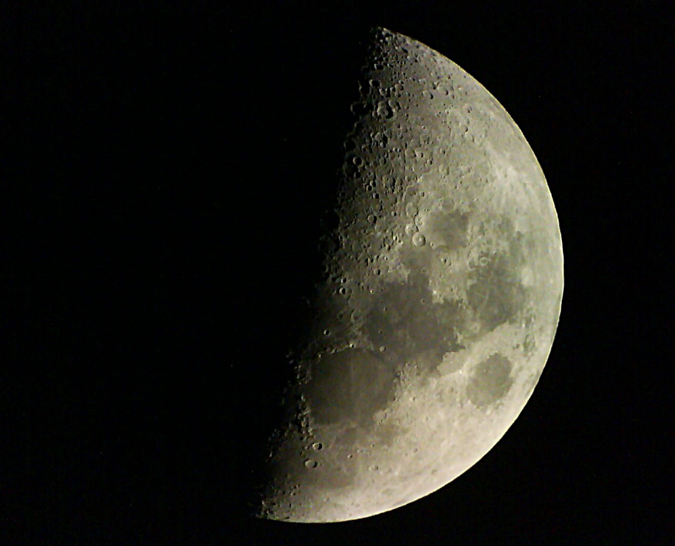
Identifying Clinical Trials
Source
Data
Publications
Declaration of Helsinki - 2008
“Authors have a duty to make publicly available the results of their research on human subjects.”

Slide 16
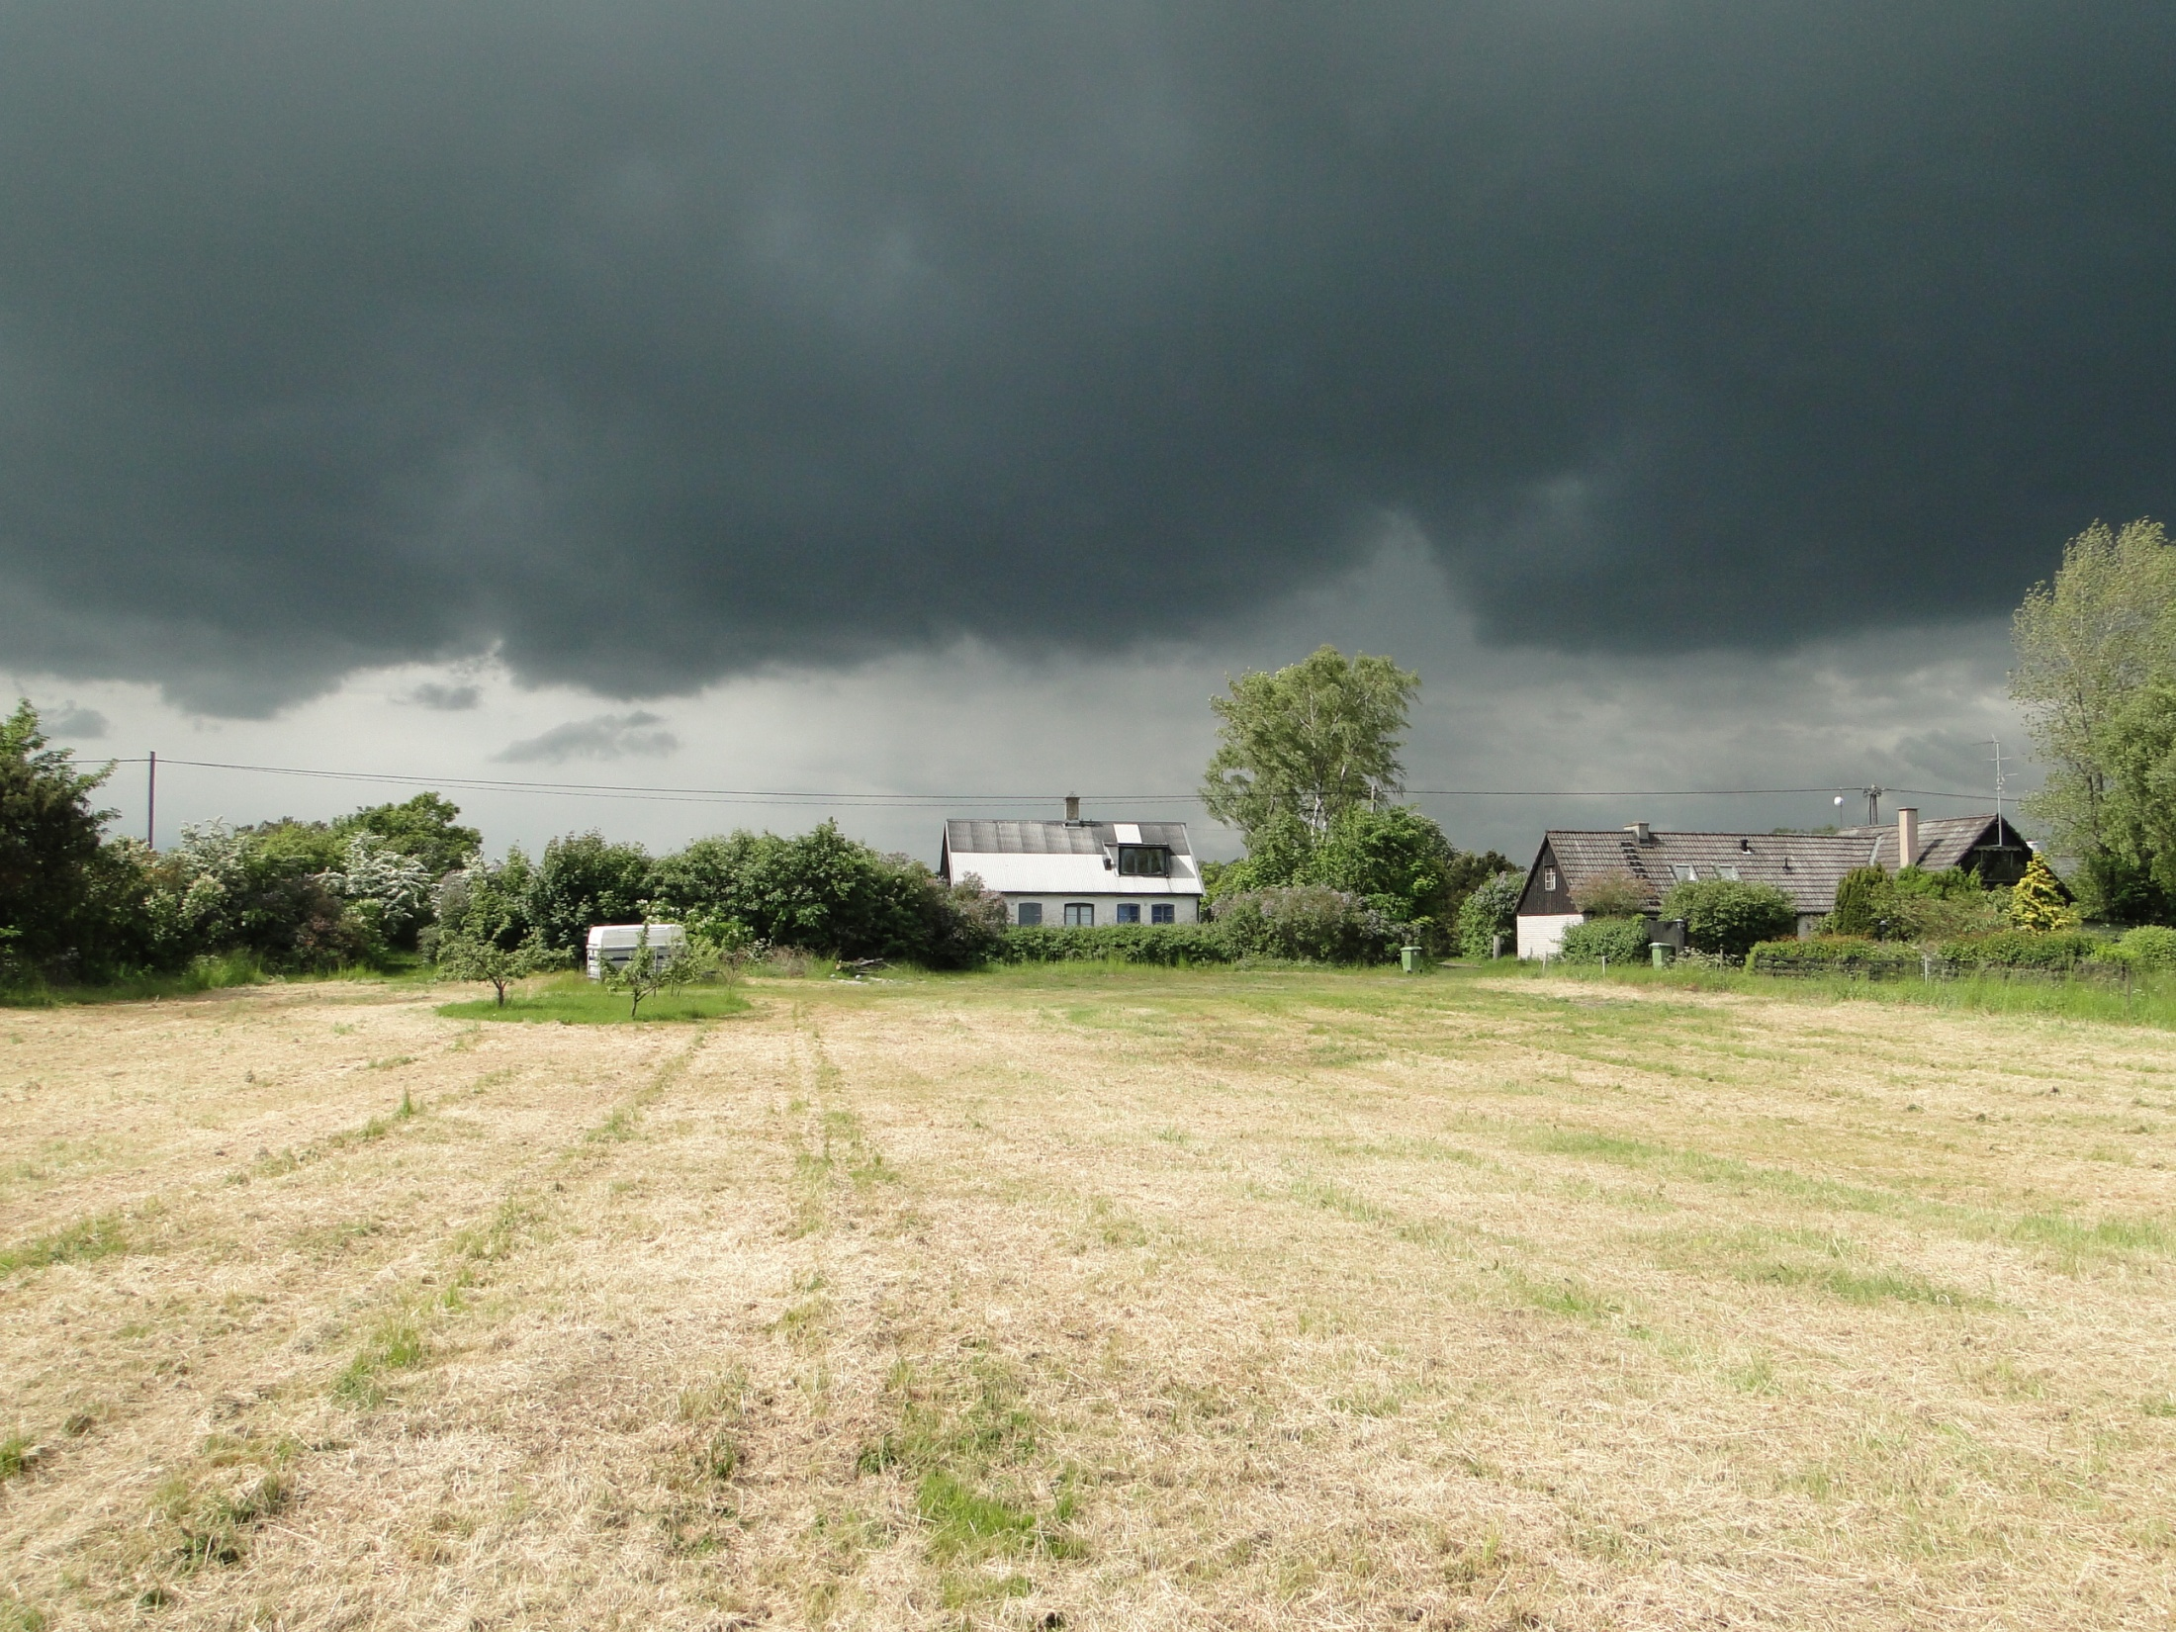

Slide 17
Identifying Clinical Trials
Source
Data
Trial Registry
WHO Trial Registry Platform
12 registries
US Trial Registry
Industry Trials: 90.9%
Non-industry Trials: 70.0%

Slide 18
Identifying Clinical Trials
Source
Data
US Trial Registry
Industry Sponsored Trials
Phase II/III trials
Global multi-regional trials

Slide 19
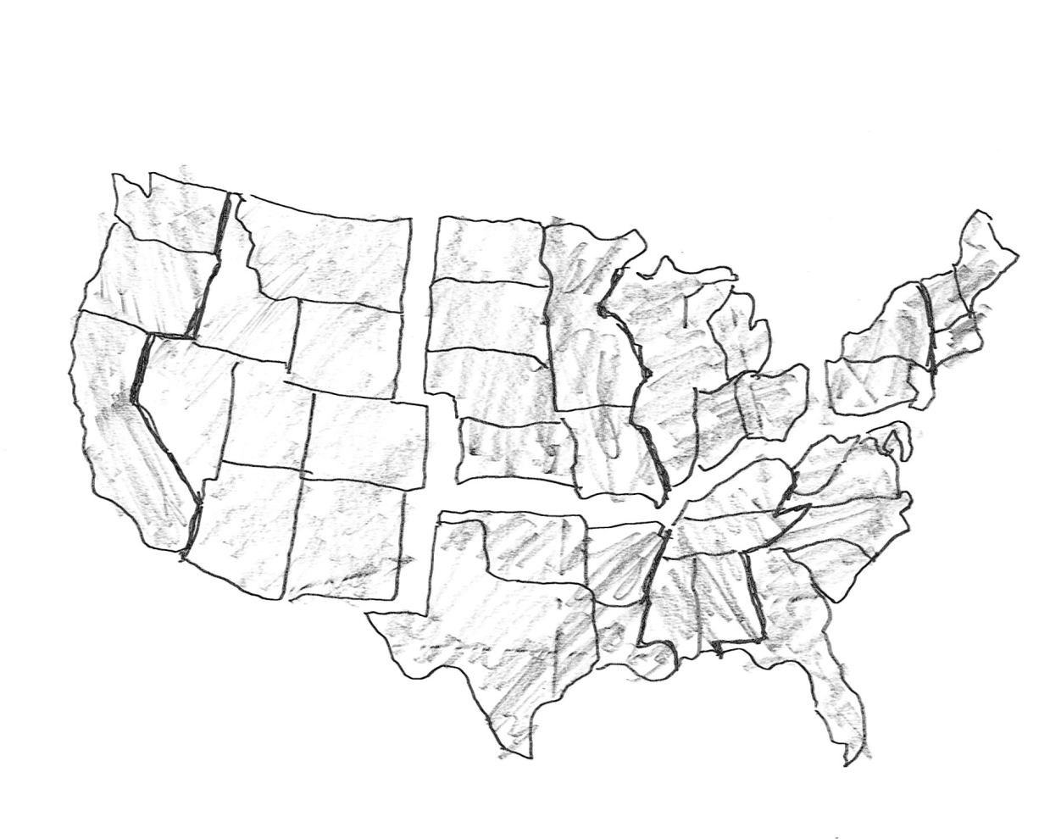
Identifying Clinical Trials
Source
Data
US Trial Registry
Non-Industry Sponsored Trials
Phase I-IV trials
Medical Procedures
US trials

Slide 20
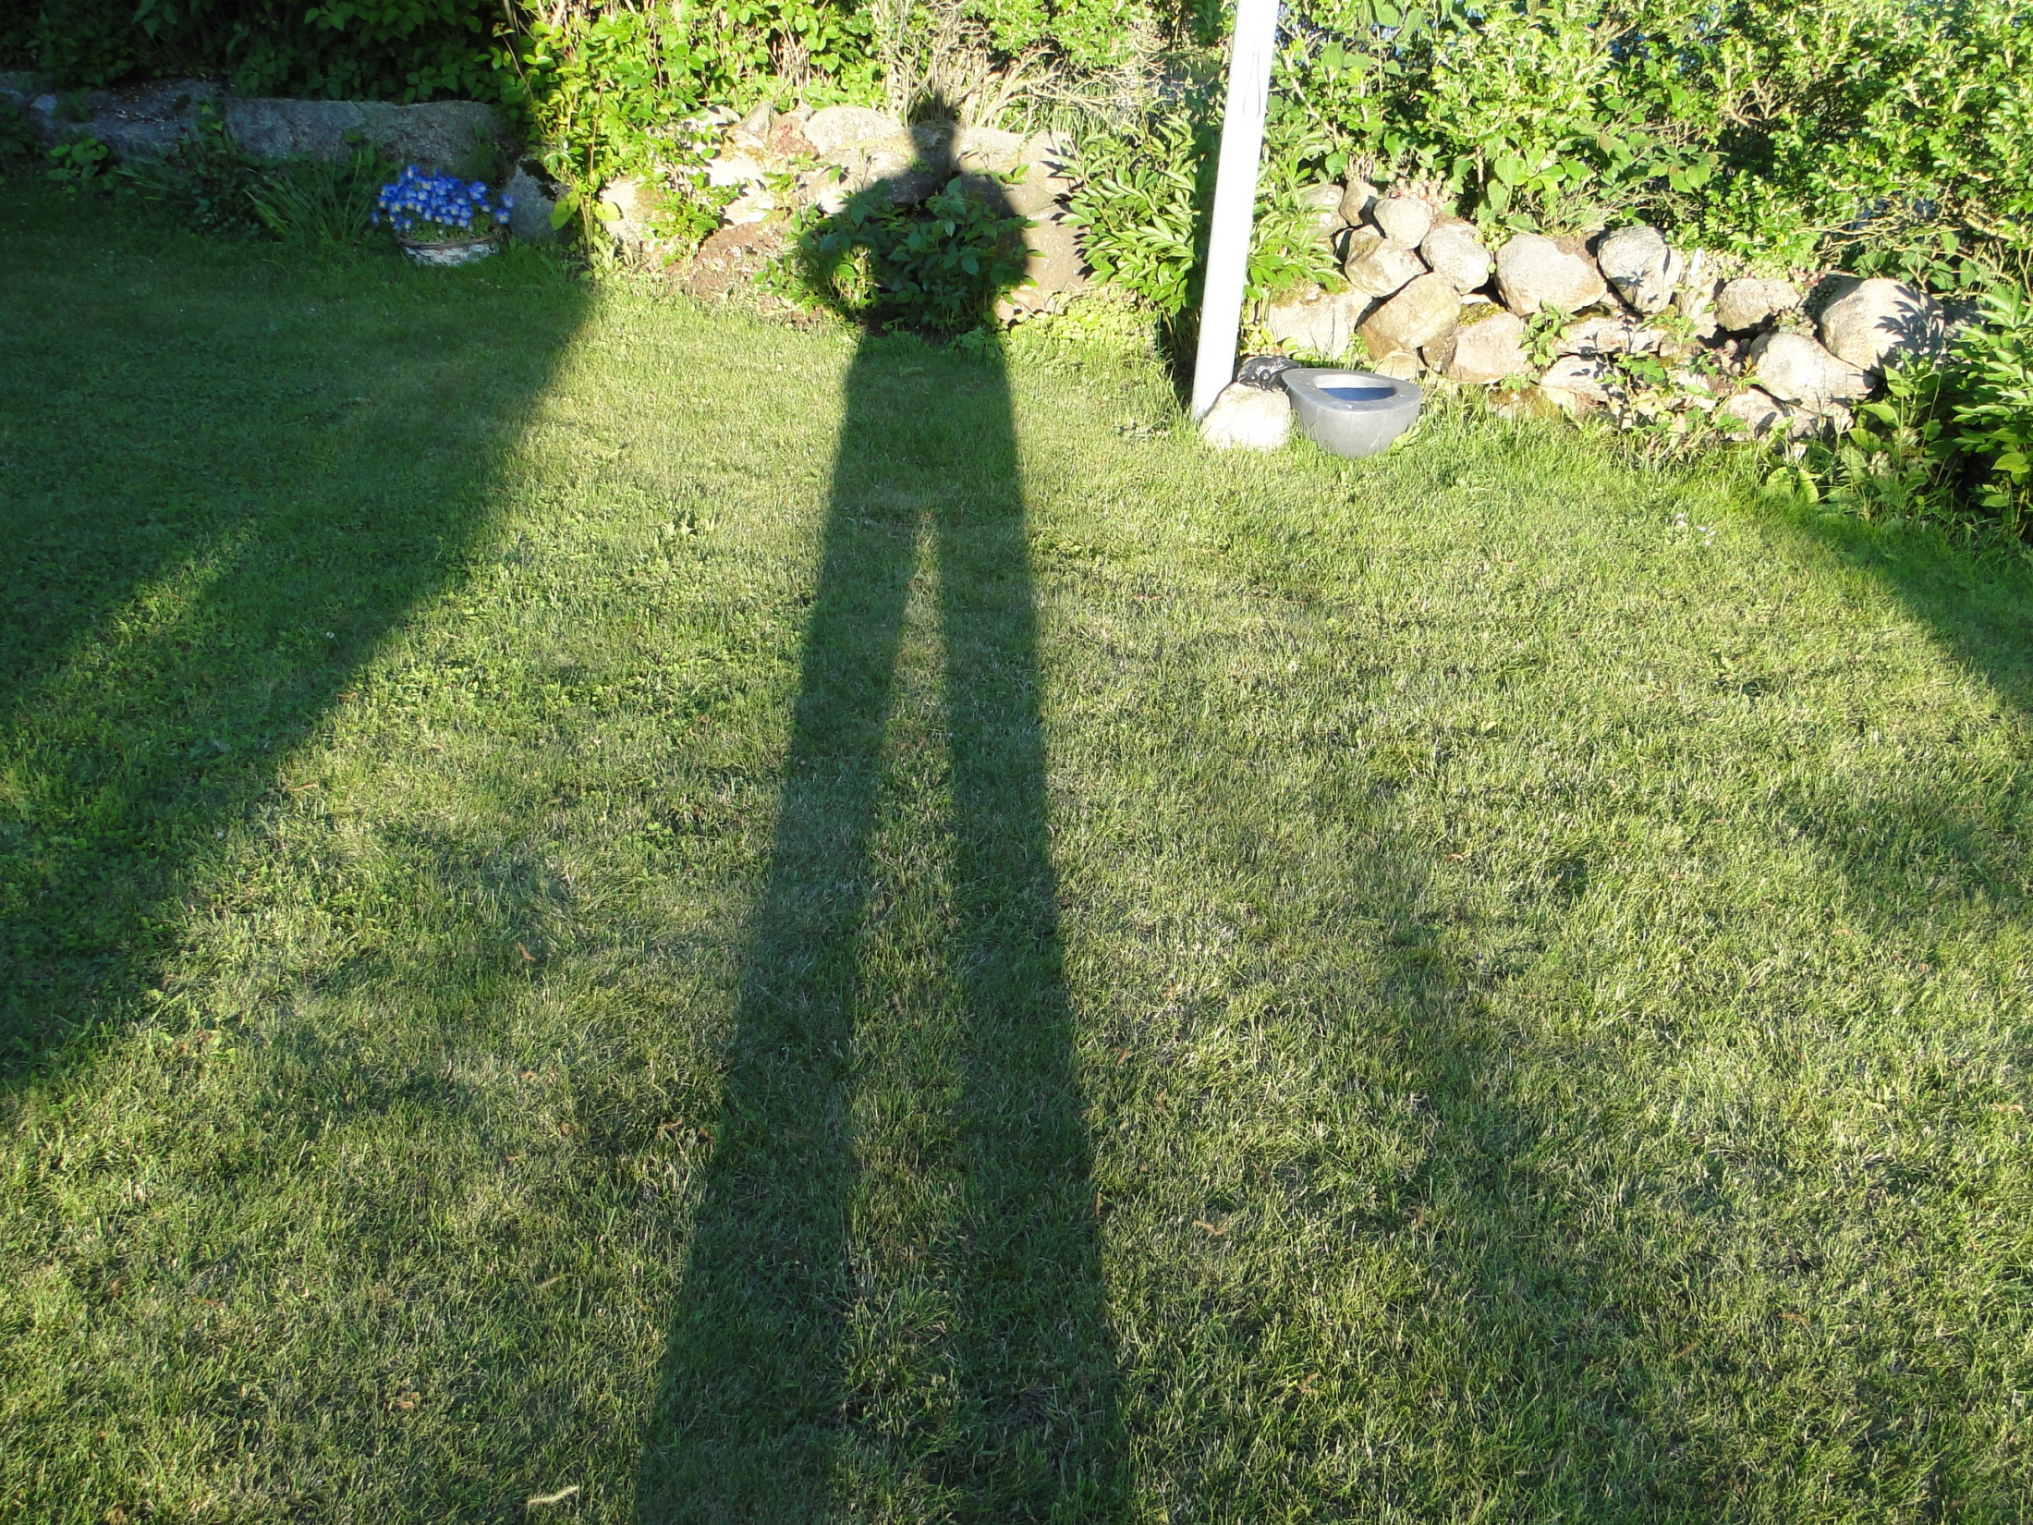

Slide 21
Asian Clinical Trial Trends
by
Sponsor - Trial Phase
Disease Area – Country
US Trial Registry

Slide 22
Industry sponsored phase II/III trials sites
45.3
%
24.3
%
30.4
%

Slide 23
Drift (%) of Phase II/III trial sites – 2.5 yrs
1.2
0.4
0.5
0.6
0.4
0.2

Slide 24
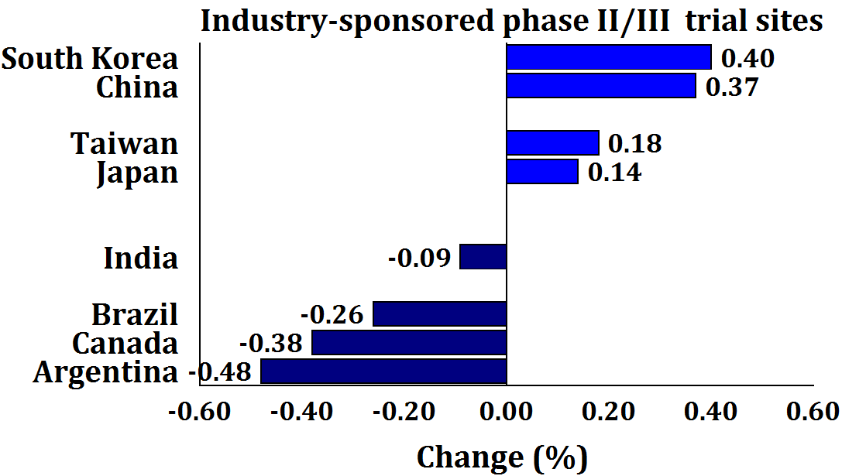
Drift (%) of Phase II/III trial sites – 2.5 yrs
1%=1,250 sites

Slide 25
Industry sponsored phase II/II trial sites
71.2%
Increase 1.2%
28.8%
Increase 0.0%

Slide 26
“It has been said that arguing against globalization is like arguing against the laws of gravity.” -– Kofi Annan (1938-)

Slide 27
US Trial Registry
2008.04 to 2011.03
4 years

Slide 28
Type of Sponsor - Phase II/III trials
Global
 | Phase II Trials |  | Phase III Trials |  | Phase II/III
 | Global |  | Global |  | Global
 | Trials | Sites | Trials | Sites | Trials | Sites
Funding | n | n | n | n | n | n
Industry | 2,410 | 40,917 | 2,104 | 93,733 | 4,514 | 134,650
Non-industry | 2,730 | 16,888 | 980 | 18,337 | 3,710 | 35,225
Total | 5,140 | 57,805 | 3,084 | 112,070 | 8,224 | 169,875

Slide 29
Type of Sponsor - Phase II/III trials
Global
Number of sites/trial
Industry 29.8 sites/trial [4,514 trials]
Non-industry 9.5 sites/trial [3,710 trials]

Slide 30
Type of Sponsor - Phase II/III trials
Global
 | Phase II Trials |  | Phase III Trials |  | Phase II/III
 | Global |  | Global |  | Global
 | Trials | Sites | Trials | Sites | Trials | Sites
Funding | n | n | n | n | n | n
Industry | 2,410 | 40,917 | 2,104 | 93,733 | 4,514 | 134,650
Non-industry | 2,730 | 16,888 | 980 | 18,337 | 3,710 | 35,225
Total | 5,140 | 57,805 | 3,084 | 112,070 | 8,224 | 169,875

Slide 31
Type of Sponsor - Phase II/III trials
Global
Number of phase II trials/phase III trial
Industry 1.15
Non-industry 2.78

Slide 32
Type of Sponsor - Phase II/III trials
Asia
 | Phase II |  | Phase III |  | Phase II/III
 | Asia |  | Asia |  | Asia
 | Trials | Sites | Trials | Sites | Trials | Sites
Funding | n | n | n | n | n | n
Industry | 410 | 3,212 | 710 | 10,188 | 1,120 | 13,400
Non-industry | 297 | 500 | 158 | 507 | 455 | 1,007
Total | 707 | 3,712 | 868 | 10,695 | 1,575 | 14,407

Slide 33
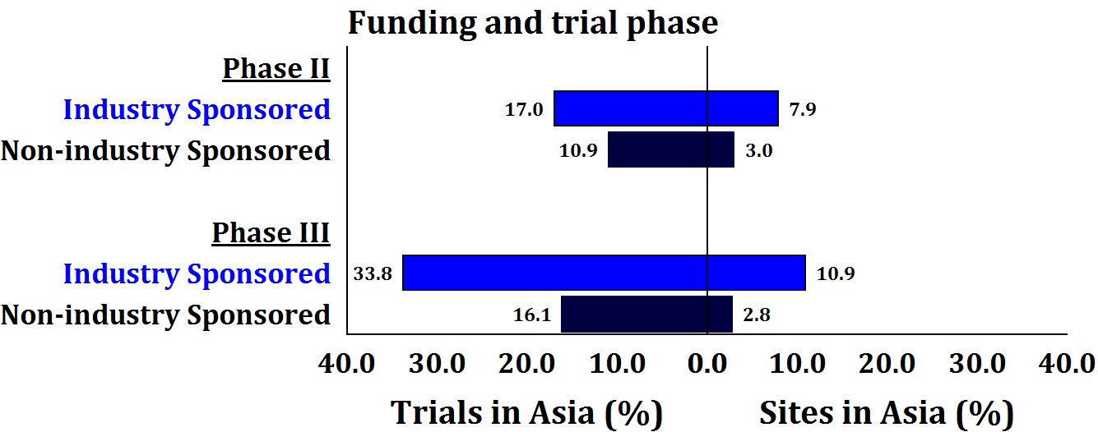
Type of Sponsor - Phase II/III trials
Asia

Slide 34
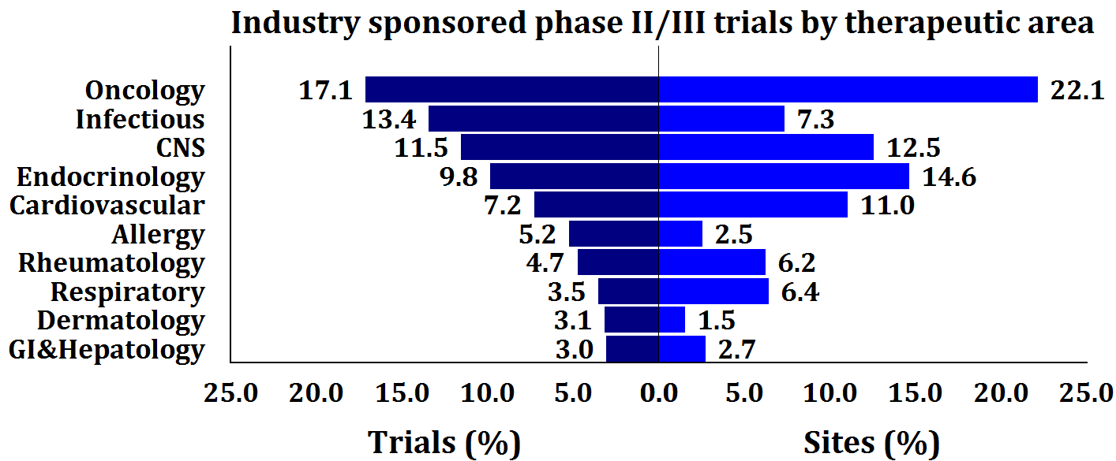
Industry Sponsor Phase II/III trials
Therapeutic Area - Global

Slide 35
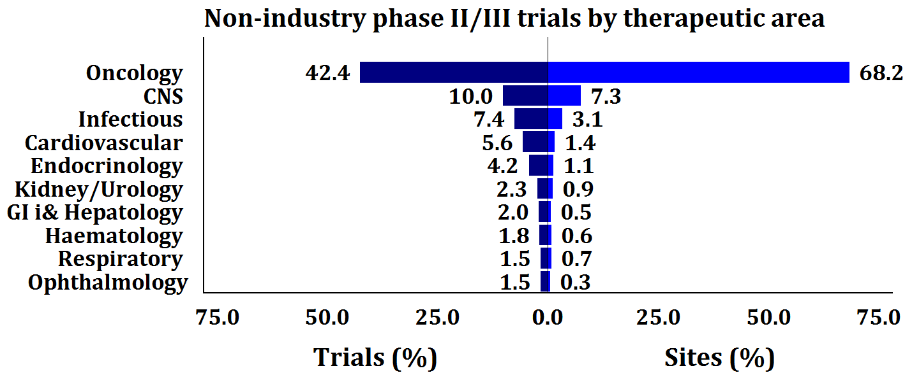
Non-industry Sponsor Phase II/III trials
Therapeutic Area - Global

Slide 36
All Phase II/III trials
Global
Oncology CVD
% %
Causes of death (#2,1) 23.2 25.4
Trials 28.5 6.5
Sites 31.7 9.0

Slide 37
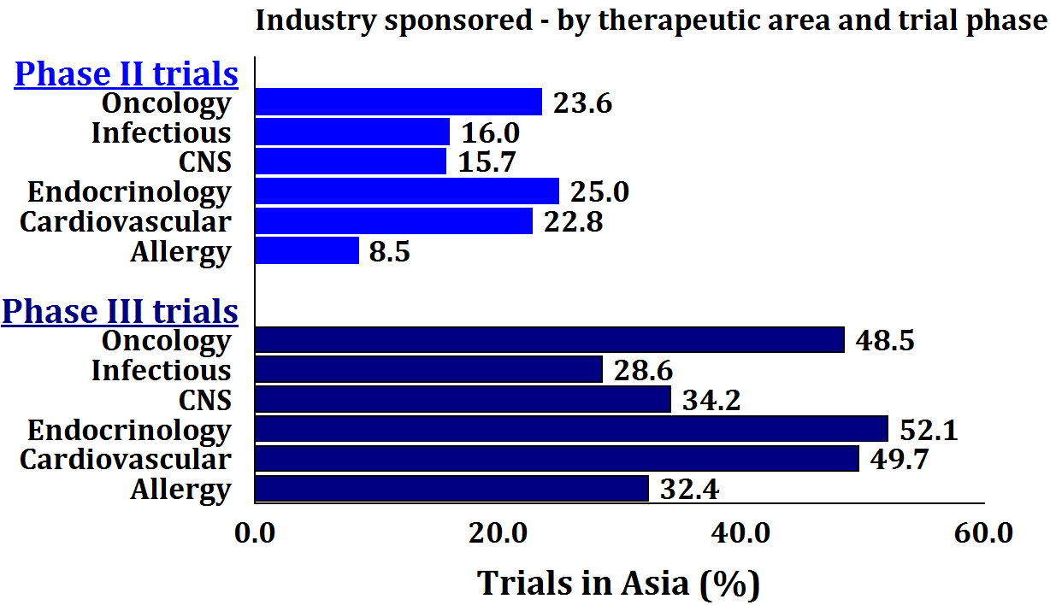
Most Active Therapeutic Areas

Slide 38
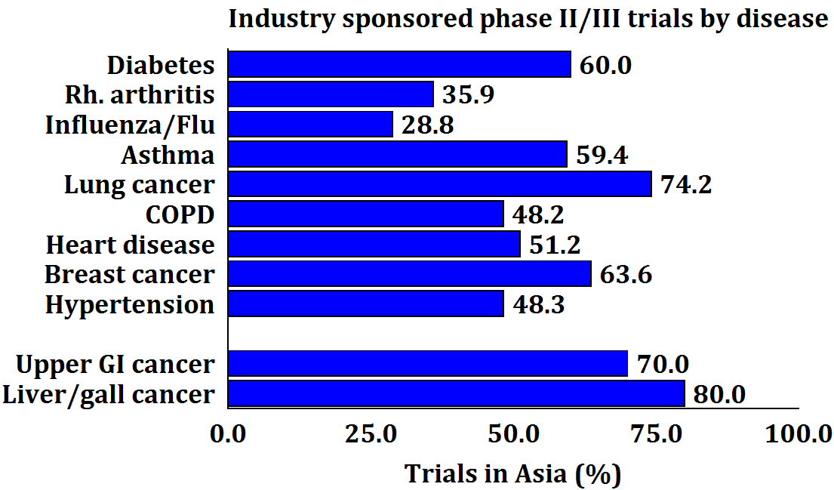
Most Active Diseases

Slide 39
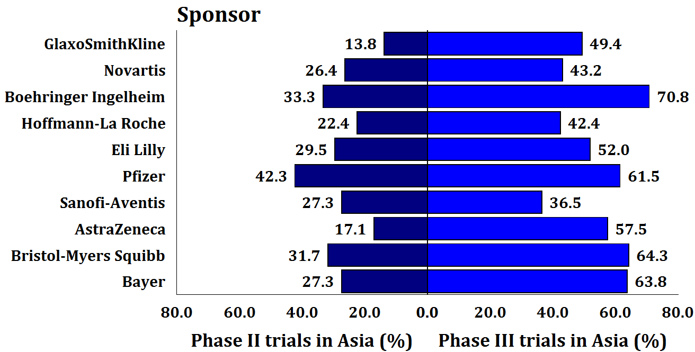
Most active sponsors globally

Slide 40
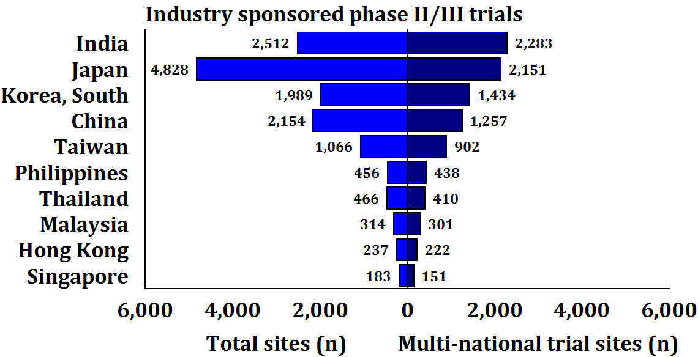
Most Active Asian Countries

Slide 41
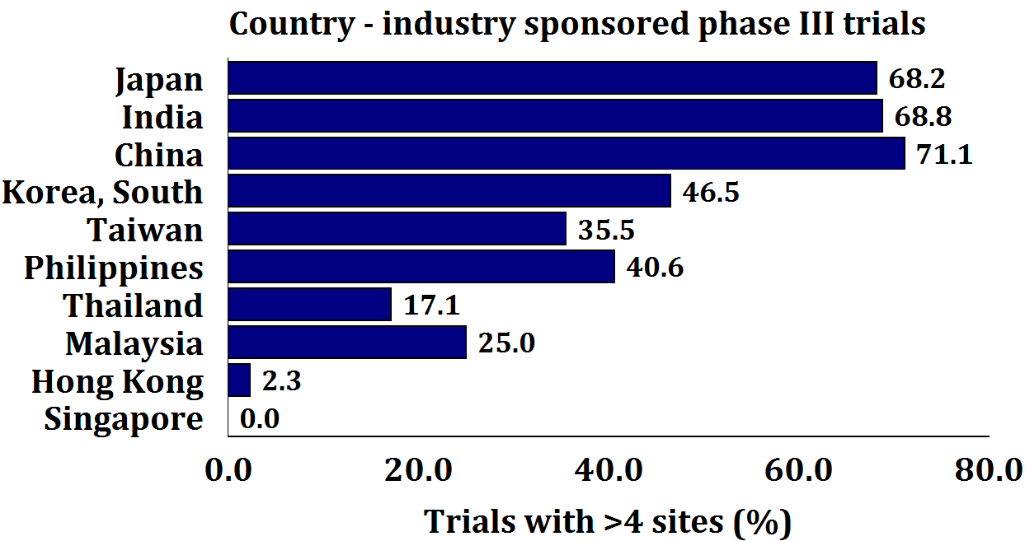
Sites / Protocol by Asian Countries

Slide 42
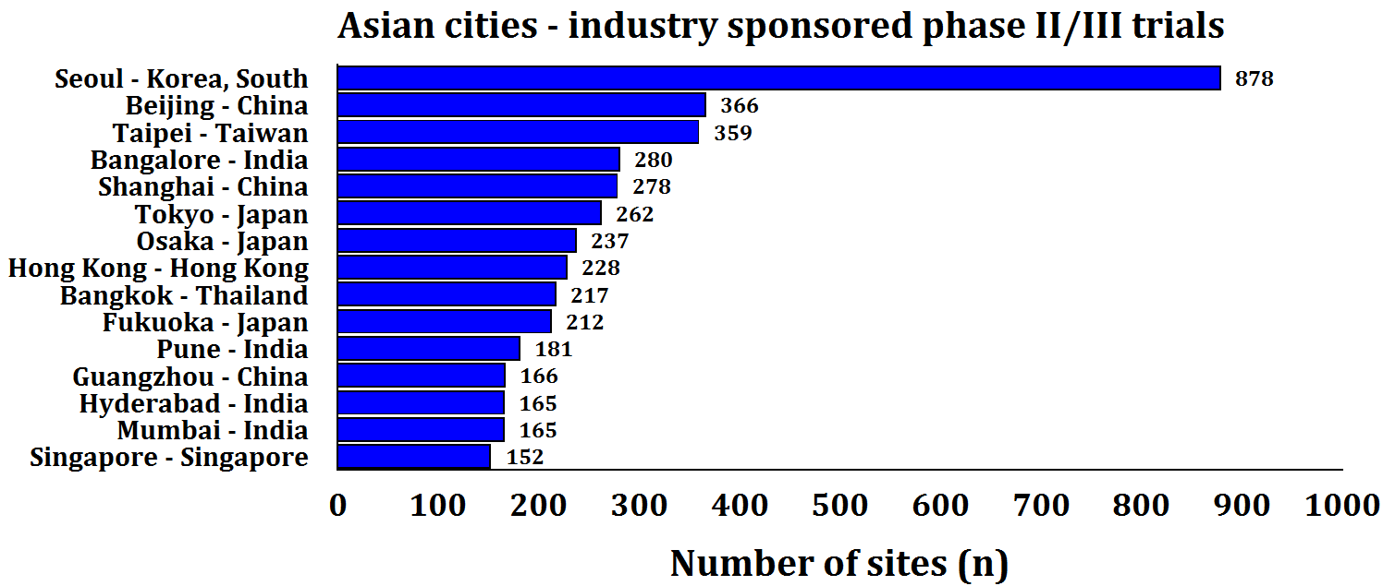
Most Active Asian Cities

Slide 43
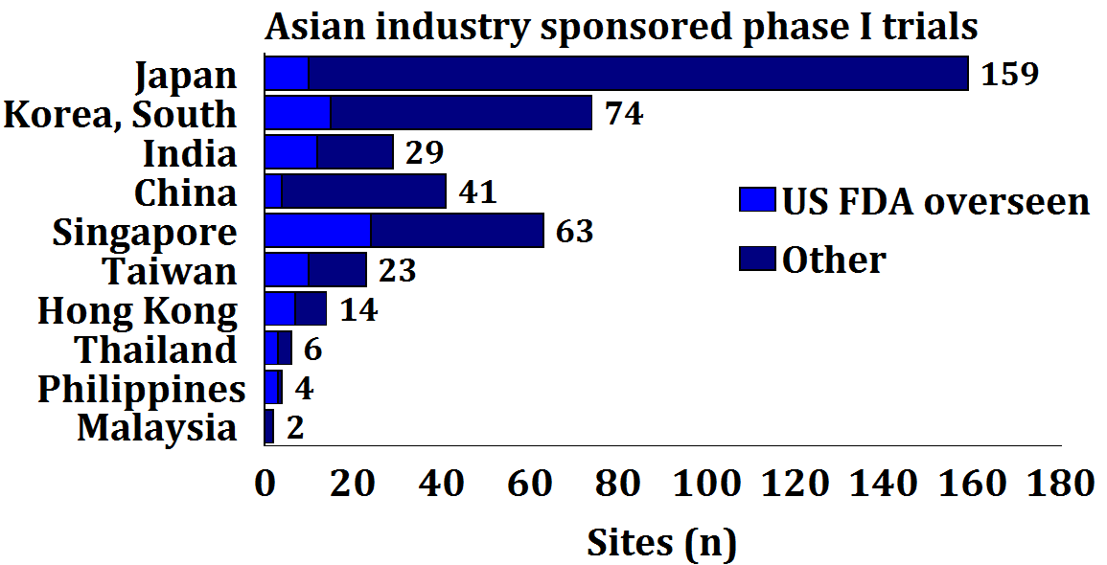
Asian Phase I Trials

Slide 45
Summary
Focus on North East Asia
Science
Academia
Clinical Trials

Slide 46
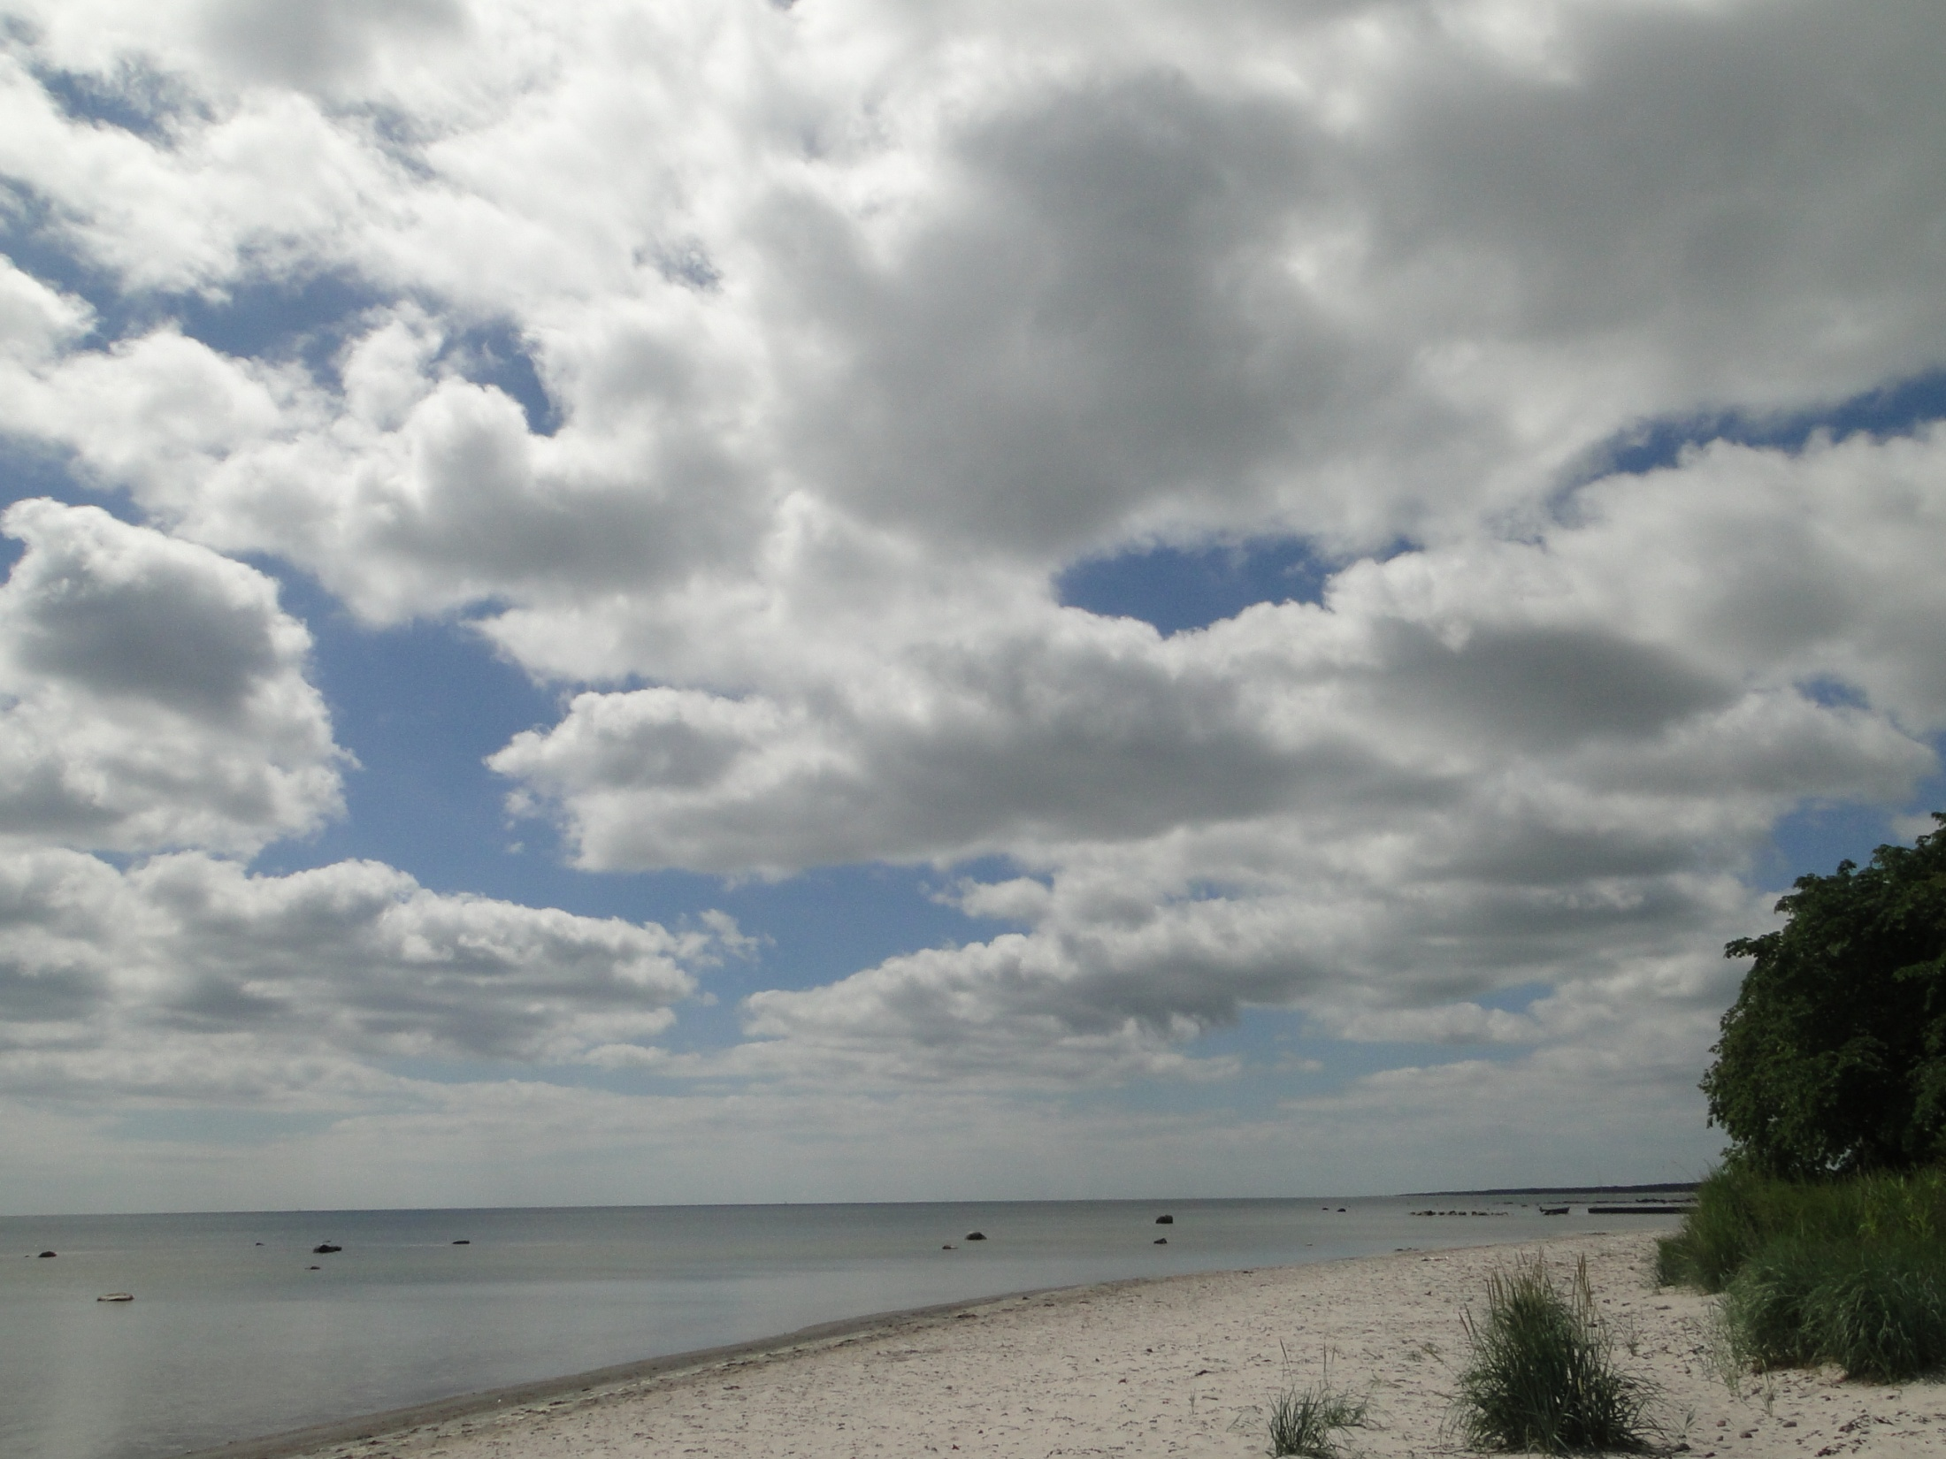

Slide 47
Summary
Diversity
Regulation
Infrastructure
Government
Population
Health Care
English
KO
JP
CN
TW
HK
IN
SG

Slide 48
Summary
Diversity
Regulation
KO
JP
CN
TW
HK
IN
SG

Slide 49
Summary
Diversity
Infrastructure
KO
JP
CN
TW
HK
IN
SG

Slide 50
Summary
Diversity
Government
KO
JP
CN
TW
HK
IN
SG

Slide 51
Summary
Diversity
Population
KO
JP
CN
TW
HK
IN
SG

Slide 52
Summary
Diversity
Health Care
KO
JP
CN
TW
HK
IN
SG

Slide 53
Summary
Diversity
English
KO
JP
CN
TW
HK
IN
SG

Slide 54
Summary
Winners?
KO
JP
CN
TW
HK
IN
SG

Slide 55
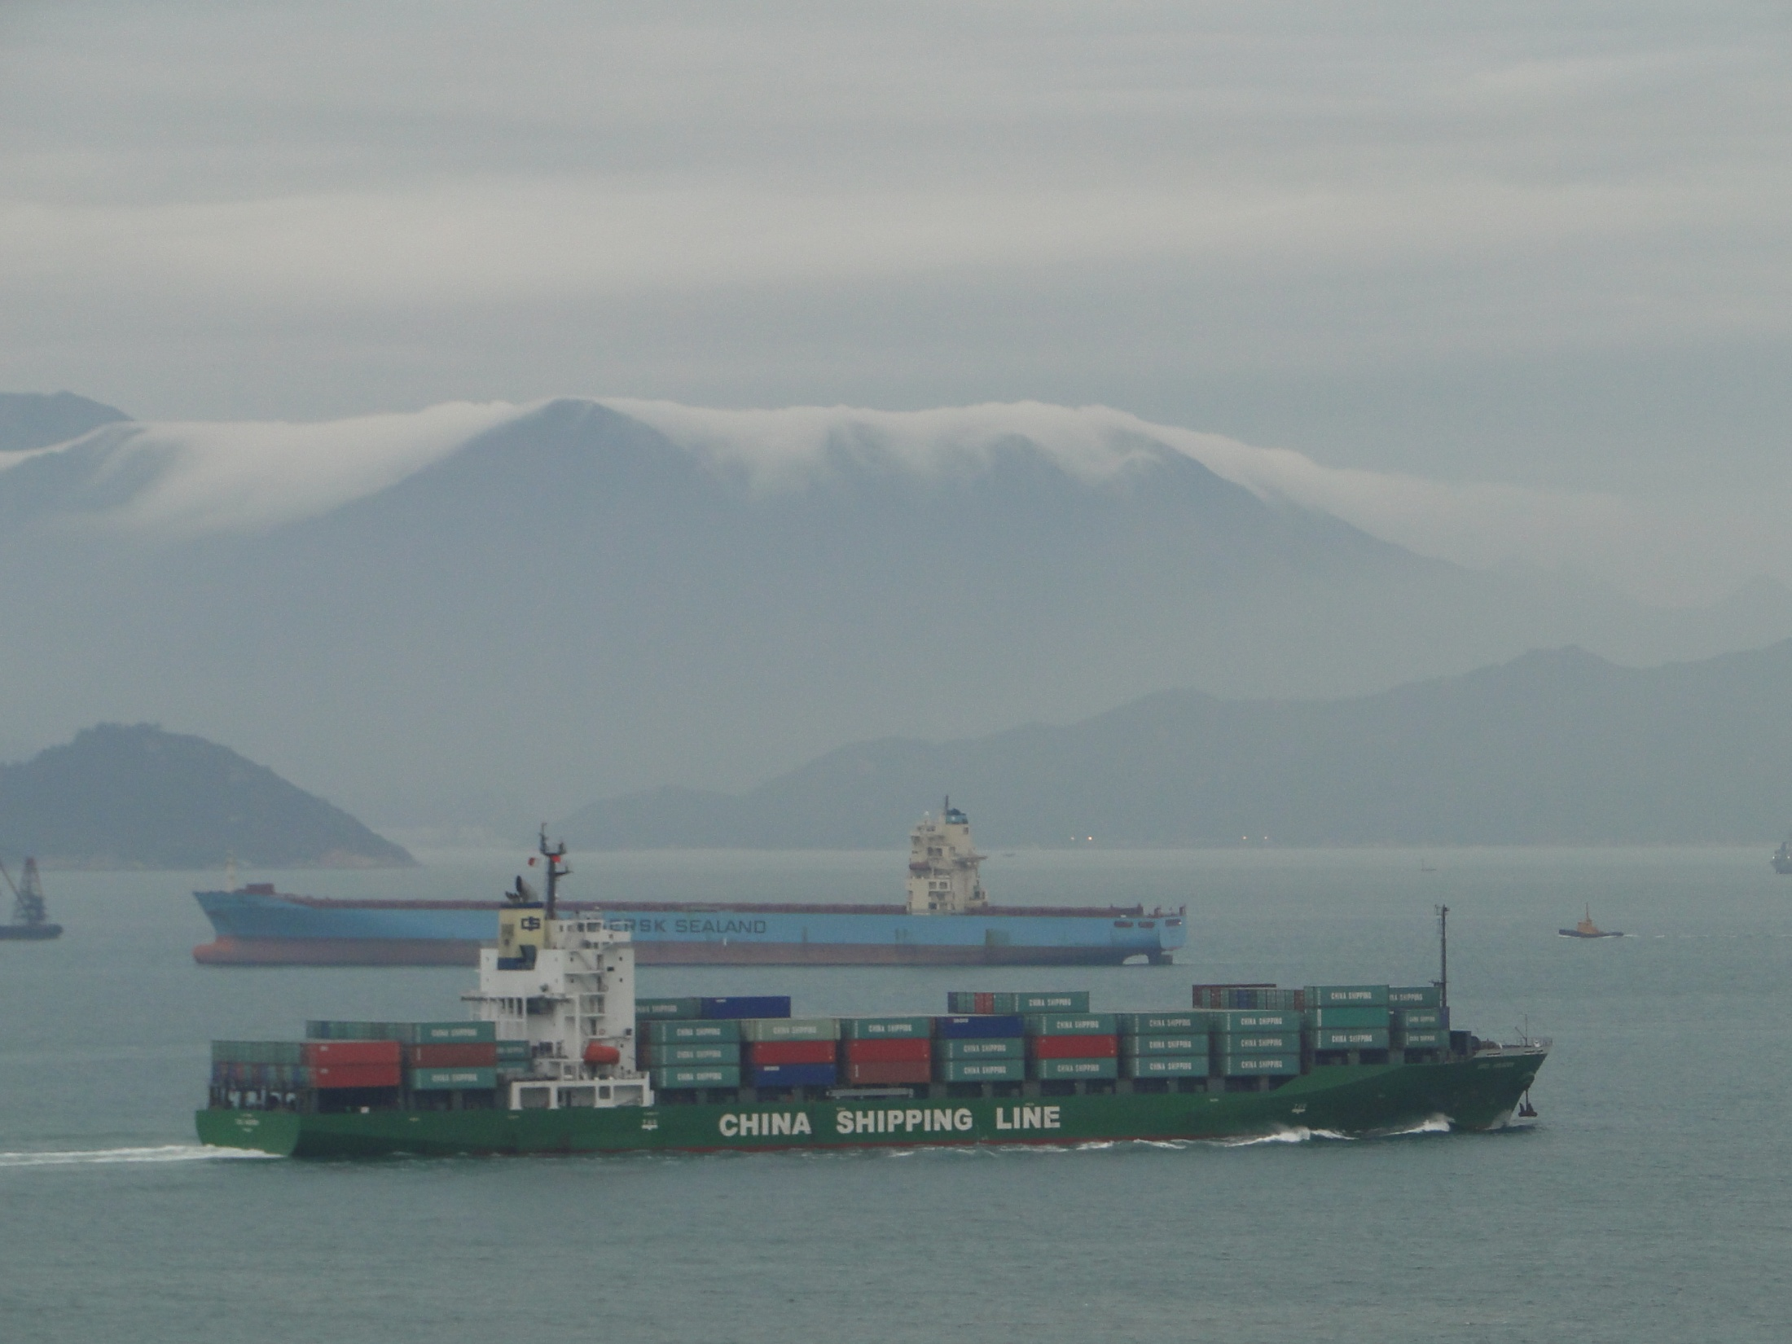

Slide 56
Clinical Research Infrastructure Development
Clinical Trial Magnifier
2011 Conference
Taipei November 18-20

Slide 57
Clinical Research Infrastructure Development
Globalization of Clinical Research
Regulatory Infrastructure
Study Site Selection Criteria
Study Site Infrastructure Development
Implementation of Infrastructure Development
Early Clinical Testing In Asia
Bio-entrepreneurship and Translational Research

Slide 58
Clinical Research Infrastructure Development
SUMMERSKILL, William, AB, MBBS, MSc, The Lancet, London, UK.
CHERN, Herng-Der, MD, PhD,
Center for Drug Evaluation, Taipei, Taiwan.
SPEERS, Marjorie, PhD
Association for the Accreditation of Human Research Protection Programs, Inc, Washington, USA.

Slide 59
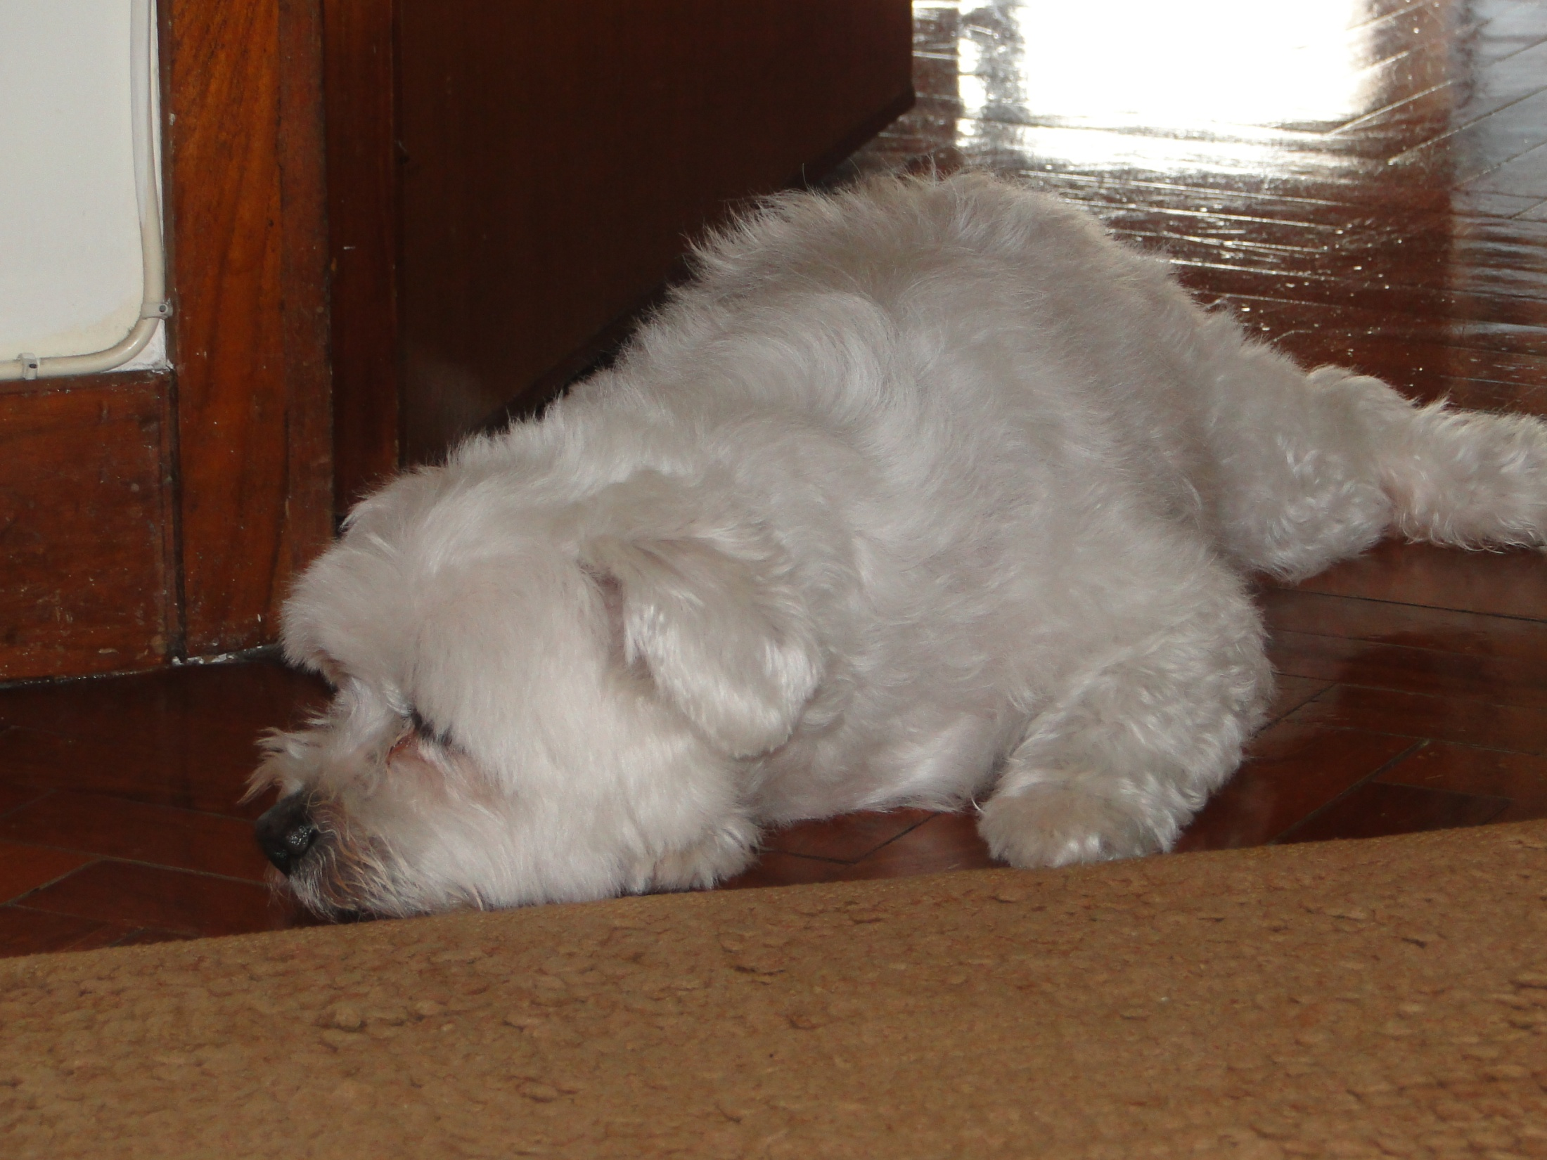
Finished?

